Slide 1
Activity Time.

Slide 2
Singular and Plural Nouns
Activity 1
Plural nouns with -es
Activity 1.
Individual work.
Have students assemble a flower to represent the -es and the endings of nouns that take -es

Slide 3
ch
sh
o
x
es
ss
z
s
zz

Slide 4
Activity 2: Pair Work Build a sentence with -es words using word cards.
Using Whiteboards and Markers

Slide 5
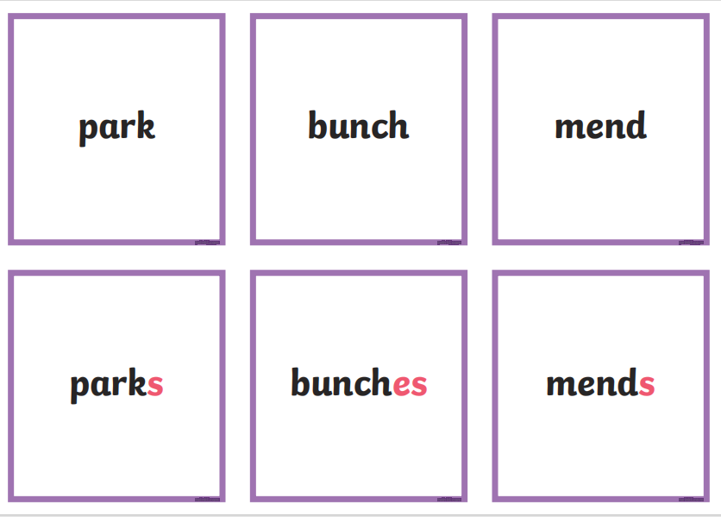

Slide 6
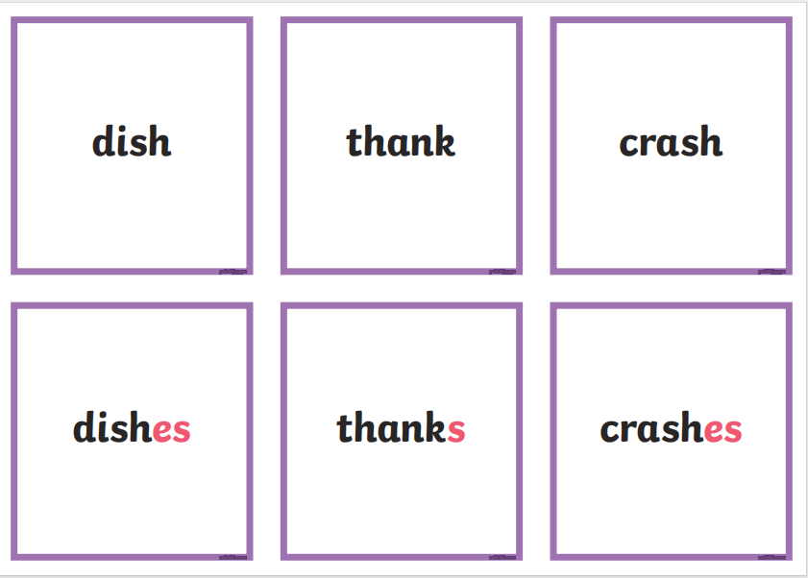

Slide 8
