Slide 1
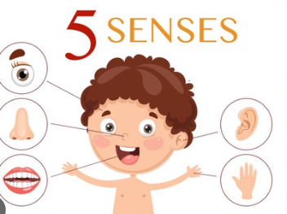

Slide 4
Monday

Slide 6
Activity Students to try and guess what is inside the box using their sense of smell.

Slide 7
Tuesday

Slide 9
Activity Students to try and guess what is inside the bag using their sense of touch.

Slide 10
Wednesday

Slide 11
Students to compare how they look with a friend. Students can then group eachother depending on hair colour, eye colour and height.

Slide 12
Thursday

Slide 13
Activity Students to try and guess what is inside
the bag using their sense of hearing.

