Slide 1
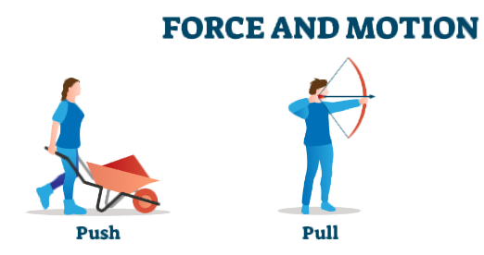

Slide 2
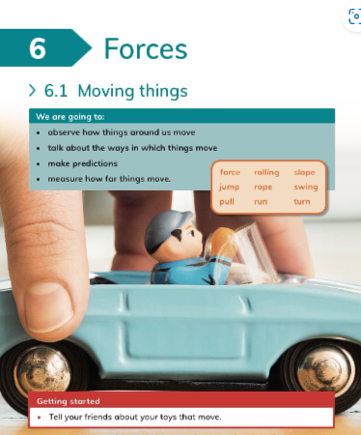

Slide 6
Activity
Give students playdough to roll and ask if it has changed size and shape. Students to apply force and explain how it has changed shape and size.
(Take pictures).

Slide 7
Monday

Slide 9
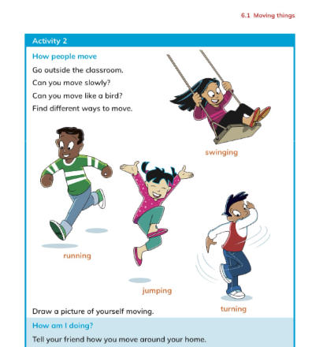
Activity
Students to go to the garden and play tug of war (Take pictures).

Slide 10
Tuesday

Slide 11
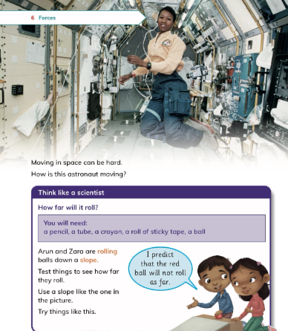
Activity
Students to roll a
marble ball down a slope.
First time by applying no force,
second time apply a hard force.
Explain to students the harder
the force the faster the ball will
roll down the slope.

Slide 12
Wednesday

Slide 13
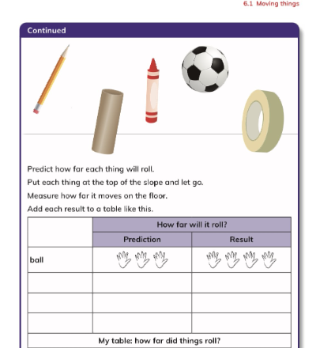
Activity
In groups, students to roll
different objects down the
slope and record their results.

Slide 14
Lab

