Slide 1
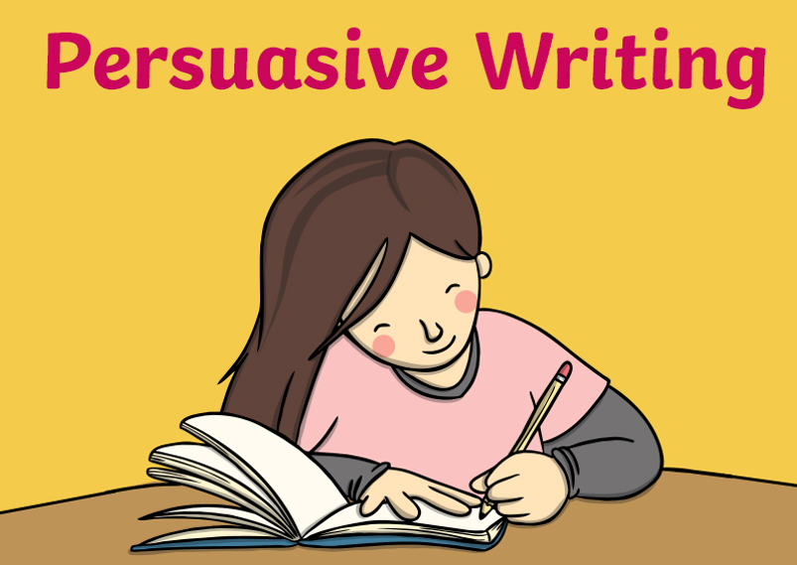

Slide 2
Dylan’s riddle of the day
When can you add two to eleven and get one as the answer?

Slide 3
Objective: To know the features of persuasive writing
Features of persuasive writing

Slide 4
This video is more about a persuasive review – Bitesize
An eye catching and snappy title
Introduction – what’s the article going to be about?
Body of the text – Mix fact (can be used as evidence) and opinion to persuade
Can address counter argument
Final Paragraph – Personal opinion. Emotive and positive language – best, popular and inspired. First person and present tense.
Conclusion - repeating point of view. End with a catchy phrase/snappy sentence. Rhetorical question.
https://www.bbc.co.uk/teach/class-clips-video/english-ks1-ks2-how-to-write-a-persuasive-text/zkcfbdm

Slide 5
Objective: To know the features of persuasive writing
Group 1
Features of persuasive writing

Slide 7
Features of persuasive writing
repetition (repeated words for emphasis) Often in threes
alliterative words (repeated first sound)
present tense (in the now, to sound urgent)
emotional language (does it make you feel something?)
a strong argument/POV (reasons for opinion)
address counter arguments (acknowledge but suggest incorrect for some, perhaps new, reason)
facts and statistics
rhetorical questions (A question to get the audience thinking)
colourful and eye-catching fonts /capitalised words.
humour (such as daring to disagree!)

Slide 8
alliteration
emotive language
hyperbole
repetition
present tense
arguments for
Features of persuasive writing
rhetorical questions
addressing counter
eye-catching and colourful
humour – dare to disagree
facts and statistics

Slide 9
Dylan’s riddle of the day
What is it that you will break when you name it?

Slide 10
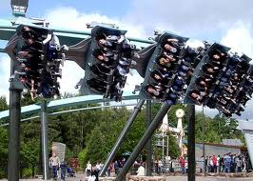
Look at the image below
Objective:
Note down five adjectives and three verbs that could be used when describing this picture.
Verb –
a doing or
action word
Adjective –
describing word
Notes:
TEACHER NOTES: This lesson includes plenaries throughout in order to fulfil Ofsted requirements. If you don’t want to use them, please do not delete them from this file, but save your own copy. Sorry to have a pre-emptive moan.

Slide 11
To persuade people to come to our theme park we might use
A FOREST. Have you heard of this before?
Language feature | Example | Why has the author done this?
Alliteration
Facts
Opinions
Rhetorical question
Emotive language
Statistics and speech
Triple/ threes

Slide 12
Persuasive language feature | Explanation
Alliteration | Words close together that each have the same sound at the start of the word. Eg. Fabulous flumes.
Facts | Things that have been proven and correct. Eg. A recent survey conducted showed that teenagers spend most of their weekends at theme parks.
Opinions | The writer’s opinion. Eg. This is the best park you will ever visit!
Rhetorical question | A question that doesn’t require an answer from the reader
Emotive language | Words that play on the readers’ emotions. Eg. Would you want your child to miss out on a fun day?
Statistics/ Speech | Statistics: Using numbers to prove a point. Eg. 86% of people who came to the theme park said they would return again. Speech: Using other opinions to persuade.
Triple/Three | Triple: Repeating a word or phrase three times for effect. Three: Listing three examples for emphasis. Eg. We have fantastic food, amazing rides and cool animals.

Slide 13
Group 1
Objective: To understand features of persuasive writing
Leaflet feature | Match the examples to the features
Alliteration (repetition of start sound) | We have the best rides, the best food, the best service.
Facts (something which is proven to be true) | Come and enjoy the world’s scariest ride. You will jump out of your seats!
Opinion (what someone thinks is true) | “We had an amazing time. The kids loved every second. I would definitely come back”
Rhetorical Question | This theme park has been voted number 1 in the country in a recent poll.
Emotive language/hyperbole (exaggeration !) | Do you dare ride?
Statistics or speech “ “ (what someone has said) | The Amazing Avalanche Accelerator
Triple/threes (repetition 3 times) | This theme park is the best theme park you will ever go to.

Slide 14
Group 2
Objective: To spot features of persuasive writing
Language feature | Example
Alliteration
Facts
Opinions
Rhetorical question
Emotive language
Statistics and speech
Triple/ threes

Slide 15
Group 3
Objective: To spot features of persuasive writing
Language feature | Example | Why has the author done this? PEE
Alliteration
Facts
Opinions
Rhetorical question
Emotive language
Statistics and speech
Triple/ threes

Slide 16
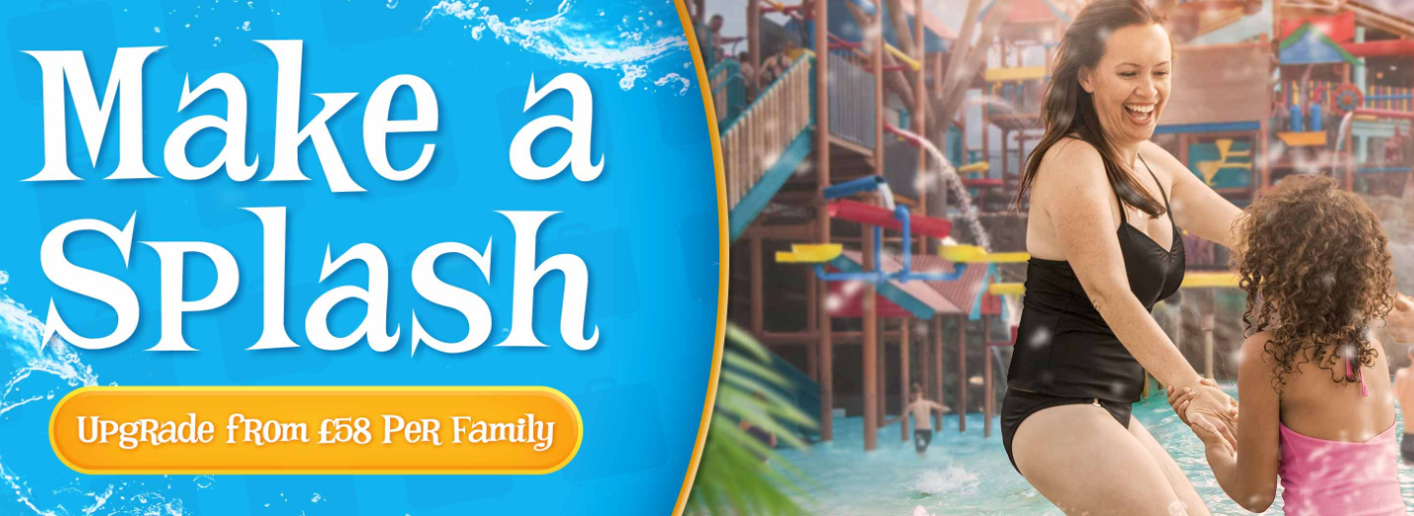

Slide 17
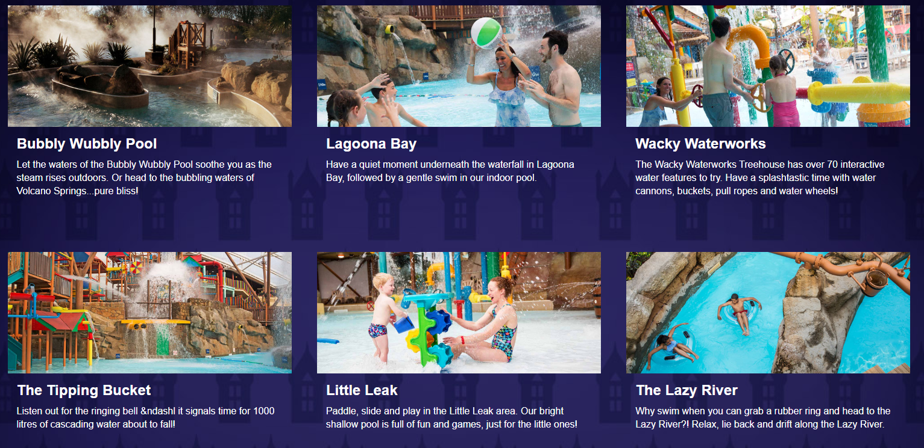

Slide 18
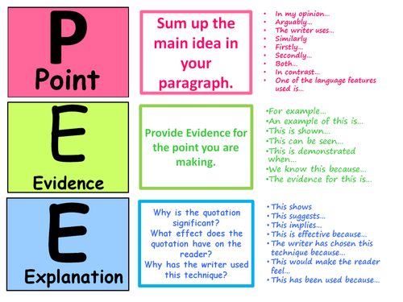
Point:
The writer has used a rhetorical question
Evidence:
He says “Wouldn’t you agree that to miss
out on this experience would be like
missing out on life’s greatest pleasures?”
Explanation:
By using a rhetorical question, the writer is trying to tempt the reader to go to the theme park.

Slide 19
Dylan’s riddle of the day
What is in the middle of March and April but not at the start of either month?

Slide 20
Quick Warm- Up! Connotations of….
The colour red
A dove
The colour black
A halo
Bright colours
The connotations of… are…

Slide 21
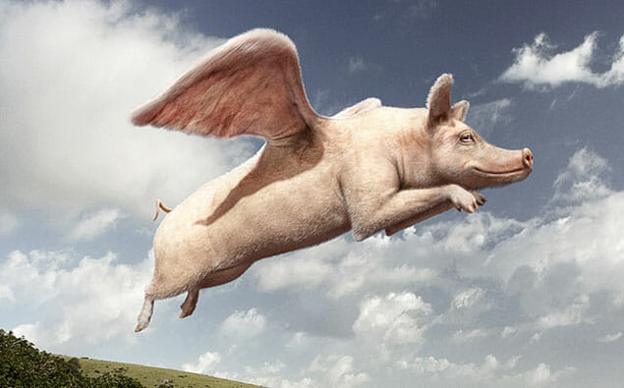
All Pigs Fly
When analysing a text, you must identify 3 things:
- Audience – who it is aimed at
- Purpose – what it is trying to do
- Form – what it is
A
P
F

Slide 22
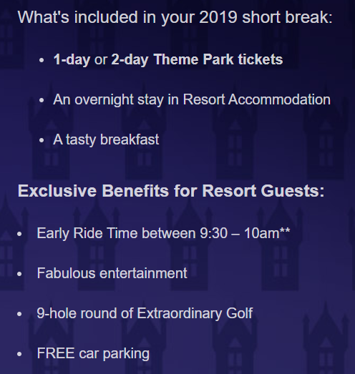
1

Slide 23
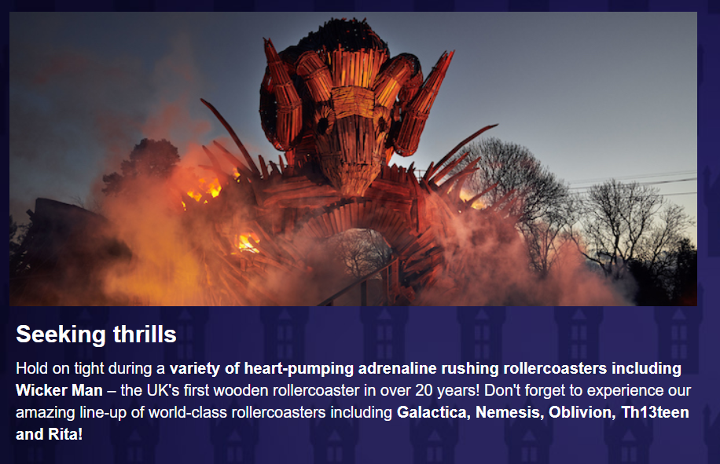
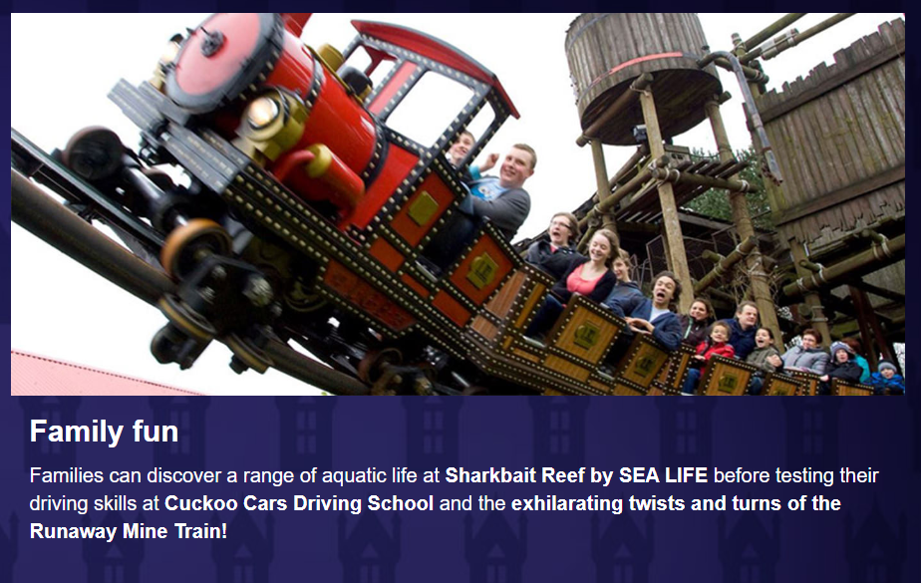
2
3

Slide 24
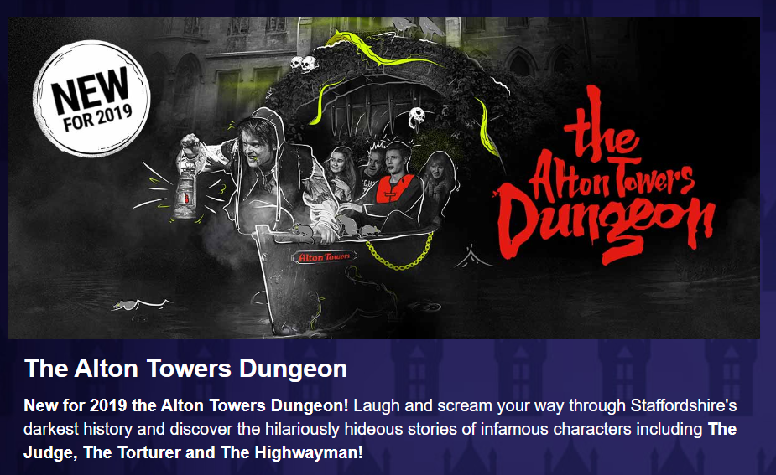
4
5

Slide 25
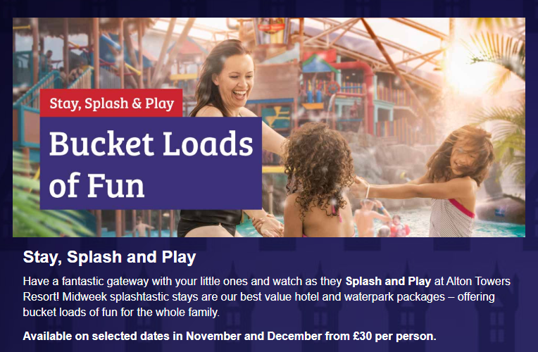
6

Slide 26
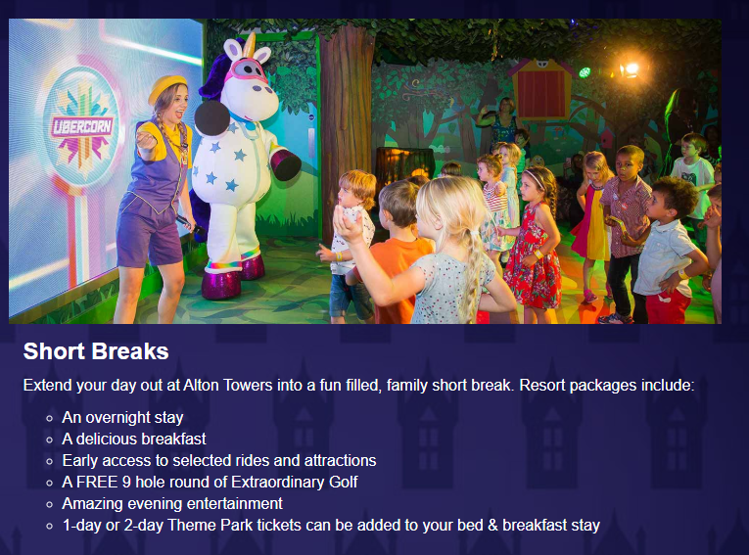
7

Slide 27
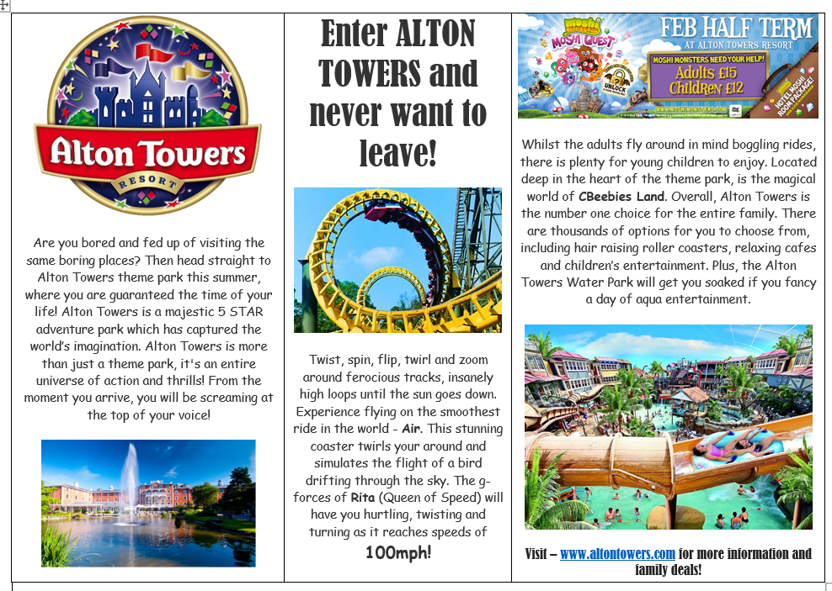
https://youtu.be/QCAKE3RHZi0
The power of the towers
https://www.youtube.com/watch?v=EGxdH_6JbbE
Alton towers 2019
8 – Don’t forget to PEE

