Slide 2
Find the word using the letters given.
Reveal Answer
v
t
e
a
m
f
b
i
o
d
n
s
v
a
n
v
a
n

Slide 3
Find the word using the letters given.
Reveal Answer
v
t
e
a
m
o
p
i
c
h
n
s
h
a
t
h
a
t

Slide 4
Find the word using the letters given.
Reveal Answer
c
s
a
b
m
g
n
i
o
r
u
d
b
a
g
b
a
g

Slide 5
Find the word using the letters given.
Reveal Answer
s
h
i
a
m
g
n
e
o
p
u
t
p
p
a
a
n
n

Slide 6
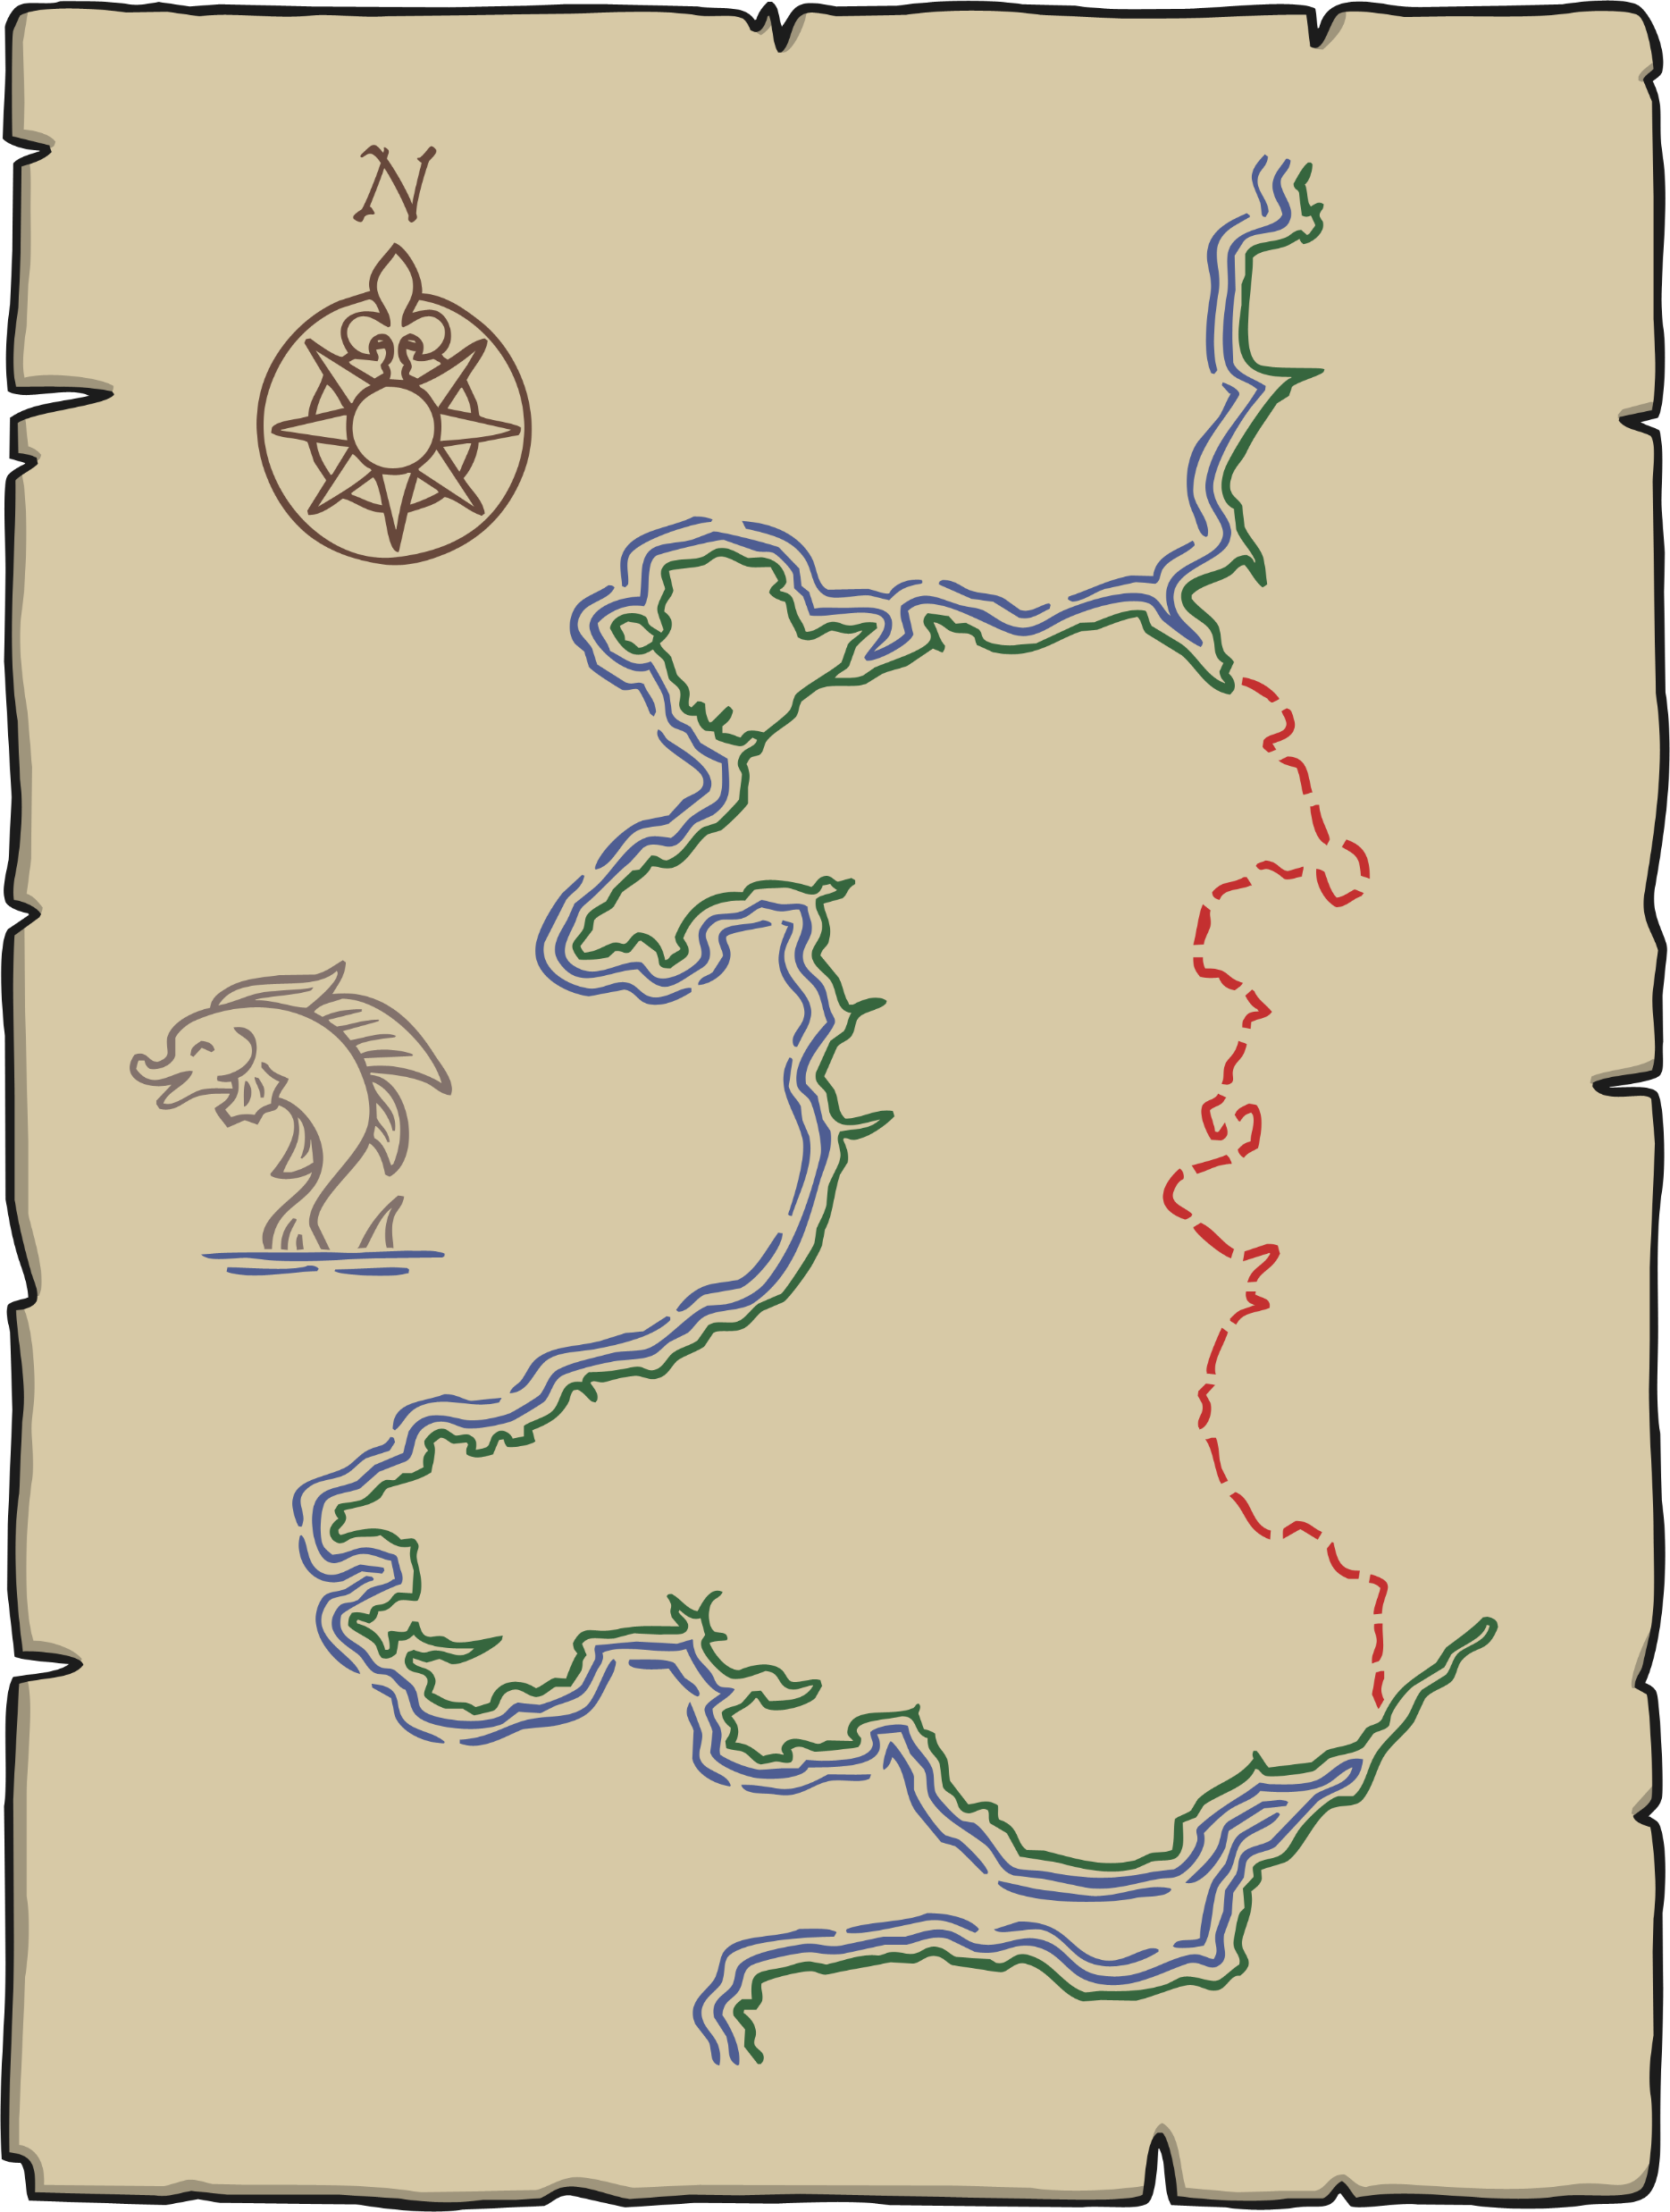
Find the word using the letters given.
Reveal Answer
e
a
i
b
s
m
n
y
o
f
v
p
m
m
a
a
p
p

Slide 7
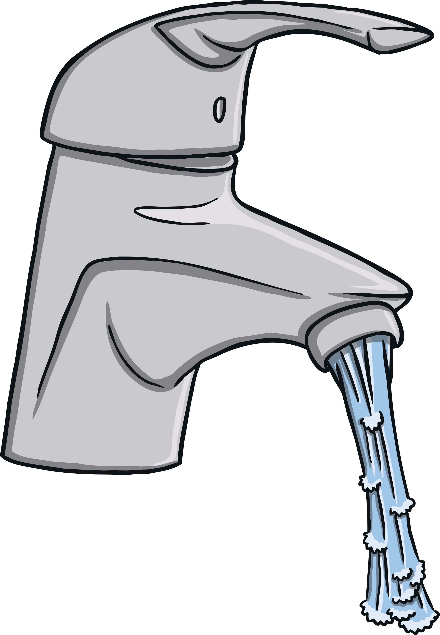
Find the word using the letters given.
Reveal Answer
l
h
q
b
t
g
a
p
s
k
u
n
t
a
p
t
a
p

Slide 8
Find the word using the letters given.
Reveal Answer
w
s
i
a
p
t
c
n
b
m
e
o
c
a
t
c
a
t

Slide 9
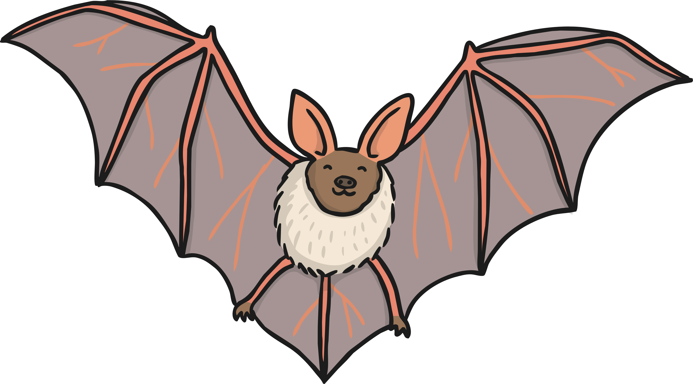
Find the word using the letters given.
Reveal Answer
t
l
i
e
s
g
c
a
o
n
b
d
b
a
t
b
a
t

Slide 10
Find the word using the letters given.
Reveal Answer
f
l
a
j
s
z
g
c
o
m
b
d
j
a
m
j
a
m

Slide 11
Find the word using the letters given.
Reveal Answer
f
a
i
e
m
s
g
c
o
t
b
d
m
m
a
a
t
t

Slide 12
Find the word using the letters given.
Reveal Answer
f
l
i
e
s
g
o
c
a
n
b
m
m
a
n
m
a
n

Slide 13
Find the word using the letters given.
Reveal Answer
f
a
i
p
s
g
u
c
o
n
b
d
c
c
a
a
p
p

