Slide 1
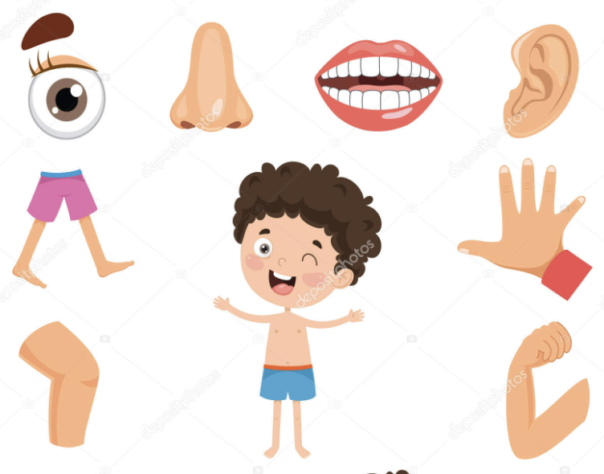

Slide 2
Ask students "What are some parts of the body that you know?” Brainstorm and write answers on board.

Slide 6
Students to solve page 50 in student workbook.

Slide 7
Tuesday

Slide 9
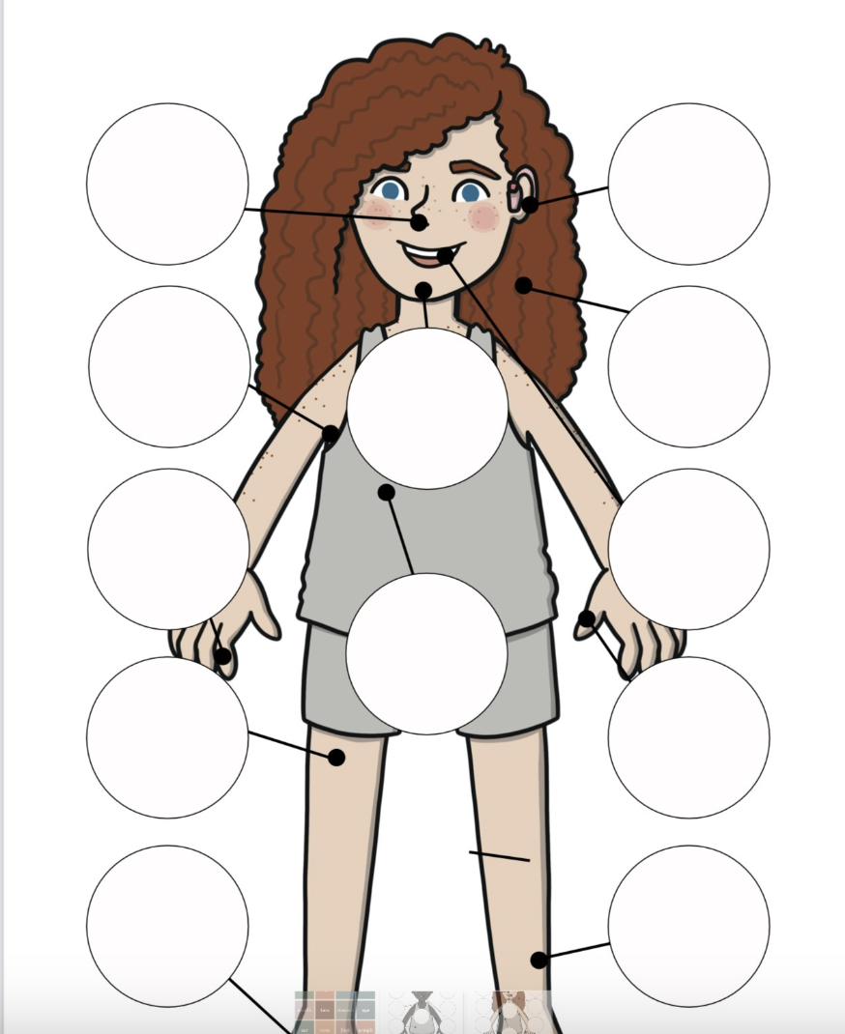
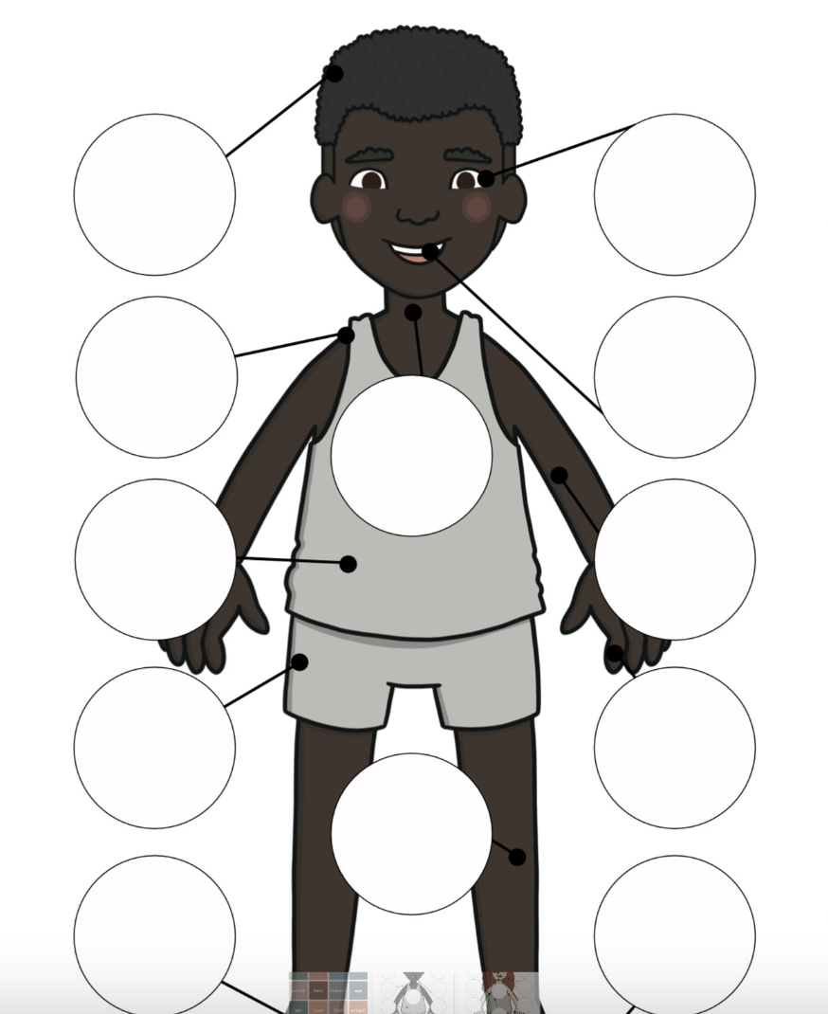
Students to work in pairs and label parts of the body.

Slide 10
Students to solve page 51 and 52 in workbook.

Slide 11
Wednesday

Slide 12
Warm up activity:
Ask are human bodies the same? Put your foot next to your friend's foot and see which foot is longer?
Now put your hand next to your friend's hand and see which hand is shorter?

Slide 13
Activity 1:
Students to be in groups of four and try to guess who is the shortest and who is the tallest.
Activity 2:
Students to draw their hands on a piece of paper and try to guess who has the shortest and longest hands.

Slide 14
Homework page 53 in student workbook.

Slide 15
Thursday
Lab

