Slide 1
COMPARING METALS
AND NON-METALS
Lesson 5.2

Slide 2
In this topic you will:
Compare the properties of metals and non-metals
Investigate materials and decide if they are metals or non-metals.

Slide 3
Warm-up

Slide 4
Comparing metals and non-metals

Slide 5
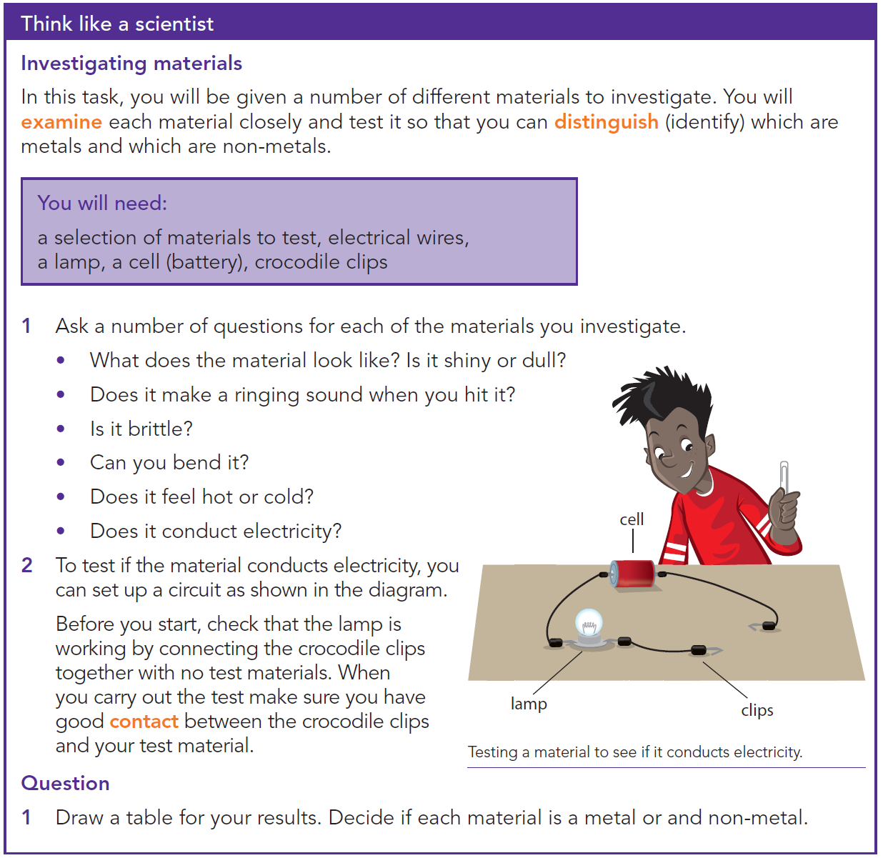
How to find if a material is a metal or non-metal?

Slide 6
Test your information

Slide 7
Answers
2- Non-metal
3- It is a liquid at room temperature.
4- Conduct electrical energy; conduct heat energy

