Slide 1
Types of file

Slide 2
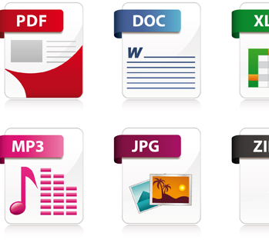
Some of types
This Photo by Unknown author is licensed under CC BY-NC.

Slide 3
Examples of files
Portable document format (PDF) A PDF file is a common file type in many work environments. ...
Word document (DOC and DOCX) ...
Hypertext markup language (HTML and HTM) ...
Microsoft excel spreadsheet file (XLS and XLSX) ...
Text file (TXT)

