Slide 1
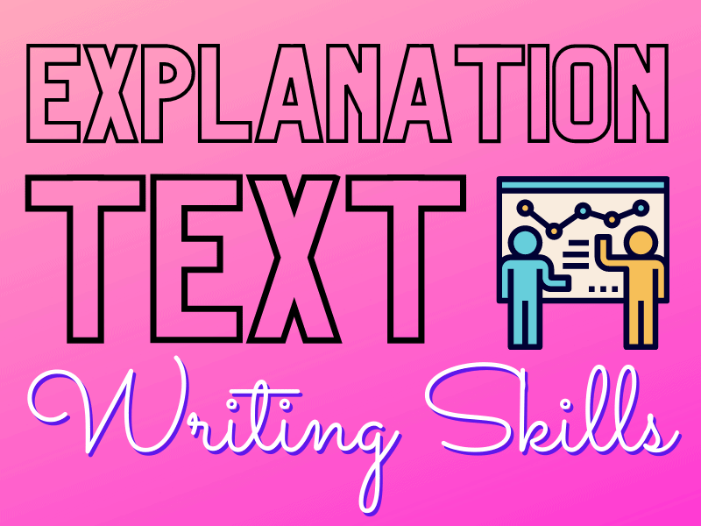

Slide 2
What are explanation texts?
Explanation texts are pieces of writing that explain something. They might tell you how or why something happens, or give information on how to do something.
Some examples are:
information books or leaflets
recipes
news or current affairs articles
guides and manuals

Slide 3
How are they written?
Their structure and form
Explanation texts often tell you about the parts of a process, usually written in chronological order – this means the process is described in the exact order that things happen or are done.
They are also written in a formal impersonal style, not using the pronouns ‘I’ or ‘you’. This helps the reader to focus better on the process being explained.

Slide 4
Top tip!
Texts that explain a process usually have a title and introduction, 'stages' that outline the key information, and finally a conclusion, to sum everything up.

Slide 5
Explanation texts that give instructions
Some explanation texts give you clear instructions on how to do something, for a specific purpose - for example, an instruction manual that explains how to build furniture.
Explanation texts that give instructions are used everywhere: Recipes, ‘How to…’ guides and the instructions that come with new toys and games are all examples. Can you think of any others?

Slide 6
What is the vocabulary used in explanation texts?
1. Formal language
When writing an explanation text, using formal language makes the piece sound clearer and well-informed. Formal language helps to articulate ideas accurately, ensuring that readers can grasp the points being presented.
In explanation writing, formal language can include technical terms needed to properly inform the audience, such as “photosynthesis” in an essay detailing how this biological process happens. It’s important that these technical terms are explained thoroughly and as early on as possible, preferably in the introduction of the piece.

Slide 7
2. Linking words
They serve as bridges between ideas, helping in achieving smooth transitions.
These sentences, often initiated by transitional phrases such as 'finally,' 'to begin with,' 'next,' 'secondly,' and 'additionally,' are particularly beneficial in explanation texts.

Slide 8
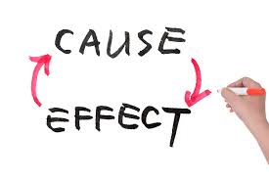
3. Cause-and-effect words
They play a vital role in creating connections between ideas and enhancing the reader's understanding of how different concepts relate to one another.
Using words like 'therefore,' 'as a result of,' 'because of this,' and 'since', improves the coherence of explanation texts.

Slide 9
4. Action verbs
Action verbs add energy and clarity to a piece of writing, helping readers vividly imagine what's happening.
When explaining things, choosing action verbs makes it easier for the audience to understand exactly what to do!

Slide 10
5. Time connectives
They guide readers through the sequence of events, helping them follow explanations smoothly.
For example, using words like "first," "next," and "finally" will make it easier for the audience to understand the correct order of events

