Slide 1
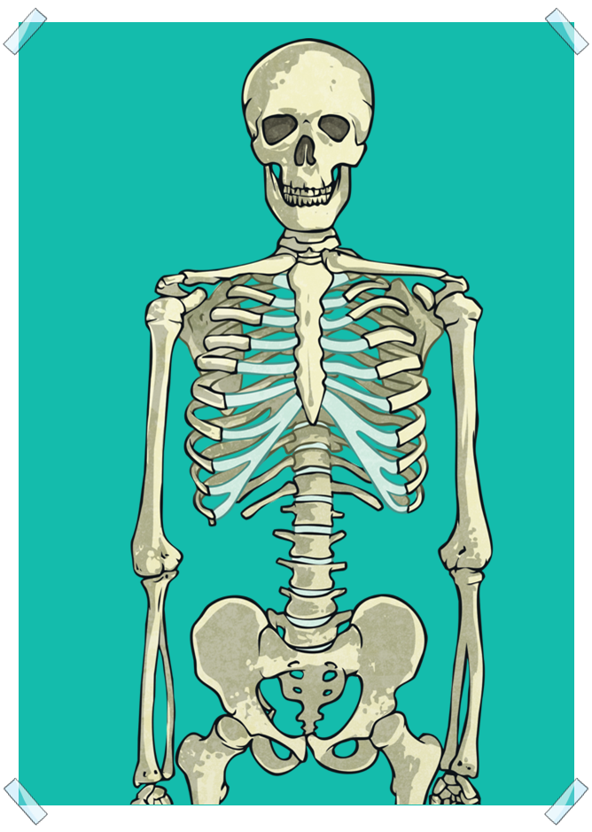
Bones and skeletons

Slide 2
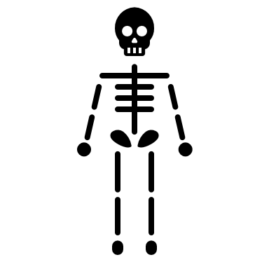
We are going to learn about:
Identify the skeleton.
Identify some of the Important bones in the human body.

Slide 3
New vocabulary for this lesson:
Bones
Frame
Skeleton
Skull
Jaw
Rib cage
Hip
Spine
model

Slide 4
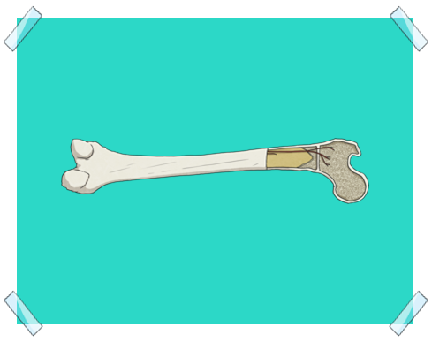
Try to touch every Part of your body and tell me what do you feel
Do you feel that hard thing under your skin
Do you know what do we call it ?
Yes, you are right it is called bones

Slide 5
Bones are hard and strong
So, does animals have bones as humans do?
Yes, they do
Can you tell me a name of one animal ?

Slide 6
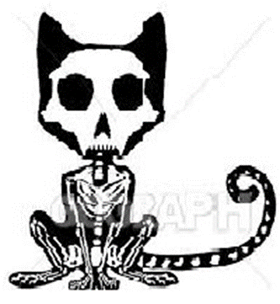
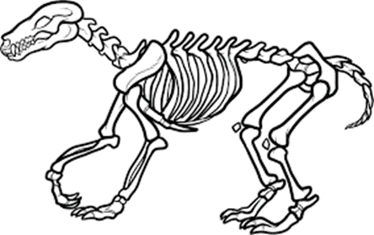
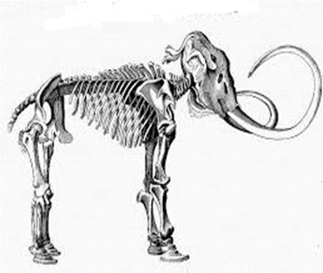
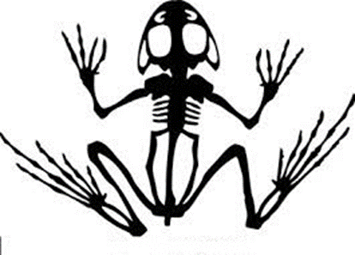
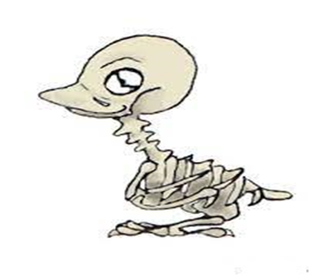
Guess what type of animal does each picture represent?

Slide 7
People and many animals have bones inside their bodies.
These bones are joined together to form a
skeleton.

Slide 8
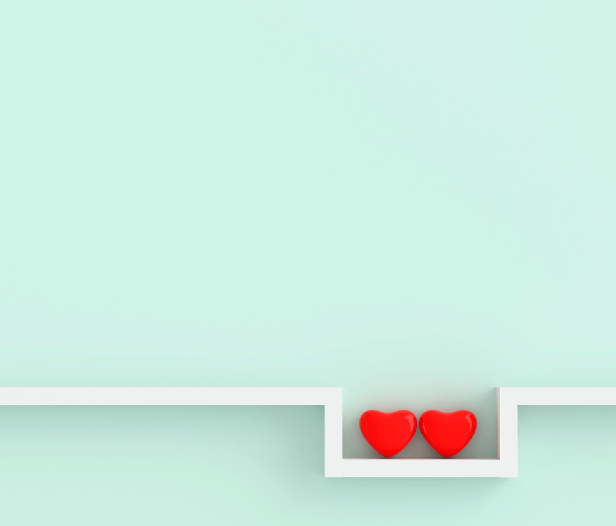
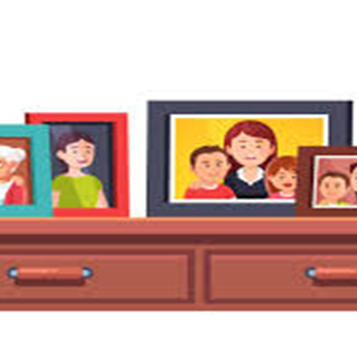
Skeleton is a strong frame that supports our body from the inside
§These are pictures of a nice family instead of keeping them in a drawer where no one can see, they put them in picture frames to hold them up to enjoy seeing them whenever you pass through .
§This is exactly what our skeleton does to our body it holds it up.

Slide 10
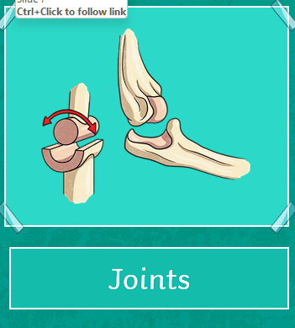
Do you know how many bones are there in our skeleton?
A baby is born with around 300 bones and as the baby grows into an adult the bones fuse together and the number of bones an adult then has is 206.
Bones are attached together through joints

Slide 11
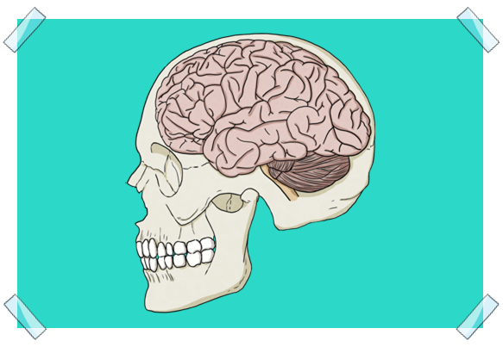
Now let's get to know our bones
Put your hands on your head ……can you feel this hard bone?
This bone is called the
Skull

Slide 12
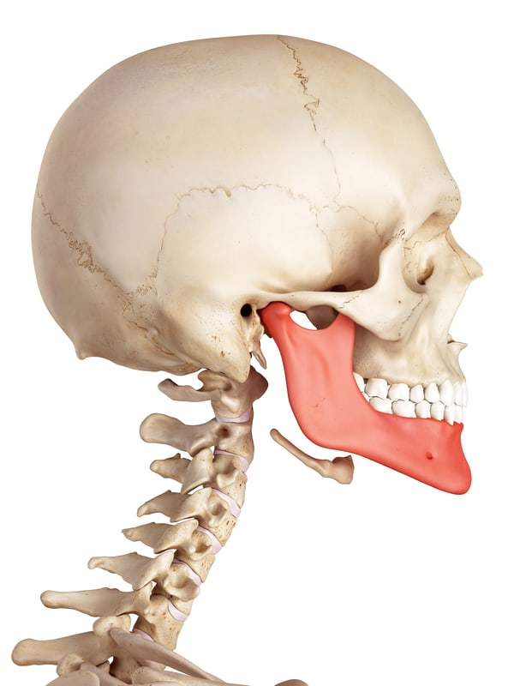
But your hands on your mouth.
Can you feel that moving part
Jawbone

Slide 13
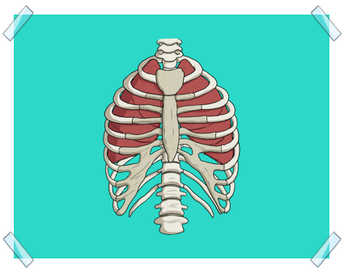
§Put your hands on the sides of your chest……
§Can you feel the hard bones?
§This is called ………….
Rib Cage

Slide 14
But your hands on your back Can you feel the hard bones Spine or backbone

Slide 15
Upper Arm bone

Slide 16
hips

Slide 17
Thigh bone

Slide 18
Lower leg bone

Slide 19
Open your books page 3

Slide 20
Video time

Slide 21
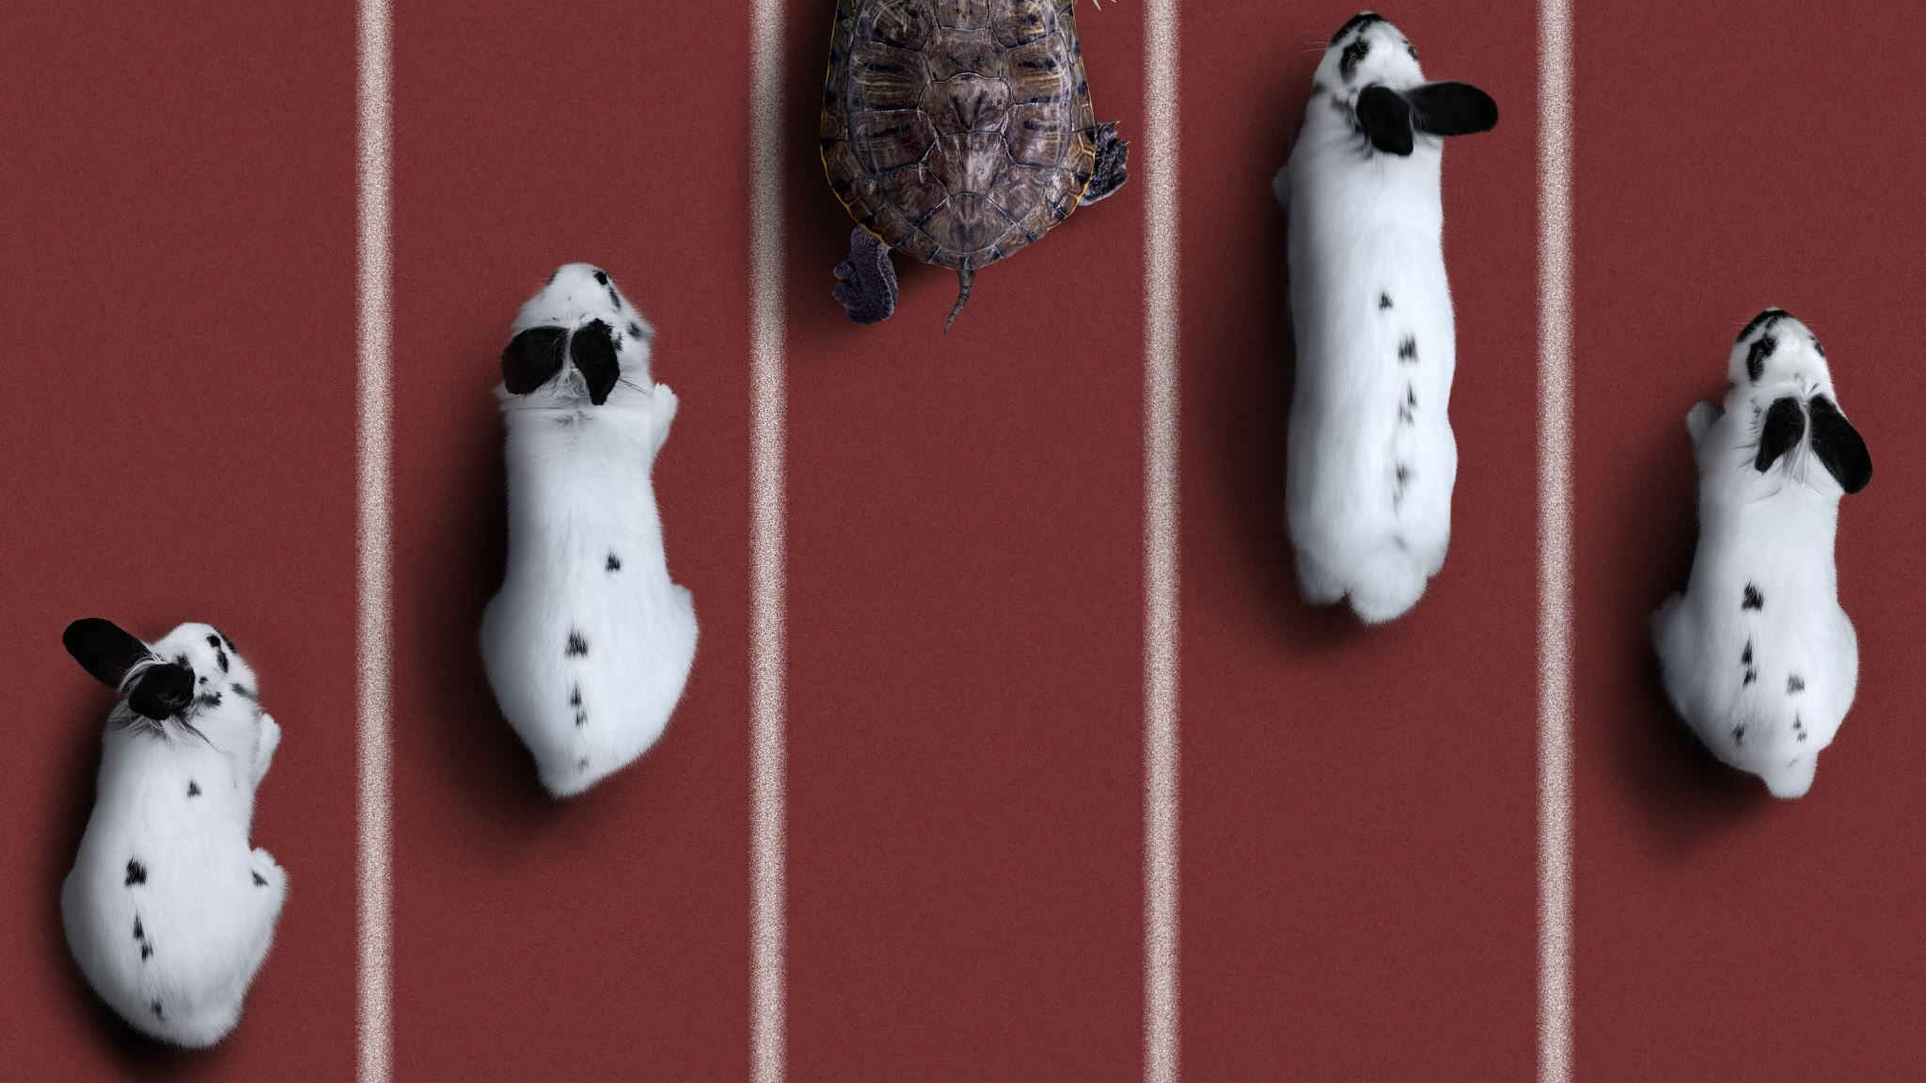
Questions
1 What are skeletons made of?
2 Why must skeletons be hard and strong?
3 Why do you think the bones of your skeleton are different sizes and shapes?
4 Bones are not very heavy. How do you think this helps animals?

Slide 22
A model
helps us understand how something works or see what something looks like that we cannot see in real life. Work with a partner to make a model of a skeleton.

