Slide 1
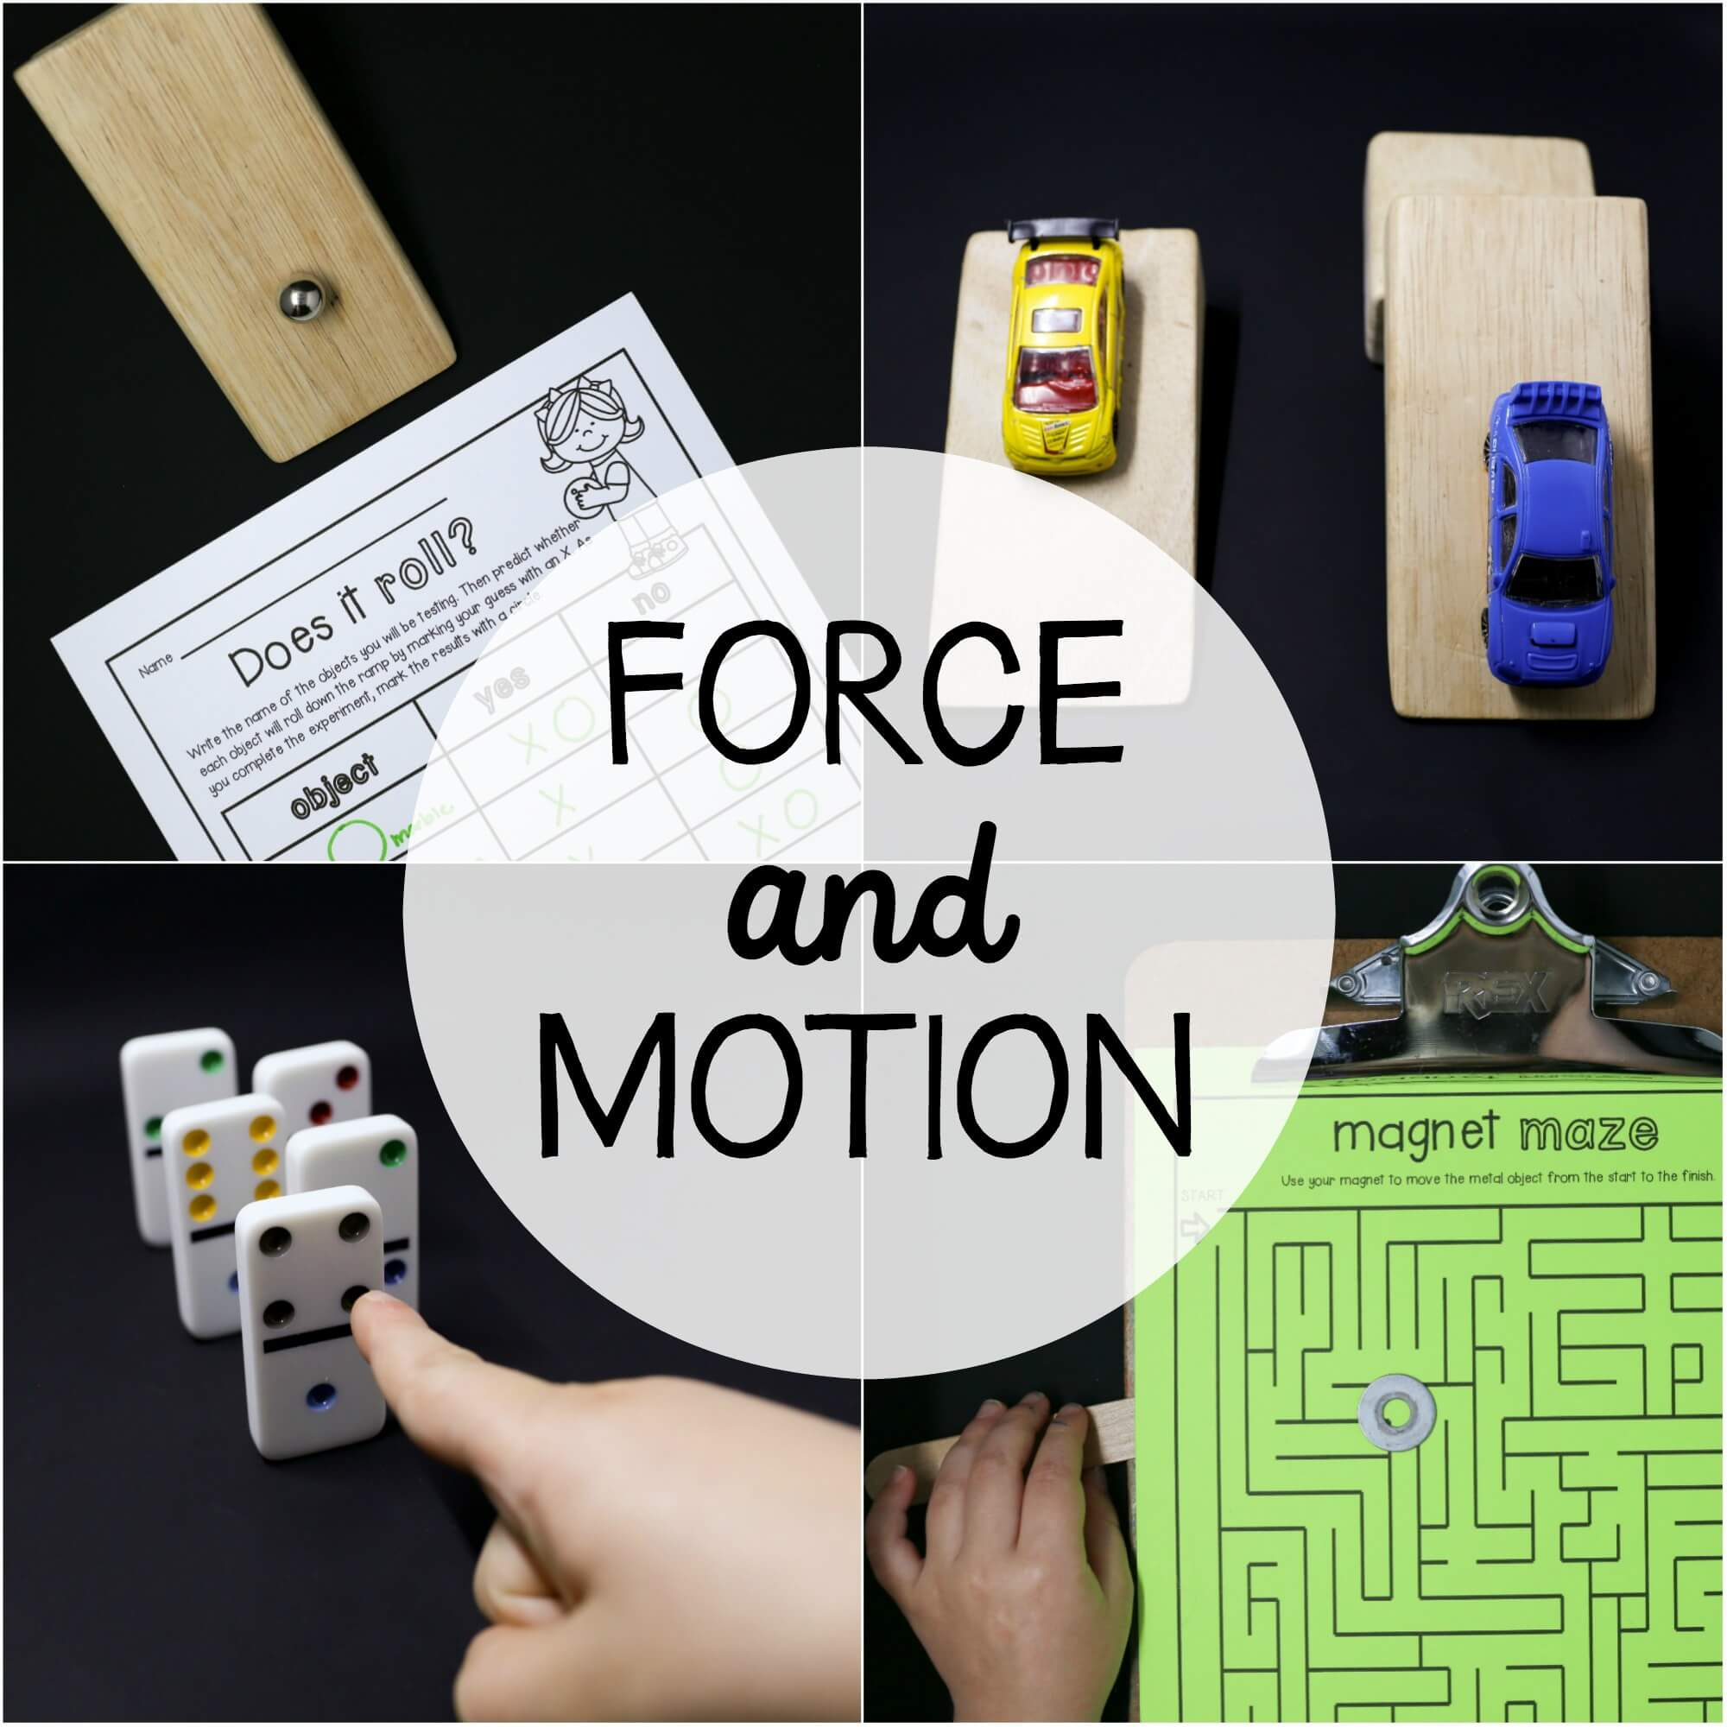
Force changes speed
Year 2 T1 W10 L2

Slide 2
Lesson Objectives
Know that things will only speed up, slowdown, or change direction when something else causes them to do so.
Identify friction as a type of forces.

Slide 3
Video
Motion and Friction for Kids | Science Lesson for Grades 3-5 | Mini-Clip
https://youtu.be/9ePpWrvOXGY

Slide 5
Video
Friction | Class 8 | Science | Physics | CBSE | ICSE | FREE Tutoria
https://youtu.be/RMcf2f4f4aw

Slide 6
Vocabulary

Slide 9
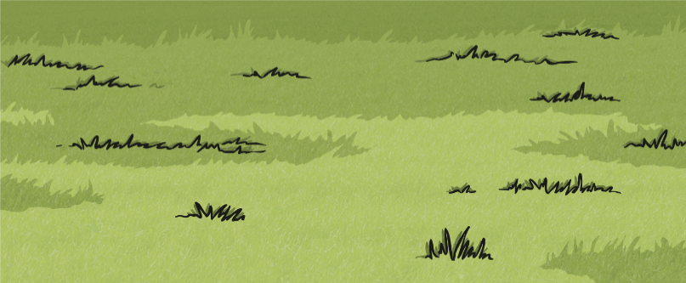
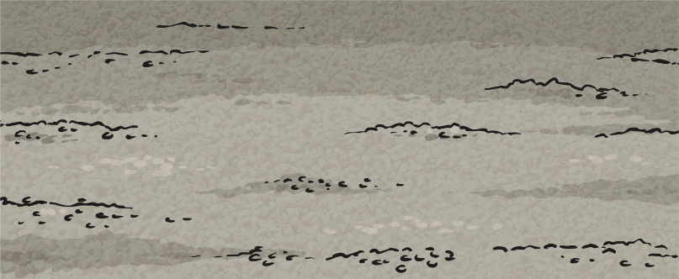
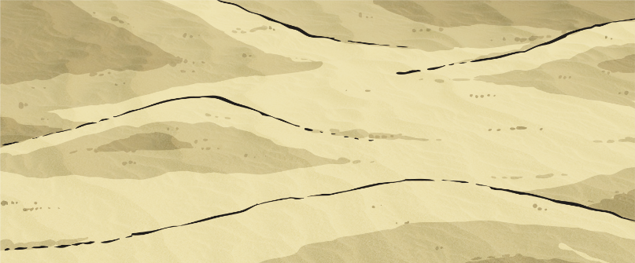
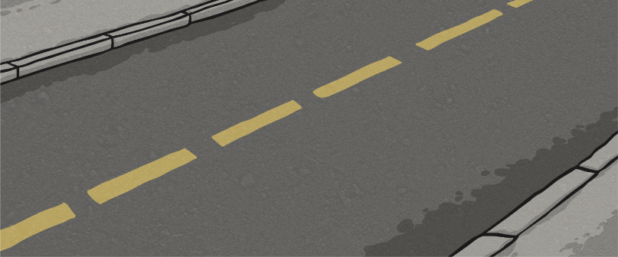
Different Surfaces
Cyclists sometimes travel over different surfaces.
Grass
Gravel
Sand
Road

Slide 10
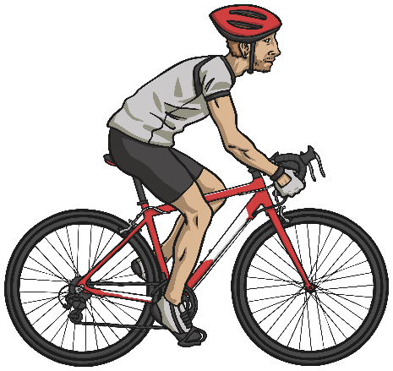
Different Surfaces
These surfaces all exert a force on the bicycle. This force is called friction.
Friction is a force that holds back the movement of an object. Friction acts in the opposite direction to the movement of the object.
The driving force pushes the bicycle, making it move.
Friction pushes on the bicycle, slowing it down.
Grass
Gravel
Sand
Road

Slide 11
Different Surfaces
Different surfaces create different amounts of friction.
The amount of friction created by an object moving over a surface depends on the roughness of the surface and the object, and the force between them.
The driving force pushes the bicycle, making it move.
Friction pushes on the bicycle, slowing it down.
Grass
Gravel
Sand
Road

Slide 12
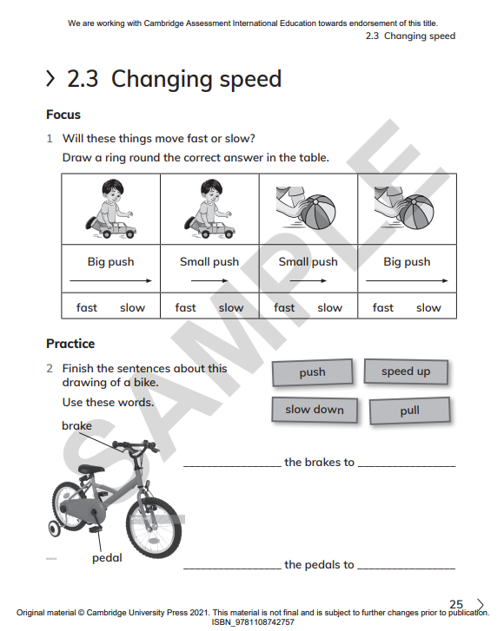
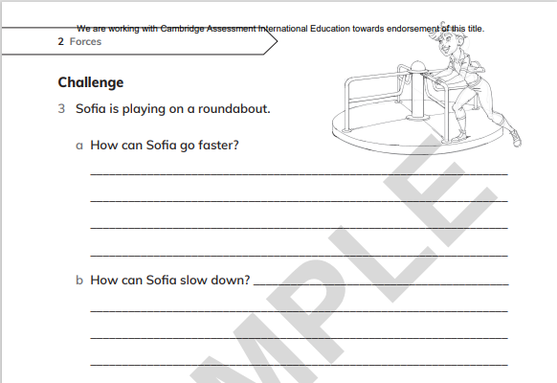
C.W

