Slide 2
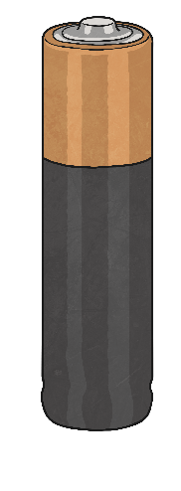
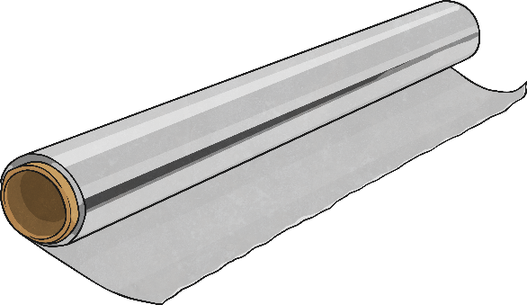
Make a simple circuit
You have a single battery (no holder), a bulb, and a piece of foil. Can you make the bulb light up?

Slide 3
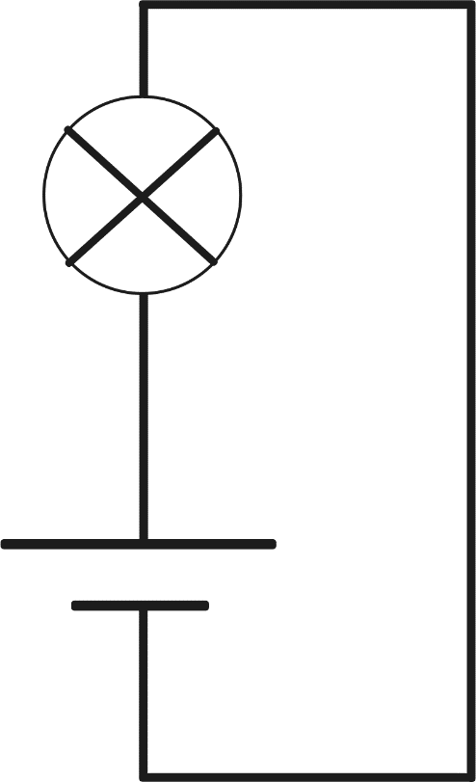
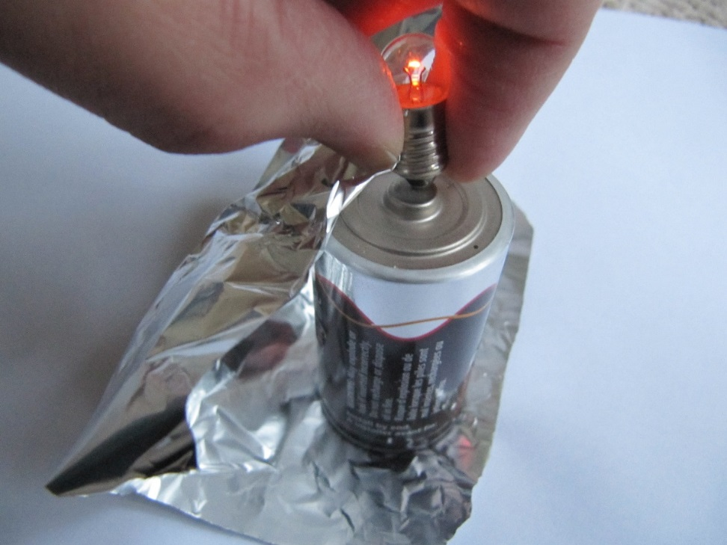
Make a bulb light up
Why does the bulb light up?
Record your circuit.
Show circuit
Hide circuit

Slide 4
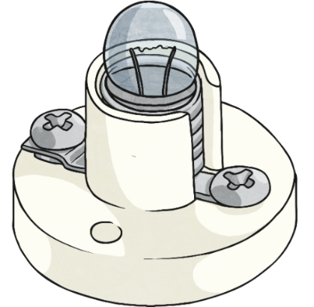
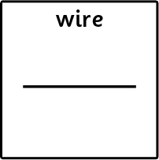
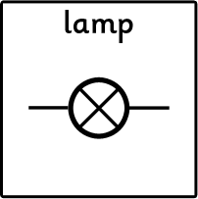
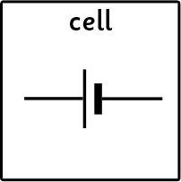
Make a simple circuit
You have a single battery in a holder, a bulb in a holder, and two wires. Can you make the bulb light up?
Wires
Bulb in a holder
Battery in a holder

Slide 5
A simple circuit
Wire
Battery in holder
Bulb in holder

Slide 6
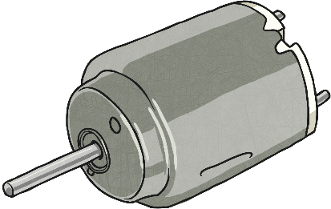
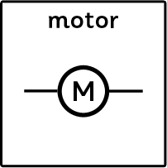
Make a simple circuit
You have a single battery in a holder, a buzzer or motor, and two wires. Can you make the buzzer sound or the motor turn on?
Wires
Motor
Battery in a holder

Slide 7
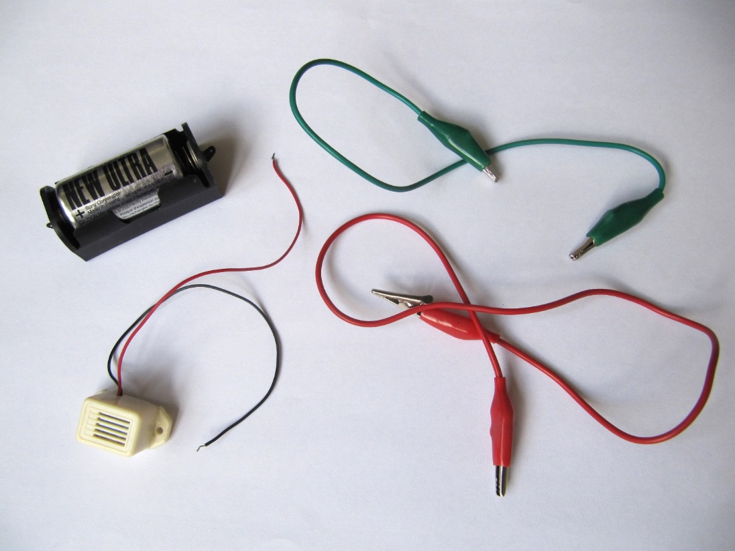
Make a simple circuit
Hide circuit
Show circuit

