Slide 1
VOCABULARY WORDS
Week 11

Slide 2
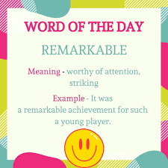
remarkable
Meaning:
Unforgettable- amazing
Sentence:
It was a remarkable achievement for such a young player.

Slide 3
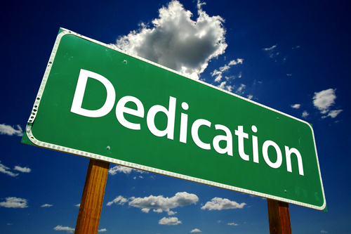
dedicated
Meaning:
devoted to a task or purpose
Sentence:
"a team of dedicated doctors"

Slide 4
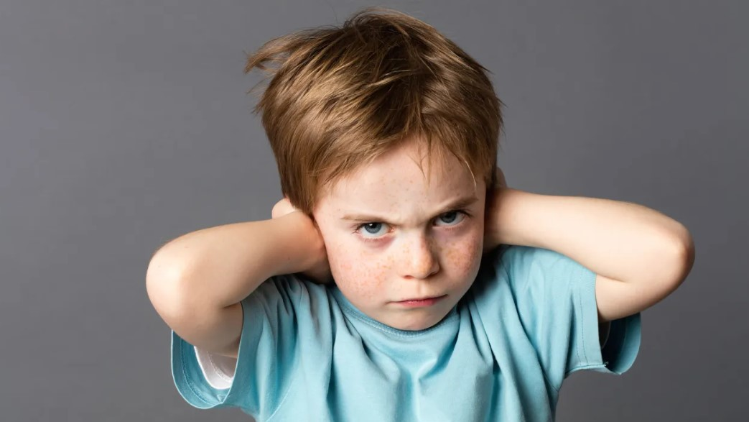
stubborn
Meaning:
headstrong
Sentence:
They are having an argument because both are so stubborn.

Slide 5
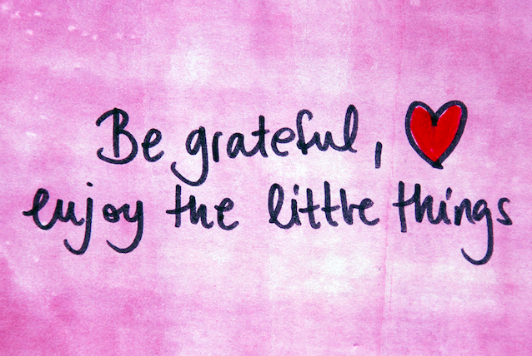
grateful
Meaning:
feeling or showing an appreciation for something done or received.
Sentence:
"I'm grateful to you for all your help"

Slide 6
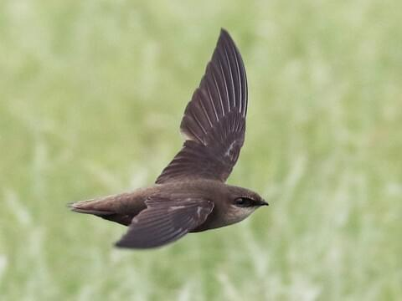
swift
Meaning:
happening quickly or promptly
Sentence:
"streams that ran swift and clear

Slide 7
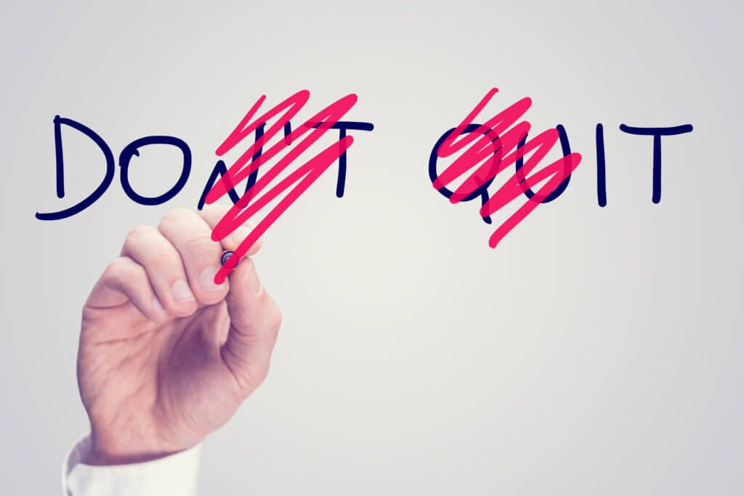
determined
Meaning:
If you are determined to do something, you have made a firm decision to do it and will not let anything stop you
Sentence:
His enemies are determined to ruin him.

