Slide 2
Hexagon
Click on the pencil for animation

Slide 3
Hexagon
Hexagons have six straight sides.
Hexagons have six angles.

Slide 4
Can you find the hexagon?

Slide 5
Hexagon
Honeycomb
Football

Slide 6
Pentagon
Click on the pencil for animation

Slide 7
Pentagon
Pentagons have 5 straight sides and 5 angles.

Slide 8
Can you find the pentagon?

Slide 9
Pentagon
Birdhouse
Button

Slide 10
Octagon
Click on the pencil for animation

Slide 11
Octagon
Octagons have 8 sides and 8 angles.

Slide 12
Can you find the octagon?

Slide 13
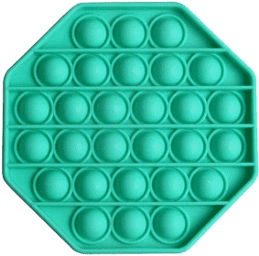
Octagon
Spider web
Pop it toy

