Slide 1
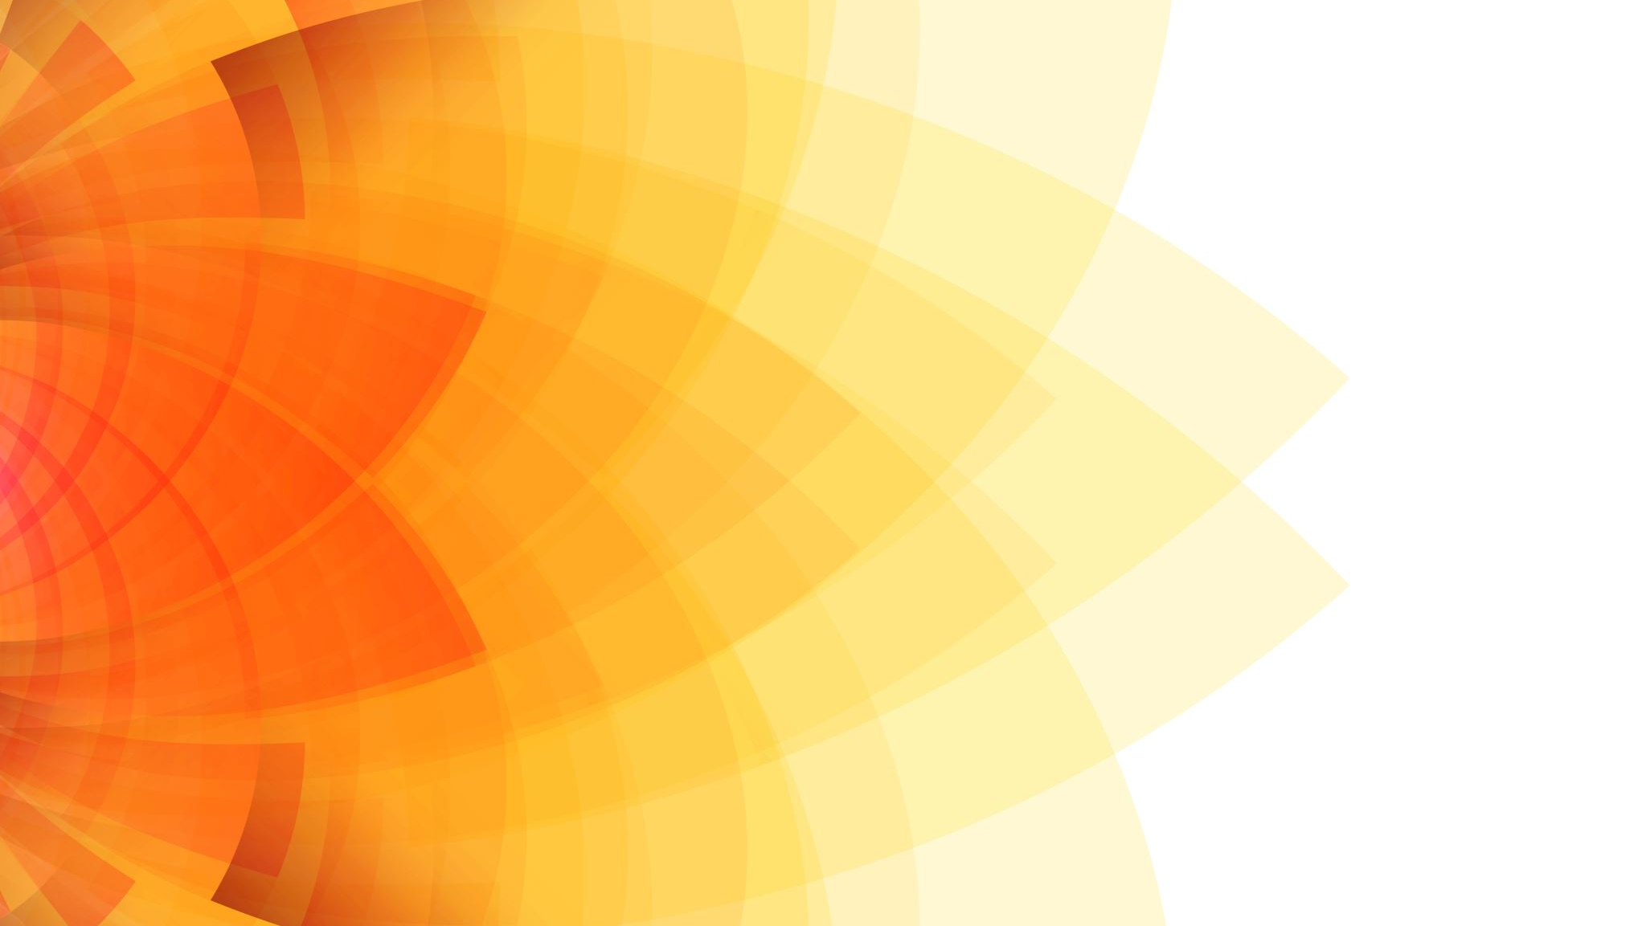
4.3 EXCRETION IN HUMANS

Slide 2
OBJECTIVES
Find out what substances humans excrete.
Study the structure of the human excretory system.
Learn how the kidney help with excretion.

Slide 3
Keywords
Bladder
Excretion
Excretory system
Kidneys
Renal
Urea
Ureter
Urethera
Urine

Slide 4
Parts of the excretory system

Slide 5
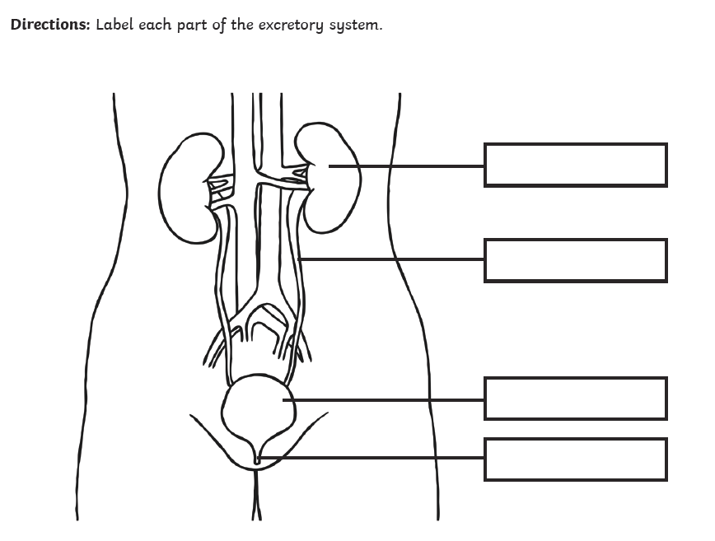
Kidney
ureter
bladder
urethra

Slide 6
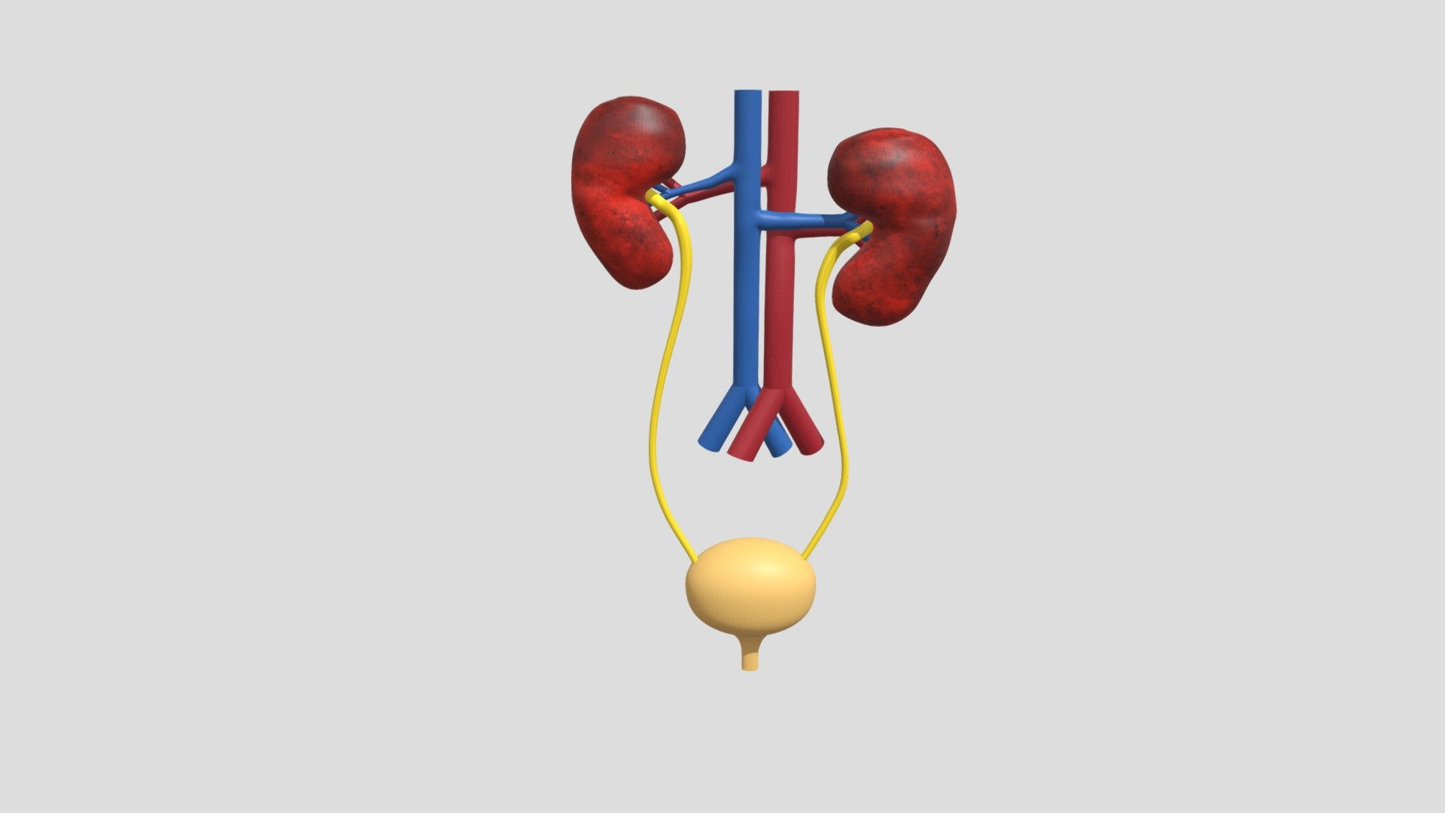

Slide 7
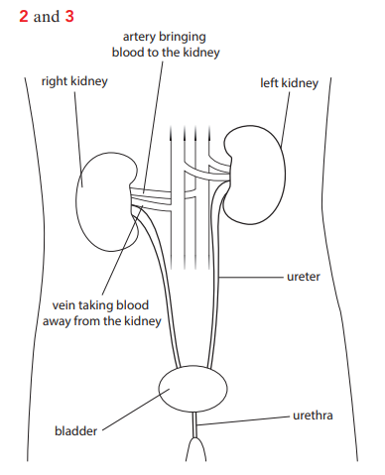

Slide 8
Excretory system
Excretion: getting rid of waste materials from the body; specifically, these waste materials have been inside the body (so do not include the egestion of faeces)
kidneys: a pair of organs in the upper abdomen, which filter the blood and produce urine
urea: an excretory product made in the liver from excess amino acids

Slide 9
Excretory system
urine: a liquid produced by the kidneys which contains urea and other waste substances dissolved in water
ureter: a tube that carries urine from the kidneys to the bladder
bladder: an organ in which urine is stored before removal from the body
urethra: a tube that carries urine from the bladder to the outside of the body

Slide 10
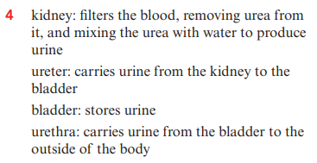

Slide 11
What is excretion?
Excretion is one of the characteristics of all living things.
Excretion means getting rid of waste materials.
In fact, this does not include all waste materials. Excretion really only applies to waste materials that have – even for only a short while – been truly inside the body

Slide 12
What is excretion? (cont.)
Eating food
from the mouth
Travel down along the long tube
To the anus
The food that travels all the way through this tube was never part of your body
Only things that moves out of the digestive system, and into the person’s blood or their body cells, are really part of their body
This means waste from digestive system, which animal ( including humans) get rid of as faeces , does not count as excretion
It has never been part of the body

Slide 13
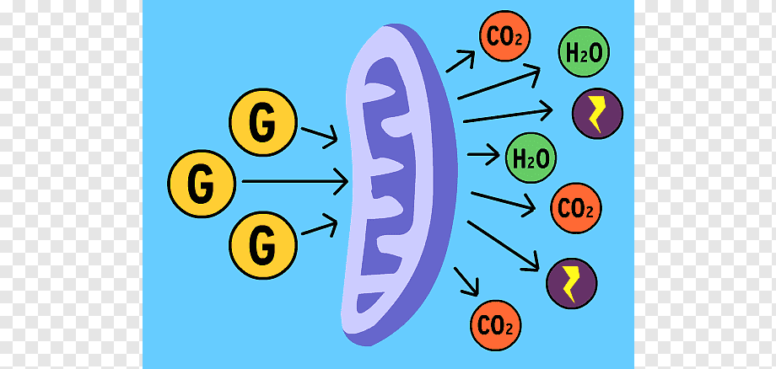
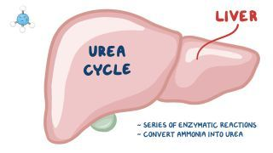
What does excretion include?
Excretion includes all the waste substances that organisms make in their cells
any substances that they have too much of, that have been part of their body.
For animals, including humans, these include:
carbon dioxide, which body cells make in respiration
urea,
a waste substance
that is made in liver cells
excess water
that is not needed by the body

Slide 14
Excreting urea
When eating food
Smaller molecules
Liver
blood

Slide 15
Excreting urea
More Protein than we need
Inside the liver
change
Smaller molecules
UREA
Urea is a poisonous substance.
If t builds up in the body, it makes a person ill

Slide 16
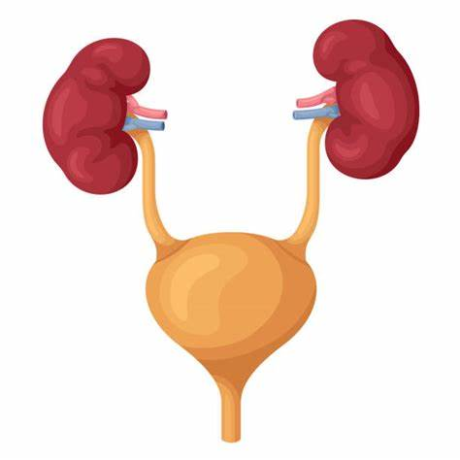
Excreting urea
As soon as urea is made in a liver cell, it is taken away from the liver in the blood
The urea is removed from the blood by the Kidneys in the excretory system.
This system is also known as the renal system.
Renal means “to do with Kidneys”

Slide 17
Excretory system
As the blood flows through the kidneys, the kidneys filter the blood. They remove all of the urea from it.
The kidneys also remove excess water from the blood. The urea dissolves in the excess water. The solution made of urea dissolved in water is called urine.
The urine made in each kidney flows down a tube called a ureter. This carries it to the bladder, which can store it for a while.
The urine can flow out of the bladder to the outside world through another tube, called the urethra.

Slide 18
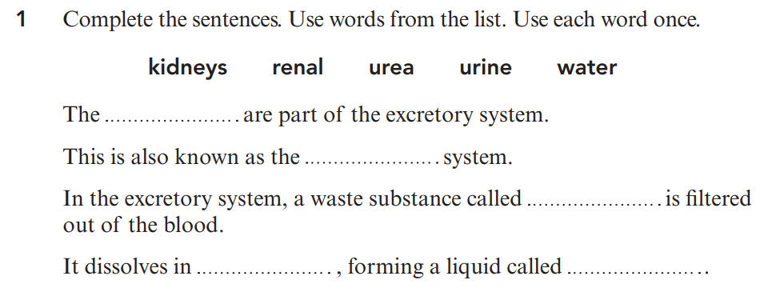
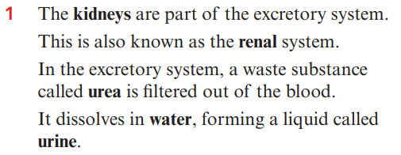

Slide 19
1 Yes; they both need water for transport and cooling.
2 We also need water for getting rid of waste materials in urine.
3 Plants use water for photosynthesis

Slide 20
Excretory system
Find the definition of the following terms:
Urine
Ureter
Bladder
urethera

Slide 21
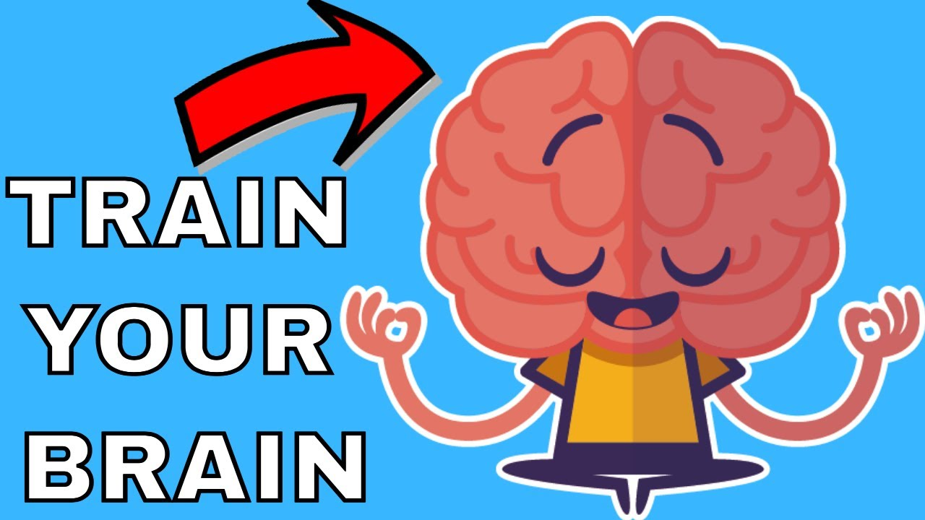

Slide 22
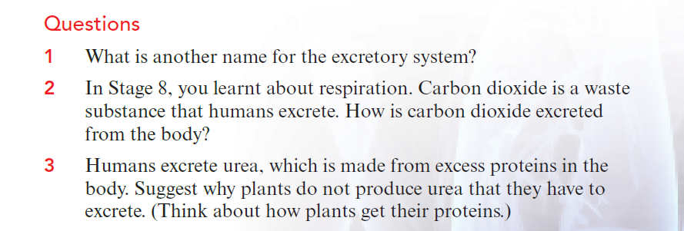
`
LB PG
158
renal system
Carbon dioxide diffuses into the blood and is carried to the lungs. There, it diffuses from the blood capillaries into the alveoli. It is removed from the body in expired air.
Plants make their own proteins, using carbohydrates that they have made in photosynthesis and nitrates that they absorb from the soil. So they are unlikely to have excess proteins that they need to get rid of.

