Slide 1
English

Slide 2
Lessons Objectives
By the end of the lesson, learners will be able to :
read the new words.
read the new words.
read the new words.
understand what conjunctions mean
01
identify the meaning for the new words.
identify the meaning for the new words.
identify the meaning for the new words.
02
use the new vocabulary in their writing.
03
use the new vocabulary in their writing.
04

Slide 3
Describing Animals

Slide 4
country side
Land away from towns and cities.
It is quieter in the countryside than the city and towns.

Slide 5
den
Home for wild animals like lions or foxes.
Foxes live in a den.

Slide 6
fur
Thick, soft hair that grows on mammals
Rabbits have soft white fur.

Slide 7
jaws
Two bones in which teeth are attached to .
Jaws are the strongest bones.

Slide 8
shiver
The body shakes because of fright.
He sat on the ground and started to shiver from fear.

Slide 9
offspring
A person’s children or an animal’s young.
The mom takes very good care of her offsprings.

Slide 10
fierce
Angry, and aggressive
He looked so fierce I was afraid of him

Slide 11
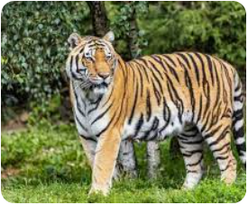
stripy
Has stripes
The zebra, and tiger are both stripy animals

Slide 12
cheeky
Rude in a charming way
The monkey is a very cheeky animal.

Slide 13
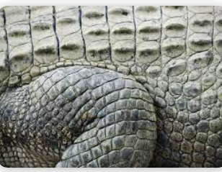
scaly
An animal with pieces of hard skin covering
Aligators, crcodiles and snakes are scaly animals

Slide 14
venomous
Uses poison
Some snakes are venomous.

Slide 15
Write the words and meanings in your copybooks.

Slide 16
Lessons Objectives
Objectives check:
read the new words.
.
01
identify the meaning of the new words.
02
03
use the new vocabulary in their writing.
04

