Slide 1
When we describe large numbers we use a shortcut,
we describe multiples of a large number.
Figures | Words | As a Calculation
400 | “four hundred” | 4 × 100
9,000 | “nine thousand” | 9 × 1,000
43,000 | “forty three thousand” | 43 × 1,000
5,000,000 | “five million” | 5 × 1,000,000
82,000,000 | “eighty two million” | 82 × 1,000,000
6,000,000,000 | “six billion” | 6 × 1,000,000,000
Try saying: 360,240,056 km

Slide 2
A more scientific method is to describe large numbers
using a multiple of powers of 10.
Figures | Words | As a Calculation | As a calculation using indices
400 | “four hundred” | 4 × 100 | 4 × 10²
9,000 | “nine thousand” | 9 × 1,000 | 9 × 10³
43,000 | “forty three thousand” | 43 × 1,000 | 43 × 10³
5,000,000 | “five million” | 5 × 1,000,000 | 5 × 10⁶
82,000,000 | “eighty two million” | 82 × 1,000,000 | 82 × 10⁶
6,000,000,000 | “six billion” | 6 × 1,000,000,000 | 6 × 10¹⁰

Slide 3
Ordinary Form
Standard Form
200
2
×
10²
“two hundred”
A number:
1 $\text{⩽} x$ $<$ 10
Integer power
of 10
3,500
3.5
×
10³
“three thousand five hundred”
A number:
1 $\text{⩽} x$ $<$ 10
Integer power
of 10
This is scientific notation for numbers.
It is standard because everyone agrees to use it.
Standardisation makes is easier to compare numbers
& to communicate scientifically.

Slide 4
Ordinary Form
Standard Form
340
3.4
×
10²
“three hundred and forty”
A number:
1 $\text{⩽} x$ $<$ 10
Integer power
of 10
48,000
4.8
×
10⁴
“forty eight thousand”
A number:
1 $\text{⩽} x$ $<$ 10
Integer power
of 10
48
×
10³
Why is it non-standard to use this?

Slide 5
We can convert a large number into standard form using a place value table.
Convert 3,200 into standard form.
We will divide the number by 10 until it is less than 10,
but more than or equal to 1.
Adjustment
Thousands | Hundreds | Tens | Units | Tenths
3 | 2 | 0 | 0 | 0
 | 3 | 2 | 0 | 0
 |  | 3 | 2 | 0
 |  |  | 3 | 2
× 1
× 10⁰
× 10
× 10¹
× 100
× 10²
× 1000
× 10³
3200 = 3.2 × 10³

Slide 6
We can convert a large number into standard form using a place value table.
Convert 4,850 into standard form.
We will divide the number by 10 until it is less than 10,
but more than or equal to 1.
Adjustment
Thousands | Hundreds | Tens | Units | Tenths | Hundredths
4 | 8 | 5 | 0 | 0 | 0
 | 4 | 8 | 5 | 0 | 0
 |  | 4 | 8 | 5 | 0
 |  |  | 4 | 8 | 5
× 10⁰
× 10¹
× 10²
× 10³
4,850 = 4.85 × 10³

Slide 7
Converting Ordinary Numbers to Standard Form
Convert 3000 to standard form.
3000
×
3
3
10
A number:
1 $\text{⩽} x$ $<$ 10
Integer power
of 10

Slide 8
Converting Ordinary Numbers to Standard Form
Convert 13,000 to standard form.
13000
×
4
1.3
10
A number:
1 $\text{⩽} x$ $<$ 10
Integer power
of 10

Slide 9
Converting Ordinary Numbers to Standard Form
Convert 14,800 to standard form.
14800
×
4
1.48
10
A number:
1 $\text{⩽} x$ $<$ 10
Integer power
of 10

Slide 10
Converting Ordinary Numbers to Standard Form
Convert 360,000 to standard form.
360000
×
5
3.6
10
A number:
1 $\text{⩽} x$ $<$ 10
Integer power
of 10

Slide 11
Converting Ordinary Numbers to Standard Form
YOUR TURN
Convert 360,000 to standard form.
Convert 8000 to standard form.
360000
8000
×
5
×
3
3.6
10
8
10
A number:
1 $\text{⩽} x$ $<$ 10
Integer power
of 10

Slide 12
Converting Ordinary Numbers to Standard Form
YOUR TURN
Convert 360,000 to standard form.
Convert 27,000 to standard form.
360000
27000
×
5
×
4
3.6
10
2.7
10
A number:
1 $\text{⩽} x$ $<$ 10
Integer power
of 10

Slide 13
Converting Ordinary Numbers to Standard Form
YOUR TURN
Convert 360,000 to standard form.
Convert 70,400 to standard form.
360000
70400
×
5
×
4
3.6
10
7.04
10
A number:
1 $\text{⩽} x$ $<$ 10
Integer power
of 10

Slide 14
Converting Ordinary Numbers to Standard Form
YOUR TURN
Convert 360,000 to standard form.
Convert 1,400,000 to standard form.
360000
1400000
×
5
×
6
3.6
10
1.4
10
A number:
1 $\text{⩽} x$ $<$ 10
Integer power
of 10

Slide 15
Converting Ordinary Numbers to Standard Form
YOUR TURN
Convert these ordinary numbers to standard form.
Convert 360,000 to standard form.
a) 6000 =
6 × 10³
b) 7800 =
7.8 × 10³
360000
c) 10,000 =
1 × 10⁴
d) 22,000 =
2.2 × 10⁴
×
5
3.6
10
e) 45,600 =
4.56 × 10⁴
f) 7,020,000 =
7.02 × 10⁶
A number:
1 $\text{⩽} x$ $<$ 10
Integer power
of 10
g) 25.4 =
2.54 × 10¹
h) 1663.8 =
1.6638 × 10³
i) 520 × 10³
5.2 × 10⁵

Slide 16
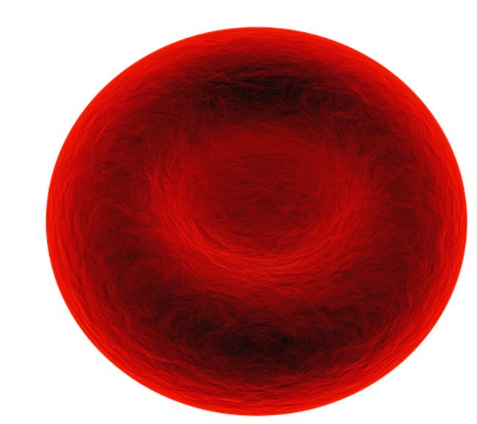
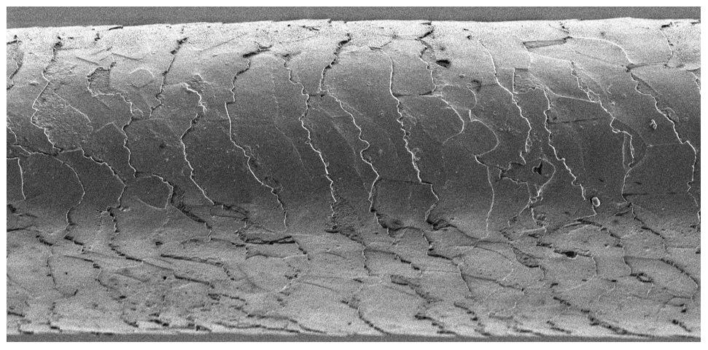
We use standard form to describe very small numbers too.
Width of a Human Hair
Diameter of a Red Blood Cell
0.00005 m
0.000007 m
50 micrometres
7 micrometres
5 × 10⁻⁵
7 × 10⁻⁶
A micrometre is a millionth of a metre.

Slide 17
What pattern do we expect if we complete this table?
A negative power means
the reciprocal.
Ordinary Number | Standard Form
6000 | 6 × 10³
600 | 6 × 10²
60 | 6 × 10¹
6 | 6 × 10⁰
0.6 | 6 × 10⁻¹
0.06 | 6 × 10⁻²
0.006 | 6 × 10⁻³
10⁻³
‘how many times to
divide by that number’
6 × 10⁻³
= 6 × $\frac{1}{103}$
= $\frac{6}{1000}$
10⁰
= $1$
= $\frac{1}{101}$
= $\frac{1}{10}$
10⁻¹
= $\frac{1}{102}$
= $\frac{1}{100}$
10⁻²
= $\frac{1}{103}$
= $\frac{1}{1000}$
10⁻³

Slide 18
We can convert a small number into standard form using a place value table.
Convert 0.005 into standard form.
We will multiply the number by 10 until it is more than or equal to 1
but less than 10.
Adjustment
Units | Tenths | Hundredths | Thousandths
0 | 0 | 0 | 5
0 | 0 | 5
0 | 5
5 | 0
× 10⁰
× 10⁻¹
× 10⁻²
× 10⁻³
0.005 = 5 × 10⁻³

Slide 19
Converting Ordinary Numbers to Standard Form
Convert 0.008 to standard form.
0.008
×
−3
8
10
A number:
1 $\text{⩽} x$ $<$ 10
Integer power
of 10

Slide 20
Converting Ordinary Numbers to Standard Form
Convert 0.064 to standard form.
0.064
×
−2
6.4
10
A number:
1 $\text{⩽} x$ $<$ 10
Integer power
of 10

Slide 21
Converting Ordinary Numbers to Standard Form
Convert 0.00073 to standard form.
0.00073
×
−4
7.3
10
A number:
1 $\text{⩽} x$ $<$ 10
Integer power
of 10

Slide 22
Converting Ordinary Numbers to Standard Form
YOUR TURN
Convert 0.00073 to standard form.
Convert 0.09 to standard form.
0.00073
0.09
×
−4
×
−2
7.3
10
9
10
A number:
1 $\text{⩽} x$ $<$ 10
Integer power
of 10

Slide 23
Converting Ordinary Numbers to Standard Form
YOUR TURN
Convert 0.00073 to standard form.
Convert 0.0081 to standard form.
0.00073
0.0081
×
−4
×
−3
7.3
10
8.1
10
A number:
1 $\text{⩽} x$ $<$ 10
Integer power
of 10

Slide 24
Converting Ordinary Numbers to Standard Form
YOUR TURN
Convert 0.00073 to standard form.
Convert 0.000901 to standard form.
0.00073
0.000901
×
−4
×
−4
7.3
10
9.01
10
A number:
1 $\text{⩽} x$ $<$ 10
Integer power
of 10

Slide 25
Converting Ordinary Numbers to Standard Form
YOUR TURN
Convert 0.00073 to standard form.
Convert 0.00073 to standard form.
0.00073
0.00073
×
−4
×
−4
7.3
10
7.3
10
A number:
1 $\text{⩽} x$ $<$ 10
Integer power
of 10

Slide 26
Converting Ordinary Numbers to Standard Form
YOUR TURN
Convert these ordinary numbers to standard form.
Convert 0.00073 to standard form.
a) 0.05 =
5 × 10⁻²
b) 0.0082 =
8.2 × 10⁻³
0.00073
c) 0.99 =
9.9 × 10⁻¹
d) 0.0074 =
7.4 × 10⁻³
×
−4
7.3
10
e) 0.10076 =
1.0076 × 10⁻¹
f) 0.0007991 =
7.991 × 10⁻⁴
A number:
1 $\text{⩽} x$ $<$ 10
Integer power
of 10
g) 10.0400 =
1.004 × 10¹
h) 50 × 10⁻³ =
5 × 10⁻²
i) 0.043 × 10⁻⁷ =
4.3 × 10⁻⁹

Slide 27
Converting Standard Form to Ordinary Numbers
Convert 6 × 10³ to an ordinary number.
6.000000
= 6,000

Slide 28
Converting Standard Form to Ordinary Numbers
Convert 5.3 × 10³ to an ordinary number.
5.3000000
= 5,300

Slide 29
Converting Standard Form to Ordinary Numbers
Convert 2.37 × 10⁵ to an ordinary number.
2.37000000
= 237000

Slide 30
Converting Standard Form to Ordinary Numbers
YOUR TURN
Convert 2.37 × 10⁵ to an ordinary number.
Convert 7 × 10⁴ to an ordinary number.
2.37000000
7.000000
= 237000
= 70,000

Slide 31
Converting Standard Form to Ordinary Numbers
YOUR TURN
Convert 2.37 × 10⁵ to an ordinary number.
Convert 7.1 × 10³ to an ordinary number.
2.37000000
7.1000000
= 237000
= 7,100

Slide 32
Converting Standard Form to Ordinary Numbers
YOUR TURN
Convert 2.37 × 10⁵ to an ordinary number.
Convert 9.05 × 10⁵ to an ordinary number.
2.37000000
9.05000000
= 237000
= 905000

Slide 33
Converting Standard Form to Ordinary Numbers
Convert 2.8 × 10⁻² to an ordinary number.
00002.8
= 0.028

Slide 34
Converting Standard Form to Ordinary Numbers
Convert 1.56 × 10⁻³ to an ordinary number.
000001.56
= 237000

Slide 35
Converting Standard Form to Ordinary Numbers
Convert 6.4 × 10⁻⁴ to an ordinary number.
00006.4
= 0.00064

Slide 36
Converting Standard Form to Ordinary Numbers
YOUR TURN
Convert 6.4 × 10⁻⁴ to an ordinary number.
Convert 8 × 10⁻² to an ordinary number.
00006.4
00008
= 0.00064
= 0.08

Slide 37
Converting Standard Form to Ordinary Numbers
YOUR TURN
Convert 6.4 × 10⁻⁴ to an ordinary number.
Convert 4.1 × 10⁻⁴ to an ordinary number.
00006.4
00004.1
= 0.00064
= 0.00041

Slide 38
Converting Standard Form to Ordinary Numbers
YOUR TURN
Convert 6.4 × 10⁻⁴ to an ordinary number.
Convert 1.06 × 10⁻³ to an ordinary number.
00006.4
00001.06
= 0.00064
= 0.00106

Slide 39
Converting Standard Form to Ordinary Numbers
YOUR TURN
Convert 6.4 × 10⁻⁴ to an ordinary number.
Convert to ordinary numbers.
a) 9 × 10⁴ =
90,000
b) 9.2 × 10³ =
9,200
00006.4
c) 4.52 × 10⁵ =
452000
d) 9 × 10⁻¹ =
0.9
= 0.00064
e) 6.1 × 10⁻³ =
0.0061
f) 8.2 × 10⁻⁶ =
0.0000082
g) 50 × 10⁻⁴ =
0.00005
h) 0.7 × 10⁵ =
70000
i) 0.006 × 10⁻³ =
0.000006

