Slide 1
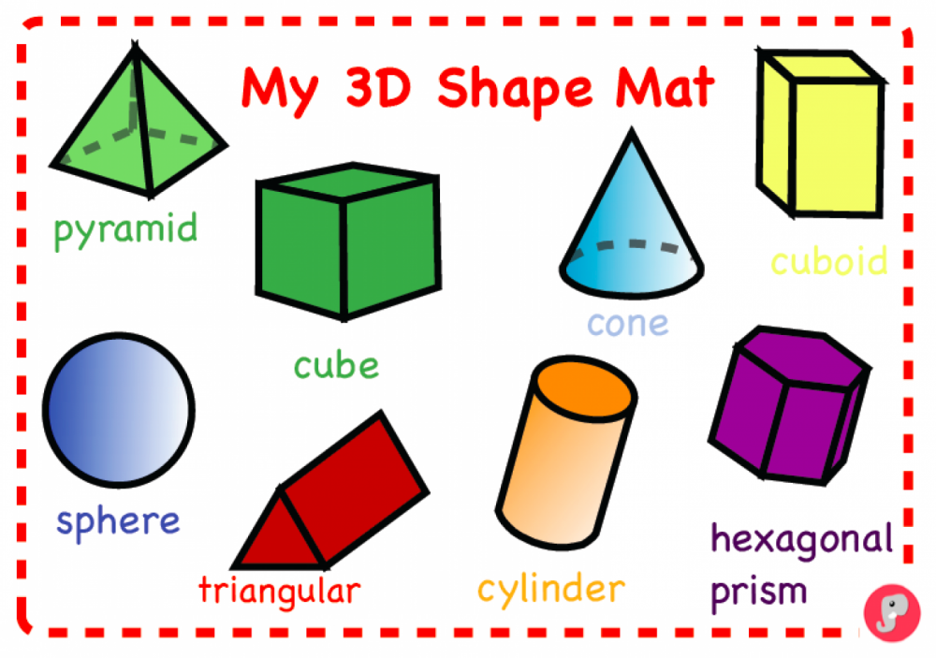

Slide 3
I’m a sphere, smooth and round, Roll me right along the ground.

Slide 4
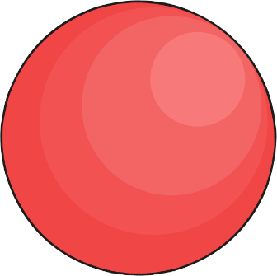
I do not stack, I roll away, There’s no flat side for me to stay.

Slide 5
I have 1 face that wraps completely, All around me, very neatly.

Slide 6
I’m a ball, used in some sports, On football pitches and tennis courts.

Slide 7
Now, put your thinking cap on! Can you find the sphere?

Slide 8
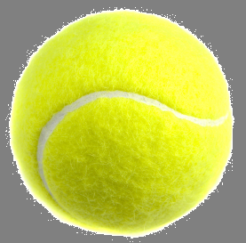
Can you find the Sphere?

Slide 9
Can you find the Sphere?

Slide 10
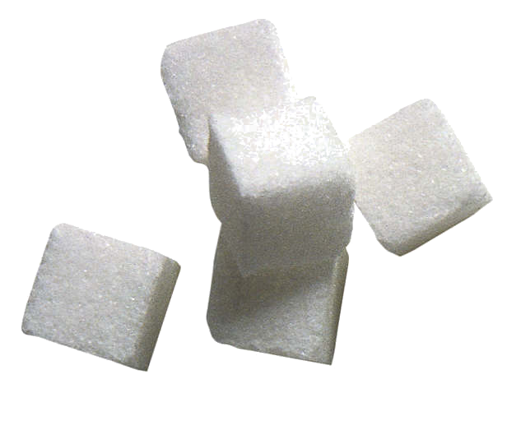
Can you find the Sphere?

Slide 11
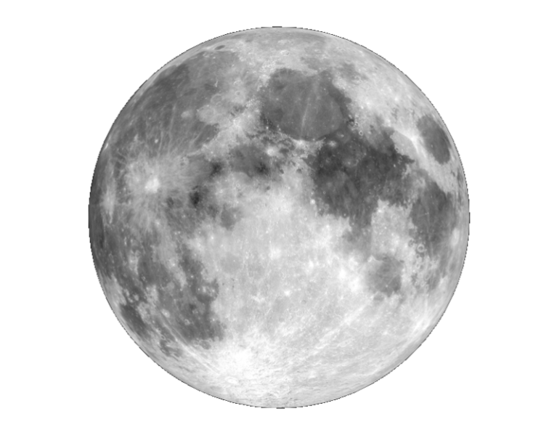
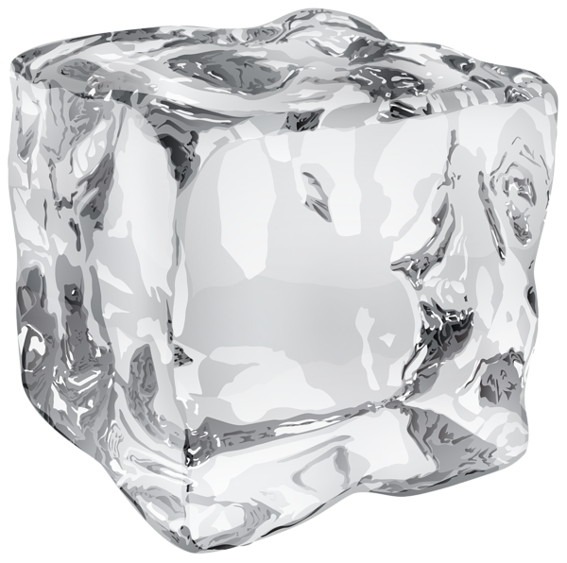
Can you find the Sphere?

Slide 12
Can you find the Sphere?

Slide 13
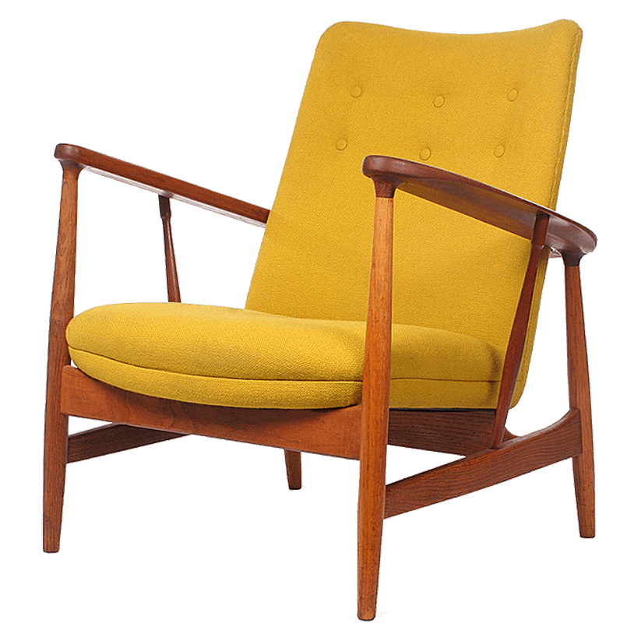
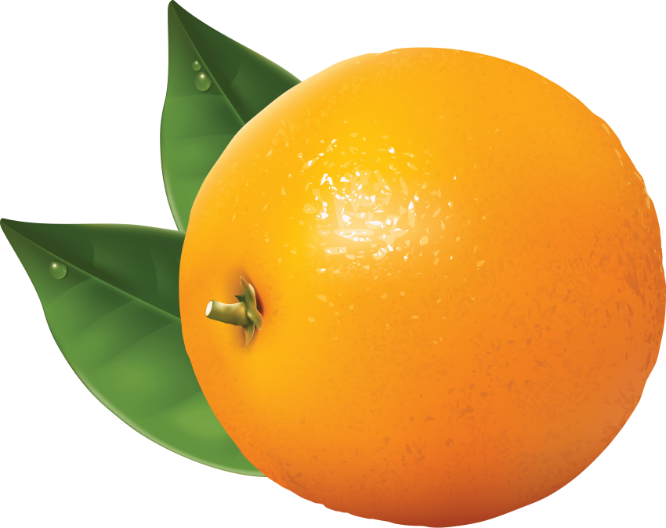
Can you find the Sphere?

Slide 14
Can you find the Sphere?

Slide 15
You are Stellar!

