Slide 2
5.6 Investigating shadow lengths

Slide 3
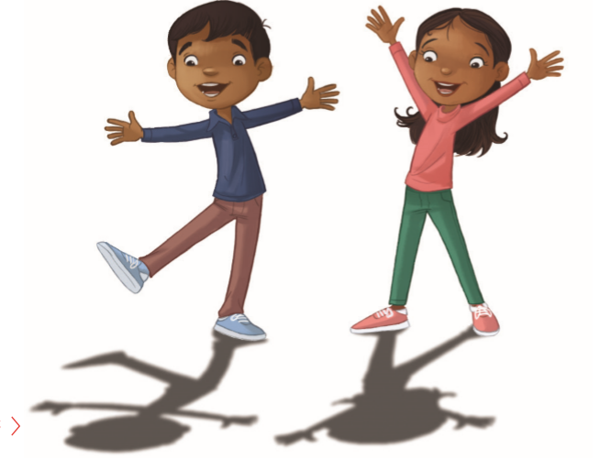
1-What is the source of light in this picture?
2 What is blocking the light?
3 What results from blocking the light? hat is the source of light in this picture? 2 What is blocking the light? 3 What results from blocking the light?

Slide 4
Our objectives for this lesson:
Determine the apparent movement of the Sun.
Determine why shadow is formed and the change in shadows.

Slide 5
Our new Vocabulary.
Apparent movement

Slide 6
Watch the following video to know how shadows are formed.

Slide 7
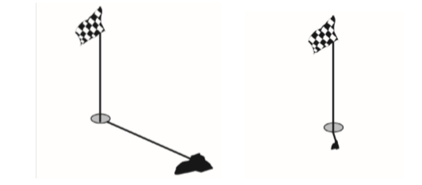
Lb. p. 117
1- What causes the shadows?
The golf flag and the stick block the light from the sun.
2 What is the difference between the two shadows?
They are different length and different directions.
3 Which shadow do you think was formed at midday and which shadow was formed in the late afternoon?
The short shadow is the midday one and the long shadow is formed in the late afternoon.
4 Why do you think the shadows are different at different times of day?
The Earth spins on its axis once every 24 hours.
Wrong answer:( the sun moves across the sky throughout the day)

Slide 8
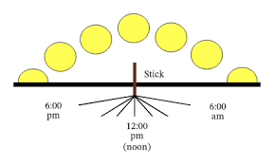
Investigate the changing length and position of a shadow
The sun was low in the sky in the early morning and the shadow was long.
The sun was high in the sky at midday and early afternoon the shadow was short .
The sun was low in the sky in late afternoon and the shadow was long.

Slide 9
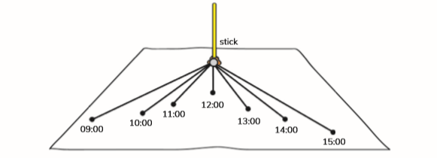
So…….
The shadow started long in the early morning .
Became shorter up to about 13:00
And then became longer again.

Slide 10
Some children did a shadow stick experiment.
Read these sentences about shadow length at different times of the day.
Choose and write down the correct alternatives.
a Between 08:00 and midday the shadow becomes shorter / longer.
b Between midday and 16:00 the shadow becomes shorter / longer.
c The shadow is longest / shortest at sunrise and sunset.
d The shadow is longest / shortest in the middle of the day.
e The changes in shadow length are because the Earth spins on its axis / the Sun moves across the sky.

Slide 11
Thank you

