Slide 1
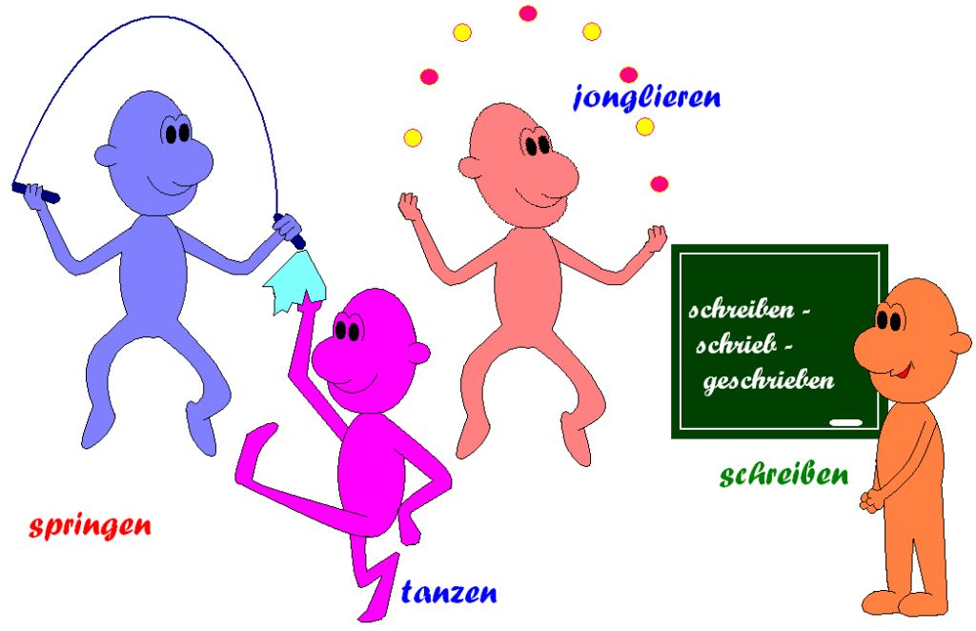
Imperative
Verben
This Photo by nknown Author is licensed under CC BY-SA

Slide 2
Was ist das ?

Slide 3
Klatsch!

Slide 4
Renn!

Slide 5
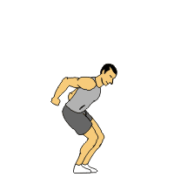
Hüpf!
This Photo by Unknown Author is licensed under CC BY-NC-ND

Slide 6
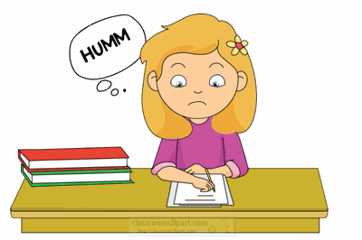
Schreib!
This Photo by Unknown Author is licensed under CC BY-SA-NC

Slide 7
Lies!

Slide 8
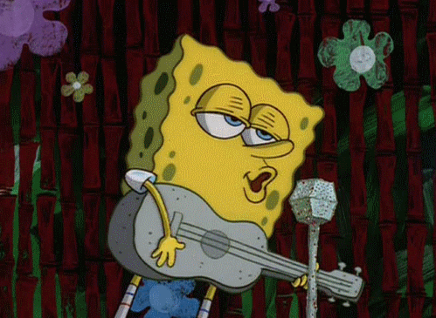
Sing!

Slide 9
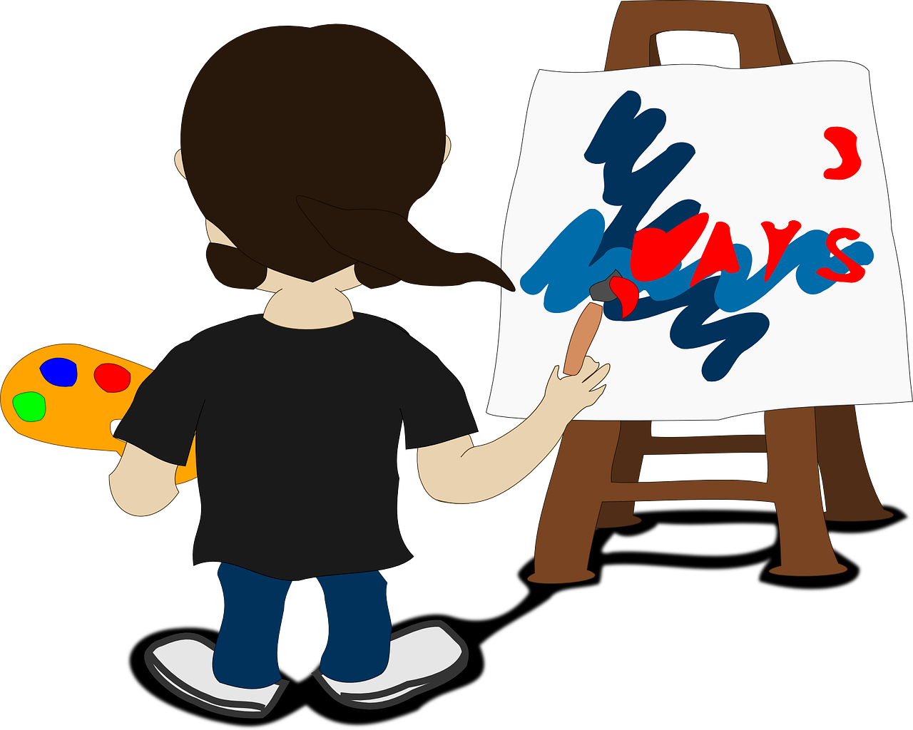
Mal!

Slide 10
Übungen
Steh auf und mach mit mir!
Renn ...
Klatsch....
Hüpf....
SEHR GUT

