Slide 1
Year 7 Suffix ant-ent-able-ible-ism-ist
By: Ms. Malak

Slide 5
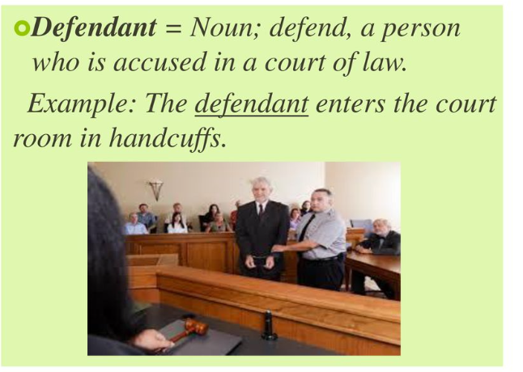

Slide 13
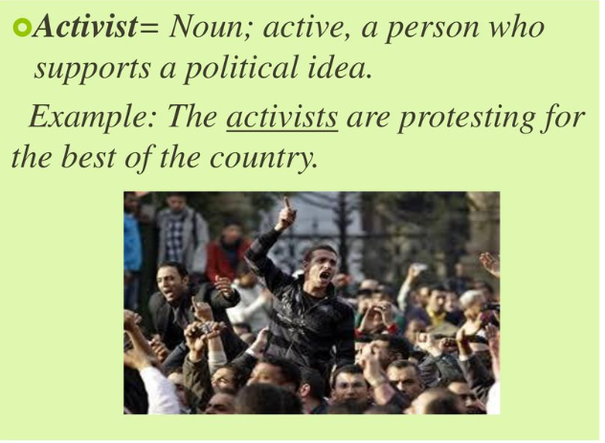

Slide 15
