Slide 1
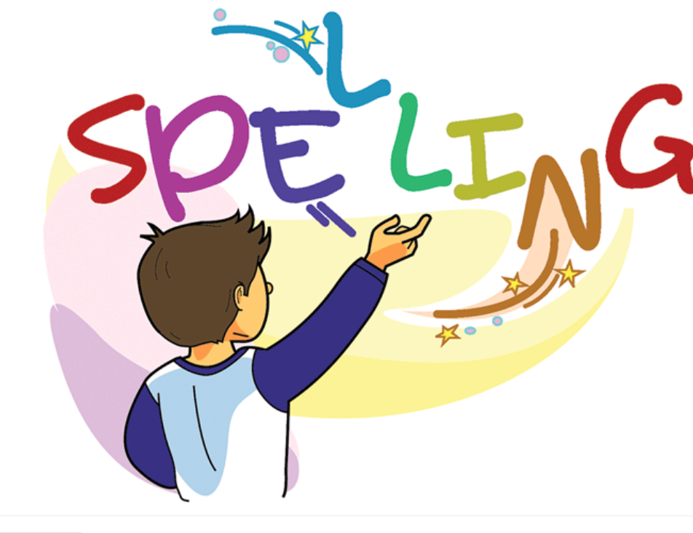

Slide 2
Spelling Test Simple Present Tense Adding “er” 10 minutes
First Session Completed

Slide 3
Adding “est” to Adjectives
Explain to students that adding “est” to an adjective is
called a superlative adjective.
Which compares 3 or more objects to each other.
The word “the” comes before the adjective.
Ex
Asia is the biggest continent
Superlative Adjective.

Slide 4
Spelling Words Adding “est” to the Adjective
nicest
If you say that something is the nicest, you mean that you find it very attractive, pleasant, or enjoyable.
These flowers are the nicest gift I ever got.

Slide 5
oldest
Someone who is the oldest has lived for many years more than the normal age and is no longer young.
My grandpa is the oldest man alive he is 120 years old.

Slide 6
youngest
A person who is the least old of a group, as the youngest member of a family.
My youngest sister is 1 month old.

Slide 7
smallest
The smallest person, thing, or amount of something is not large in physical size.
The ant is the smallest inscet.

Slide 8
longest
Something that is the longest measures a very great distance from one end to the other.
The Nile River is among the longest rivers on Earth.

Slide 9
strongest
Someone who is the strongest is very healthy with very good muscles and can move or carry very heavy things, or do very hard physical work.
The African bush elephant holds the strongest animal on earth.

Slide 10
shortest
Someone who is the shortest is not tall at all they are very short.
The shorest woman in the world is 63 cm tall.

Slide 11
weakest
If someone is the weakest, they are not healthy at all or do not have good muscles at all, so that they cannot move quickly or carry heavy things at all.
Snails are some of the slowest and, at the same time, one of the weakest animals on earth.

Slide 12
coldest
Something that is the coldest has a very low temperature or a lower temperature than is normal or acceptable.
Antarctica is the coldest place in the world

Slide 13
loudest
If a noise is the loudest, the level of sound is very high and it can be easily heard. Someone or something that is very loud produces a lot of noise.
The Blue Whale is one of the loudest animals in the world.

Slide 14
Thank You

