Slide 1
Year2 W9 L2
Non standard measurement
Science

Slide 2
Lesson Objective
Take measurements in non-standard units.

Slide 3
Video
Measuring! | Mini Math Movies | Scratch Garden
https://youtu.be/2wUsdsae0ro

Slide 4
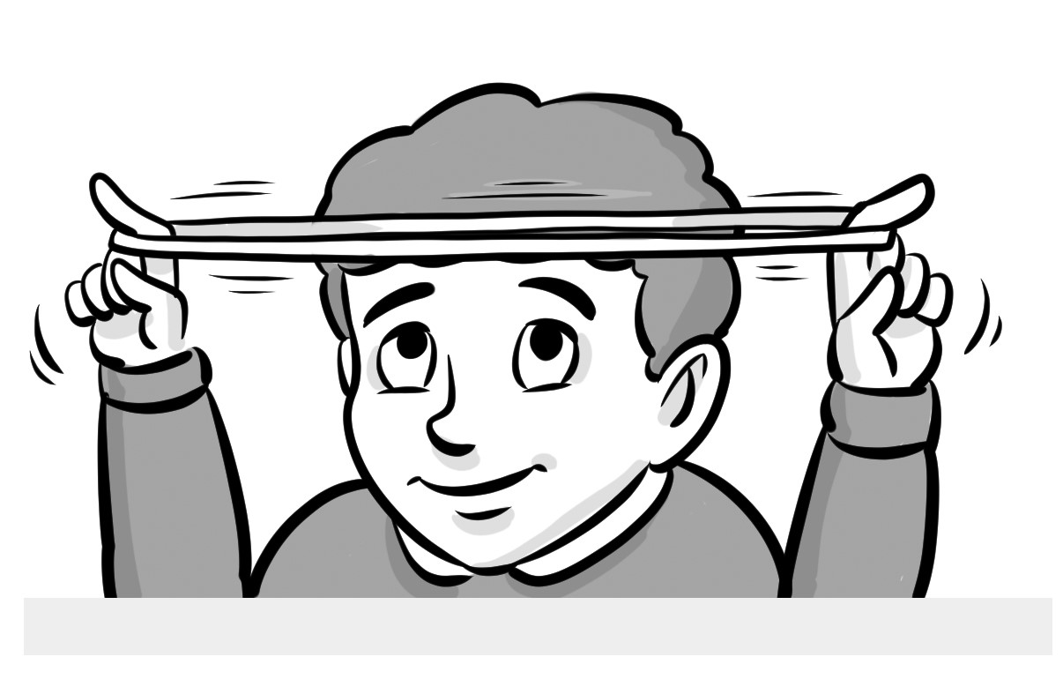
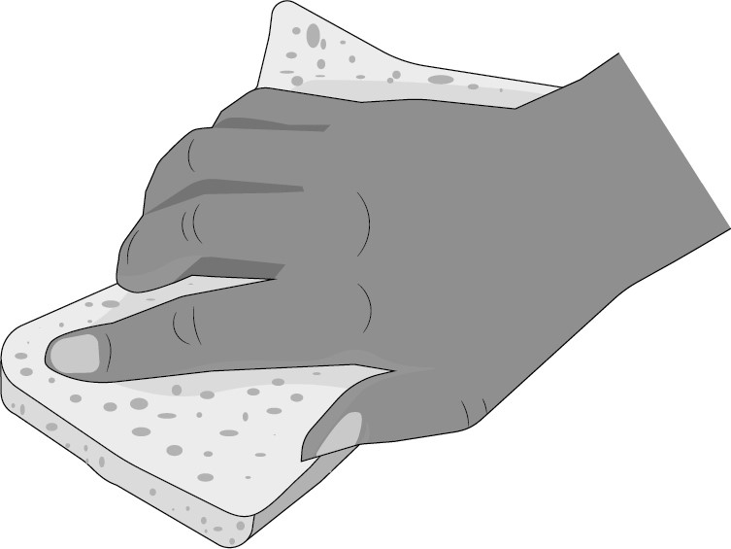
Vocabulary
Change shape
Stretch
Squash

Slide 5
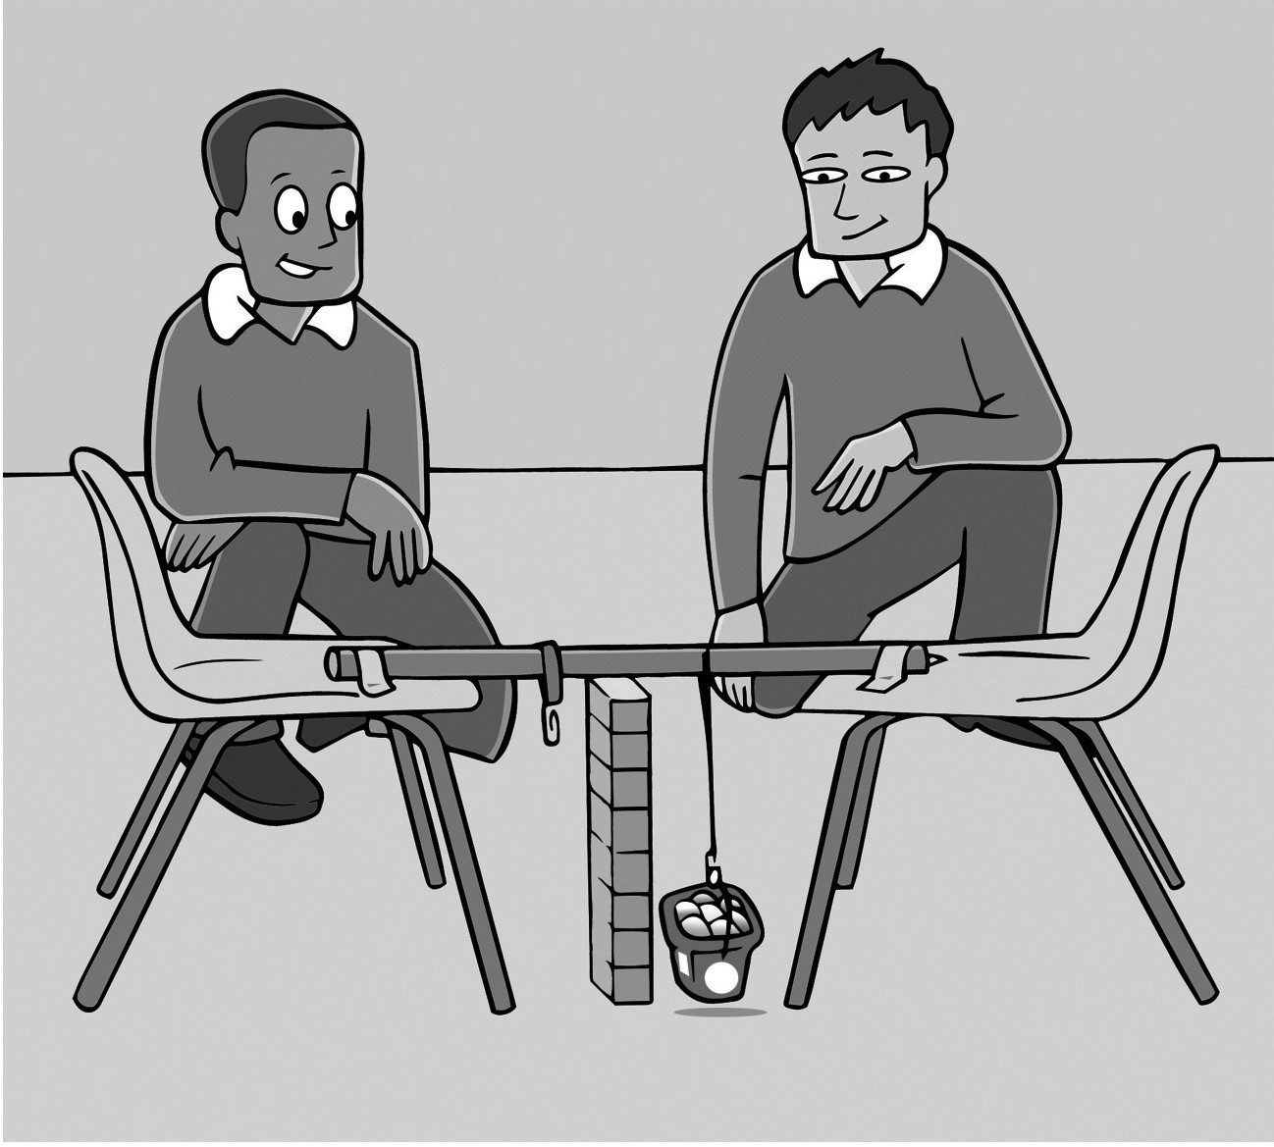
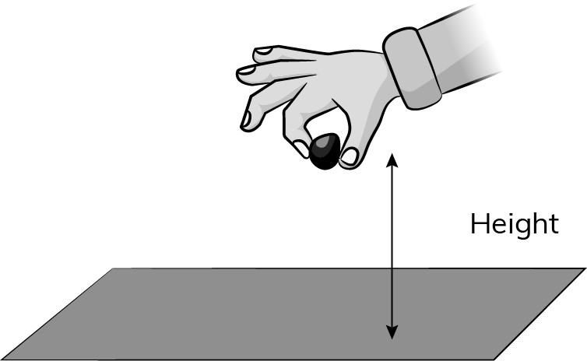
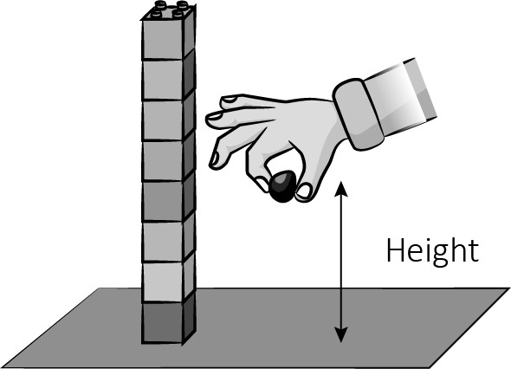
Vocabulary
Measure
Investigation
Hight

Slide 6
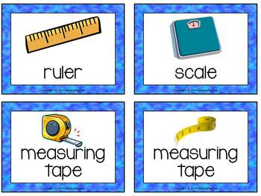
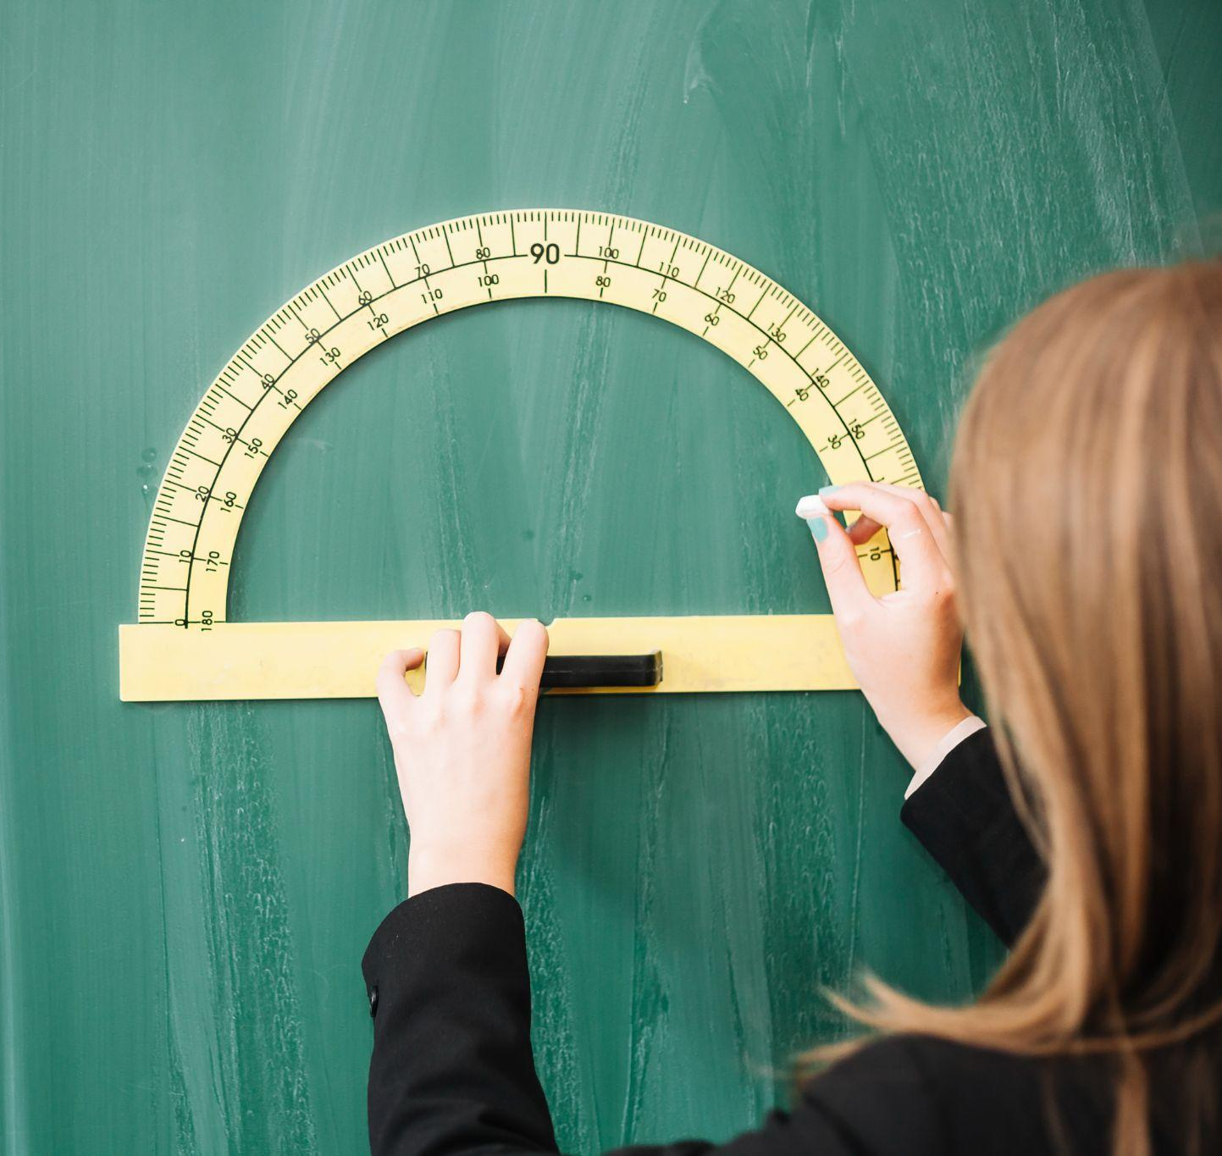
Which tools can I use to measure?

Slide 7
We can also use..

Slide 8
Let's measure

Slide 9
Now measure different things using your hands, rubbers, pencils, or any other suitable units.

Slide 10
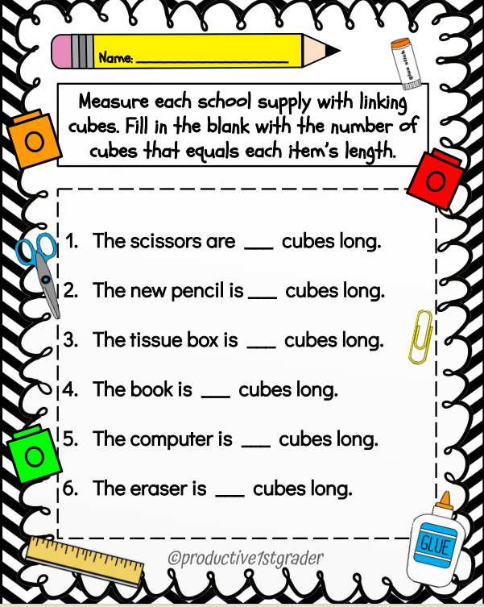
CW

Slide 11
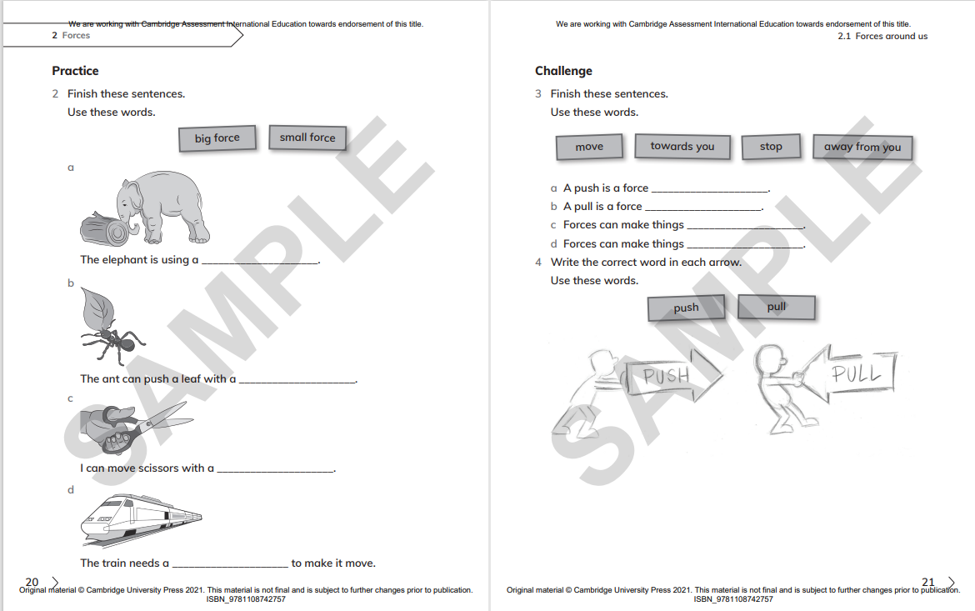
H.W

