Slide 2
Meet Number Ten
Hello, I am Number Ten. What do you notice about me? What do I have 10 of? My good friend, Number Five, has invited me to some beehives. We are going to plant some flowers for the bees. I will take some seeds with me.
How many seeds did you count?
10

Slide 3
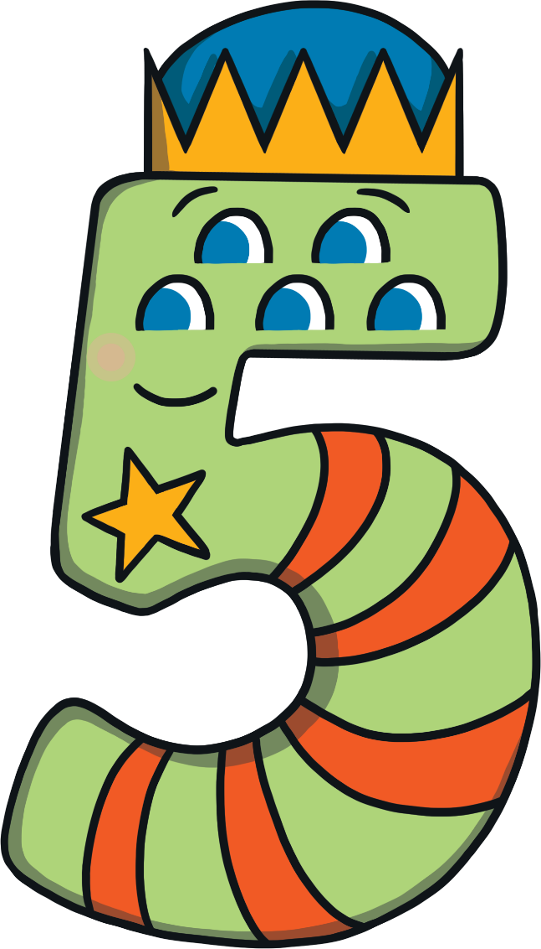
Meet Number Five
I am going to plant some flower seeds for the bees. How many do I have?
Hello, I am Number Five. What do you notice about me? What do I have 5 of?

Slide 4
Number Ten and Number Five arrived at the beehives. They were excited to see each other and they both had a funny feeling. Then, there were was a loud bang and…

Slide 5
…something magical happened!
I am Number Fifteen.

Slide 6
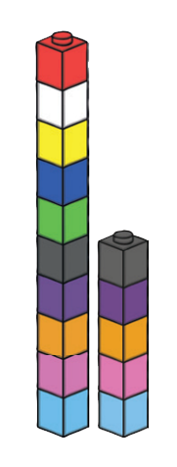
Cube Towers
This is the number 15 shown as towers of cubes.
Can you check that there are 15? How can you be sure?
15 is 1 tower of ten and 5 blocks more

Slide 7
Number Fifteen heard a buzzing sound. Suddenly, the bees arrived!
I can hear some more buzzing. Are more bees arriving?
I can see 10 bees and 5 bees. That’s 15 bees altogether.
How many bees are there?

Slide 8
Number Fifteen wanted to plant the flower seeds. Can you remember how many seeds Number Ten put in the seed packet?
Click on the seed packet that Number Ten brought to the beehives.

Slide 9
Can you remember how many seeds Number Five brought to the beehives? Click on the correct ten-frame.

Slide 10
We make 15.
I am 5.
I am one 10.

Slide 11
Number Fifteen needed some plant pots to plant her seeds in.
0
10
Try again.
Try again.
Try again.
Try again.
Try again.
Try again.
Try again.
Try again.
Try again.
Try again.
Try again.
Try again.
Try again.
Try again.
I need to plant these seeds in plant pot 15 but some of the numbers have fallen off. Can you click on the correct plant pot?
Thank you, this is plant pot 15. What number would come before 15?

Slide 12
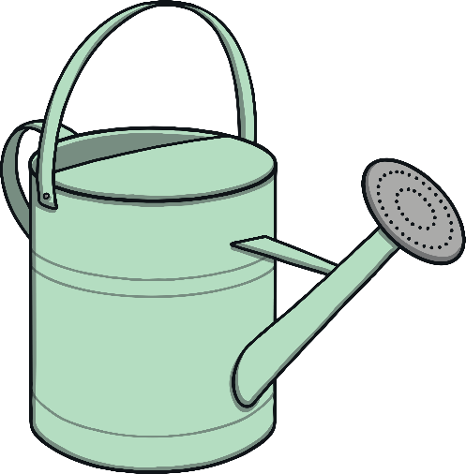
Next, Number Fifteen needed to water the seeds. She needed a watering can with enough water for 15 seeds. Which watering can do you think Number Fifteen used? How do you know it is the correct watering can?
ten
10
nine
9
fifteen
15
fifteen
15

Slide 13
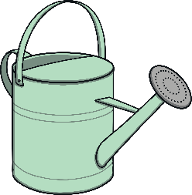
fifteen
15
fifteen
15
The flowers started to grow! How many flowers can you see? How many more flowers need to grow so that we have 15 flowers? Let’s water them and count. Click on the watering can.
Thank you, this is plant pot 15. What number would come before 15?
Do we have 15 flowers? How do you know?

Slide 14
We are 15.
I am 5.
I am one 10.
Thank you, this is plant pot 15. What number would come before 15?

Slide 15
It was time for Number Fifteen to go home. She started to have a funny feeling.

Slide 16
Suddenly, there was another loud bang!
What do you think is going to happen to me now?

Slide 17
Number Ten and Number Five said goodbye to each other and made their way home.

Slide 18
Number Lines
Can you spot the number 15 on the number line? Which numbers are next to number 15?
Click the hand to reveal the answer!
0
1
2
3
4
5
6
7
8
9
10
11
12
13
14
15
16
17
18
19
20

Slide 19
Number Lines
20
How about this number line?
Can you spot the number 15?
Is it in the same place?
19
18
17
16
15
14
13
12
11
10
9
8
7
6
5
4
3
2
Click the hand to reveal the answer!
1
0

Slide 20
Can you find 15 on the number track? Click on Number Fifteen to move her onto the number track.
20
19
18
17
Which number comes before number 15? Which number comes after number 15? Can you spot any patterns when you look at the number track?
16
14
13
12
11
10

