Slide 1
Spelling
Year 4 – Term 2

Slide 2
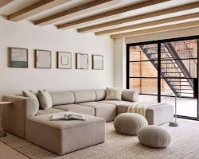
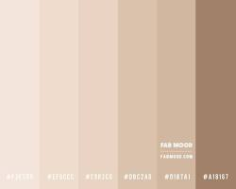
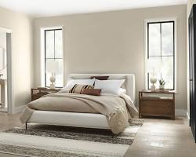

Slide 3
Beige (n.): Beige is a light brownish-yellow color, like the color of sand at the beach. Antonym: Brown Synonym: Cream
Sentence 1: I wore my beige jacket to school today.
Sentence 2: The cat curled up on the beige carpet for a nap.

Slide 4
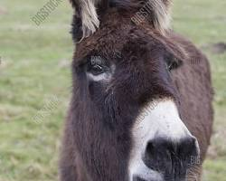
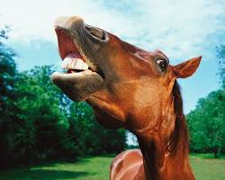
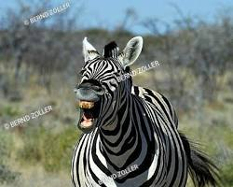
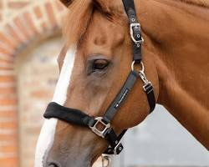

Slide 5
Neigh (v.): Neigh is the sound a horse makes. Antonym: No antonym for neigh Synonym: Whinny
Sentence 1: The horse neighed loudly when it saw its food.
Sentence 2: I can hear the horses neighing in the stable.

Slide 6
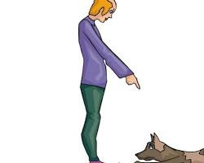
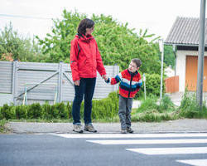
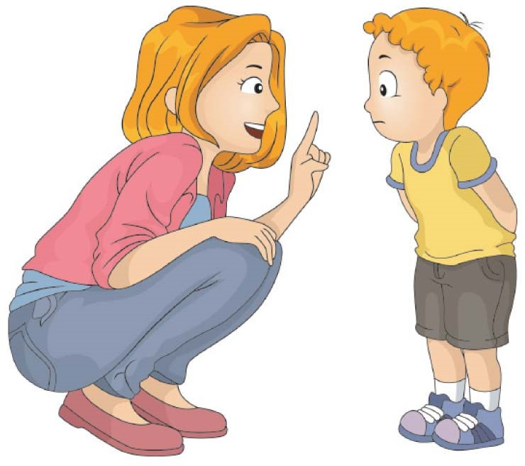
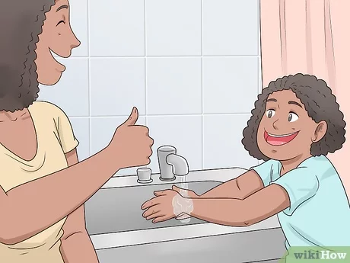

Slide 7
Obeyed (v.): Obeyed means to do what someone tells you to do. Antonym: Disobeyed Synonym: Listened
Sentence 1: The child obeyed her mother and brushed her teeth.
Sentence 2: The puppy wagged its tail when it obeyed the command to sit.

Slide 8
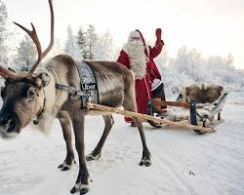
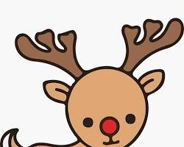
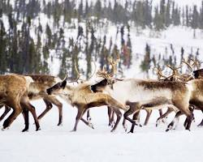
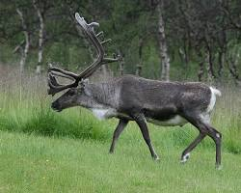

Slide 9
Reindeer (n.): A reindeer is a large deer with big antlers that lives in cold places like the North Pole. Antonym: No antonym for reindeer Synonym: Caribou
Sentence 1: Santa Claus rides a sleigh pulled by reindeer.
Sentence 2: Reindeer can be seen grazing in the snowy tundra.

Slide 10
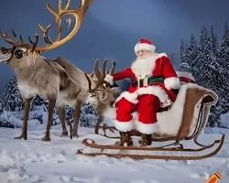
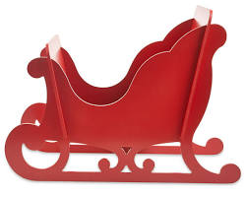
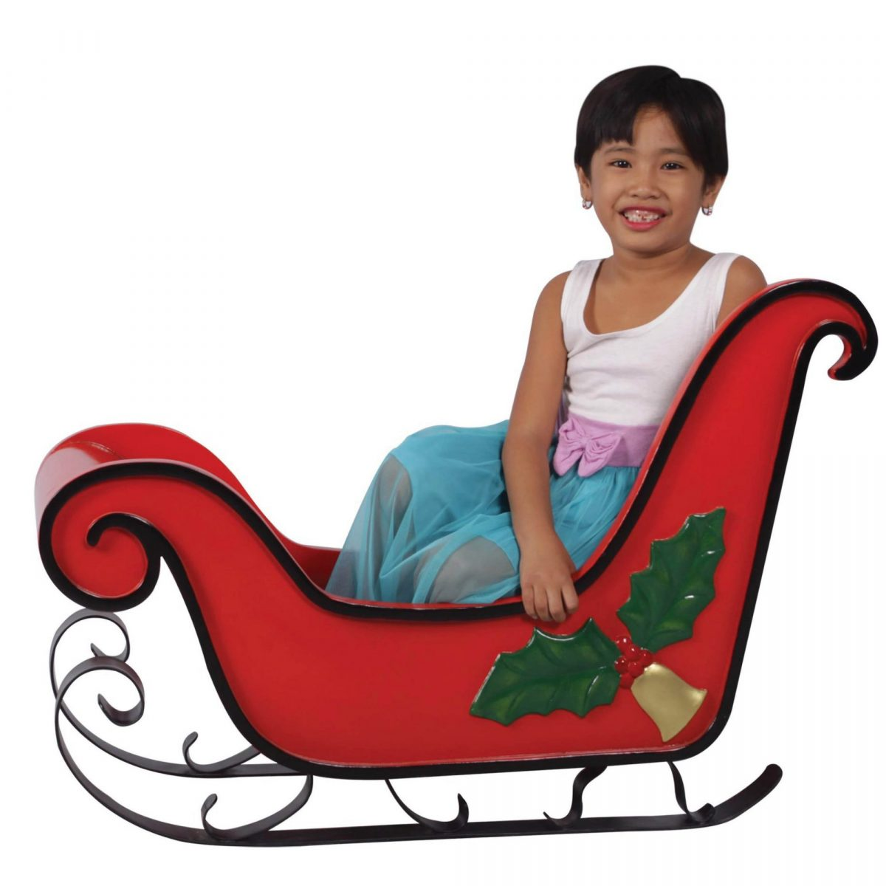
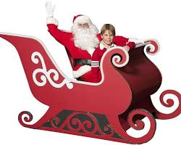

Slide 11
Sleigh (n.): A sleigh is a light carriage with runners instead of wheels, used for riding on snow. Antonym: Car Synonym: Sled
Sentence 1: We went for a sleigh ride through the winter wonderland.
Sentence 2: The children built a snowman and then went sledding down the hill.

Slide 12
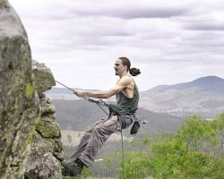
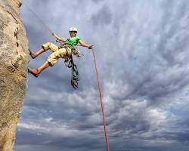
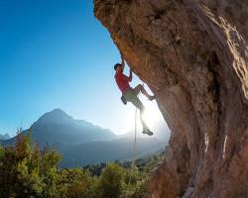
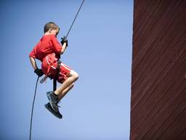

Slide 13
Abseil (v.): Abseil is to climb down a rock face by sliding down a rope. You use special equipment to do this safely. Antonym: Climb up Synonym: Rappel
Sentence 1: The climbers abseiled down the cliff face after reaching the summit.
Sentence 2: Abseiling is a fun activity that can be done outdoors with an adult.

Slide 14
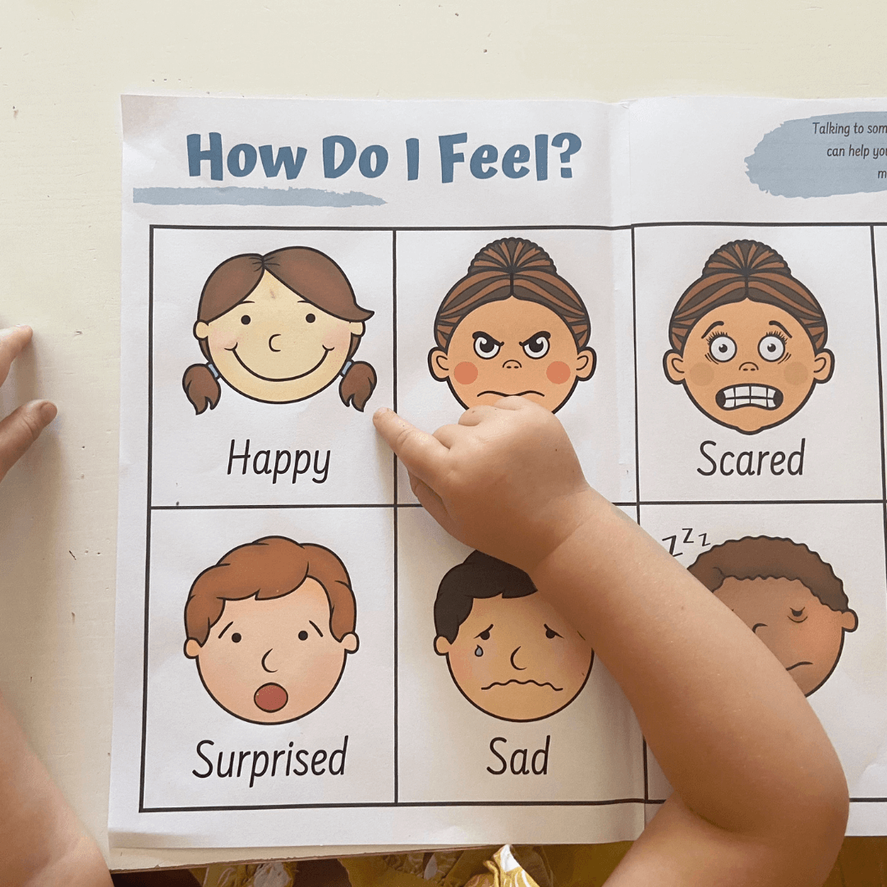
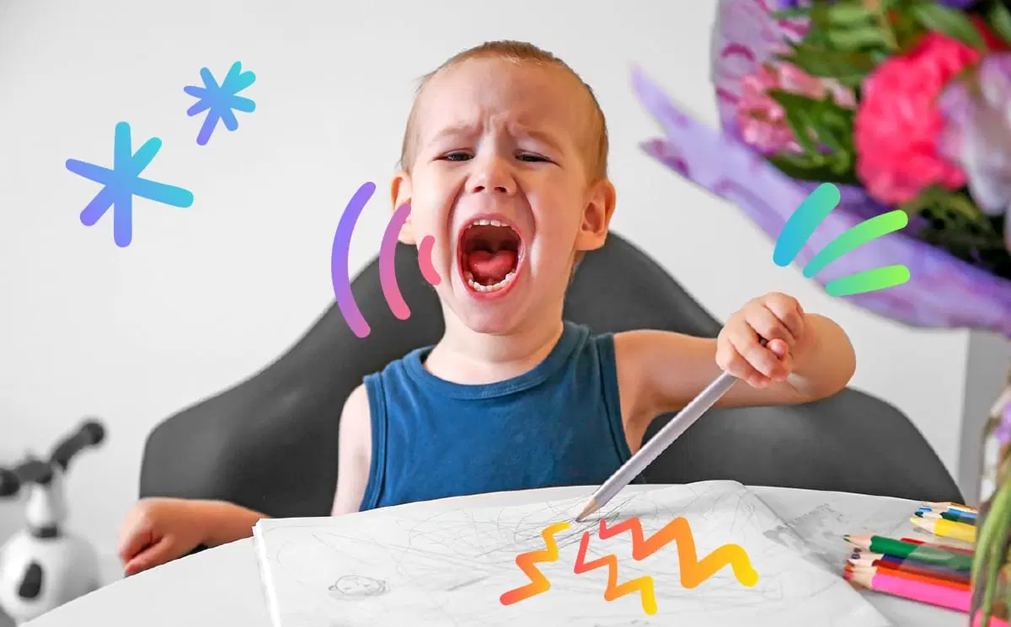
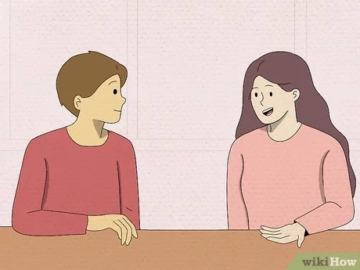

Slide 15
Convey (v.): to express an emotion or an idea. Antonym: close up Synonym: express
Sentence 1: the boy conveyed his anger through shouting.
Sentence 2: The postman conveys his happiness by singing.

Slide 16
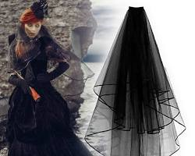
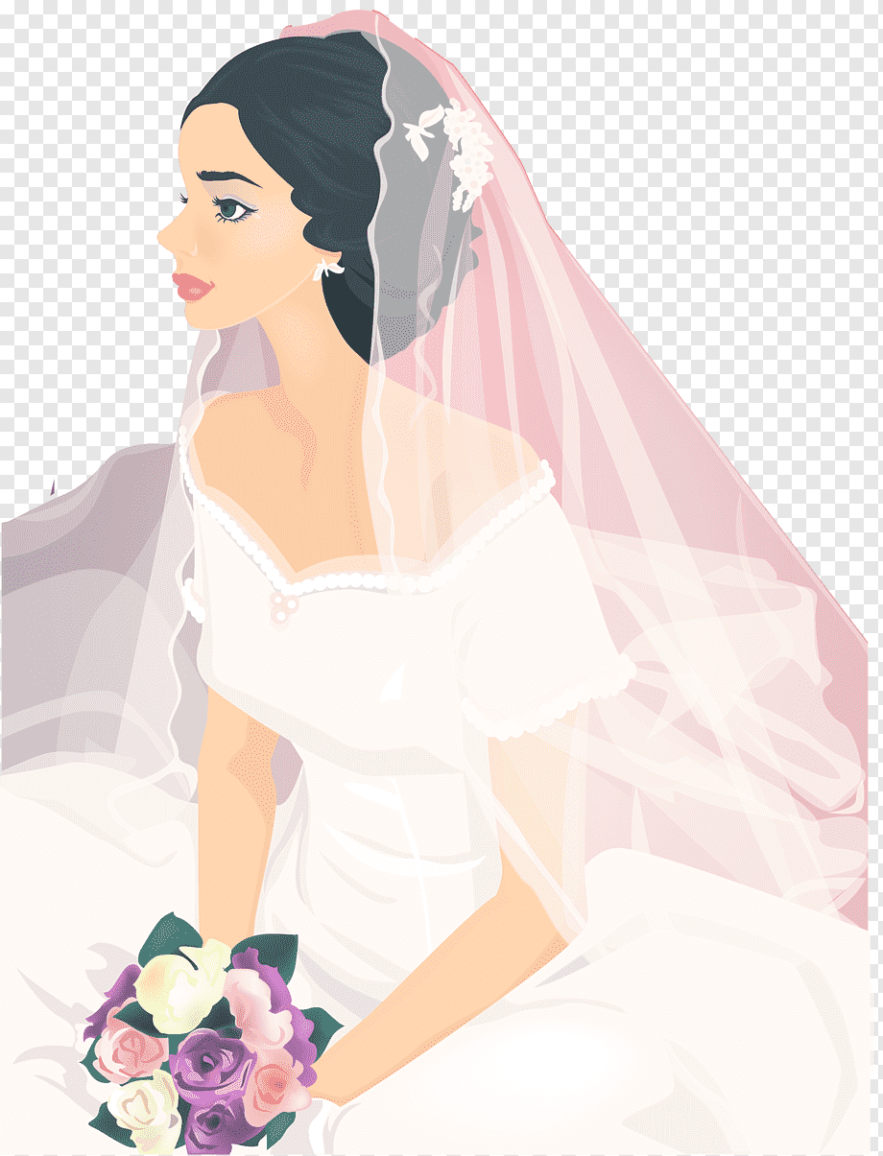
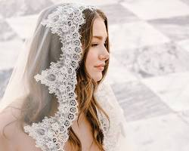

Slide 17
Veil (n.): A veil is a piece of fabric that covers all or part of someone's face. Antonym: No antonym for veil Synonym: Covering
Sentence 1: The bride wore a beautiful white veil at her wedding.
Sentence 2: Pirates sometimes wore veils to hide their identity.

Slide 18
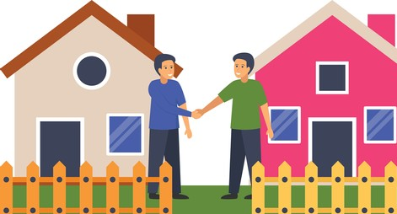
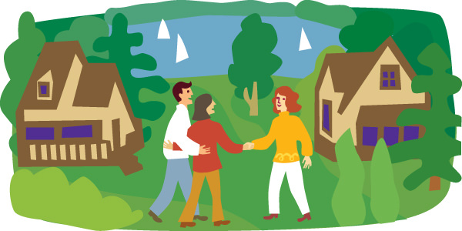
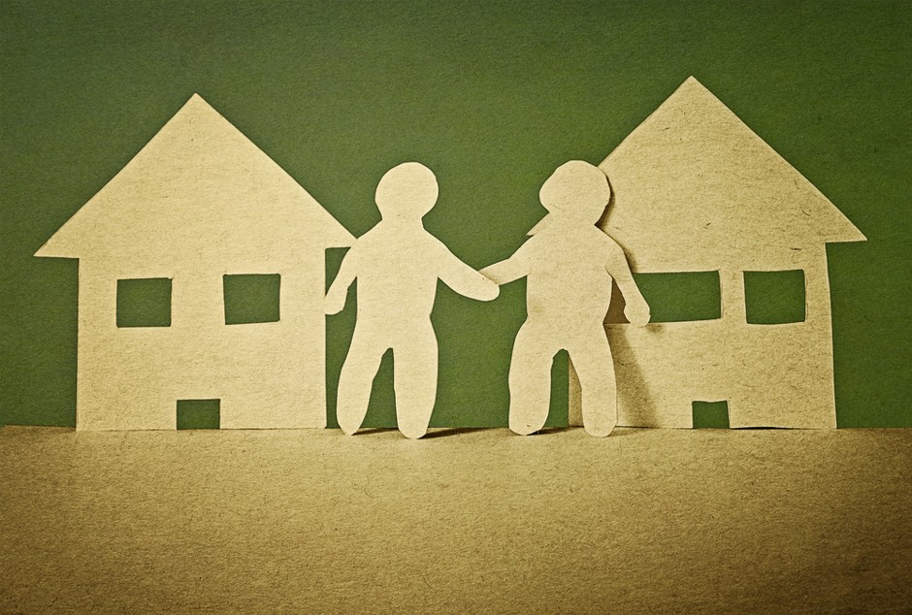

Slide 19
Neighbour (n.): Your neighbour is the person who lives next door to you.
Example sentences:
Sentence 1: We borrowed some sugar from our kind neighbour.
Sentence 2: It's always nice to have friendly neighbours.

Slide 20
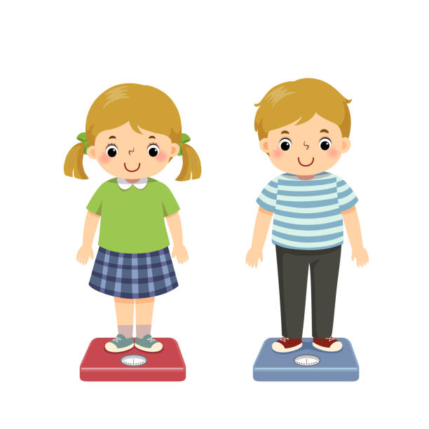
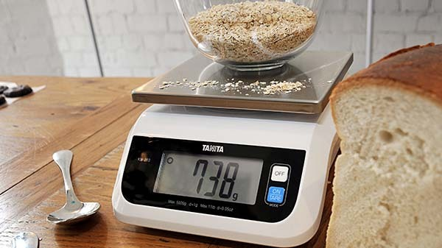
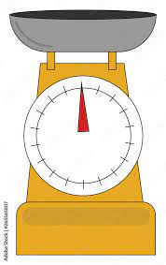

Slide 21
Weigh (v.): Weigh means to find out how heavy something is. Antonym: Light Synonym: Measure
Sentence 1: I can weigh myself on the scale in the bathroom.
Sentence 2: The baker weighs the ingredients carefully before baking a cake.

Slide 23
Grey (adj.): Grey is a color that is like the color of clouds or
Sentence 1: The cat has soft grey fur.
Sentence 2: The sky turned grey as the rain clouds gathered.

Slide 24
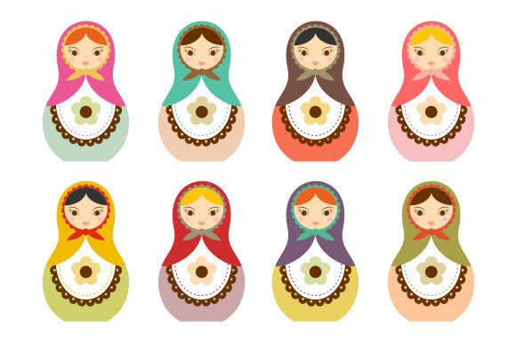
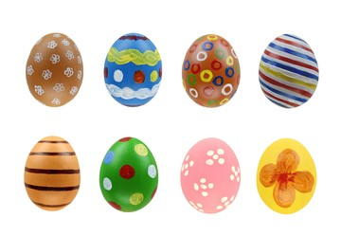

Slide 25
Eight (n.): Eight is a number that comes after seven and before nine.
Example sentences:
Sentence 1: I ate eight slices of pizza (a bit much!).
Sentence 2: There are eight legs on a spider.

Slide 26
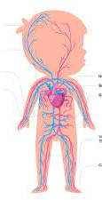
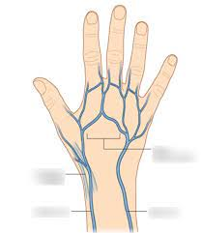

Slide 27
Vein (n.): A vein is a thin tube inside your body that carries blood back to your heart.
Sentence 1: You can sometimes see blue veins on your arm.
Sentence 2: Leaves have veins that transport water and nutrients.

Slide 28
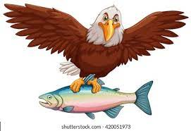
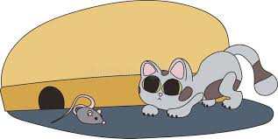
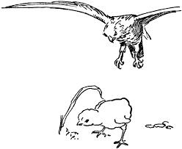
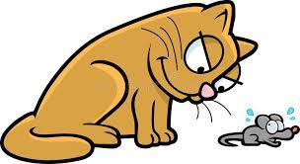

Slide 29
Prey (n.): Prey is an animal that is hunted by another animal for food. Antonym: Predator Synonym: Victim (in this context)
Sentence 1: The hawk swooped down to catch its prey, a small mouse.
Sentence 2: The spider patiently waited for its prey to get caught in its web.

Slide 30
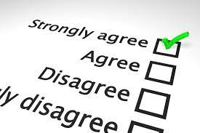
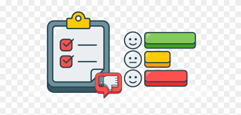

Slide 31
Survey (n.): A survey is a way of collecting information from a group of people by asking them questions. Antonym: No direct antonym, but "not asking questions" could be the opposite. Synonym: Poll
Sentence 1: Our teacher conducted a survey to see what our favorite subject was.
Sentence 2: The zookeepers did a survey to see which animals the visitors liked best.

