Slide 3
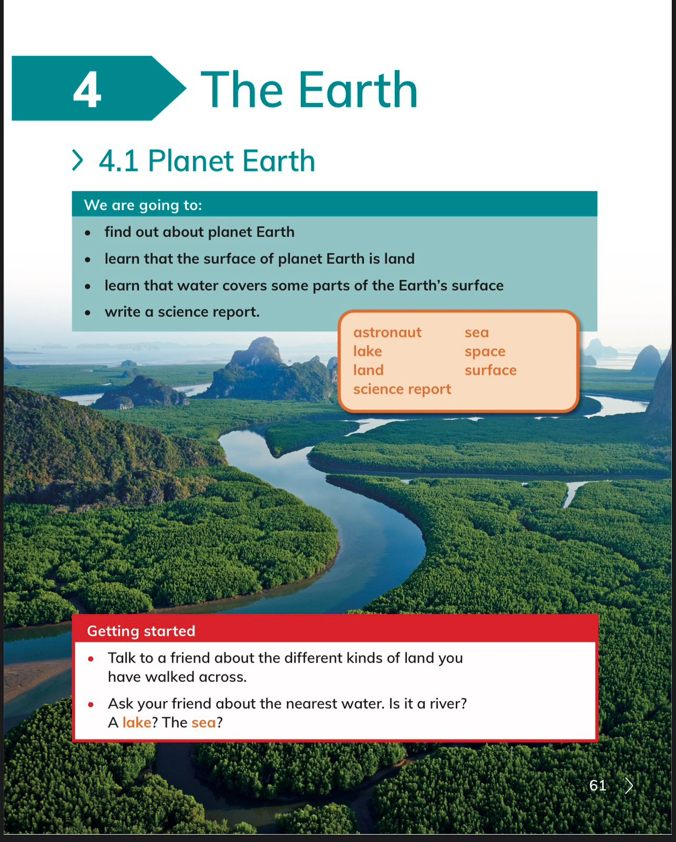

Slide 4
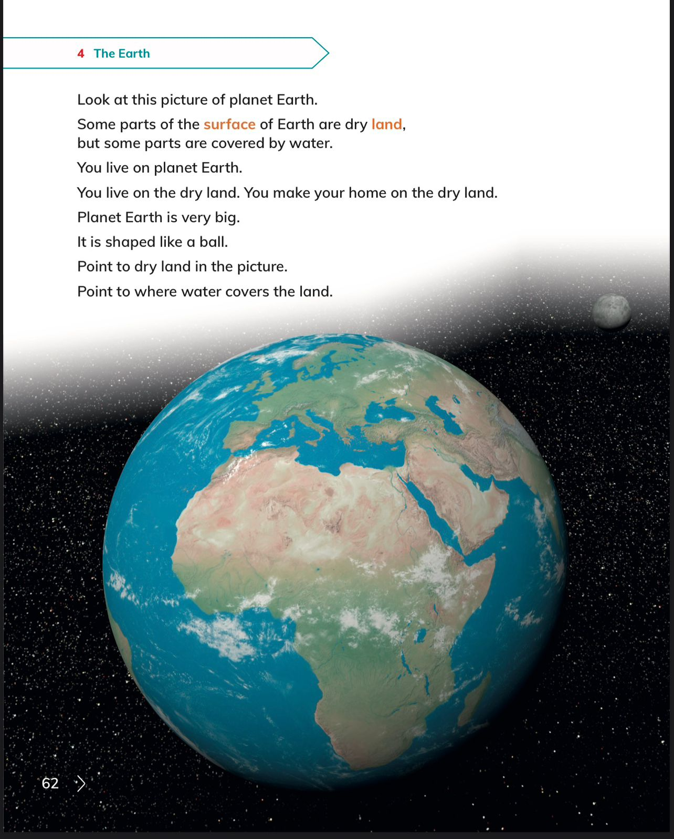

Slide 6
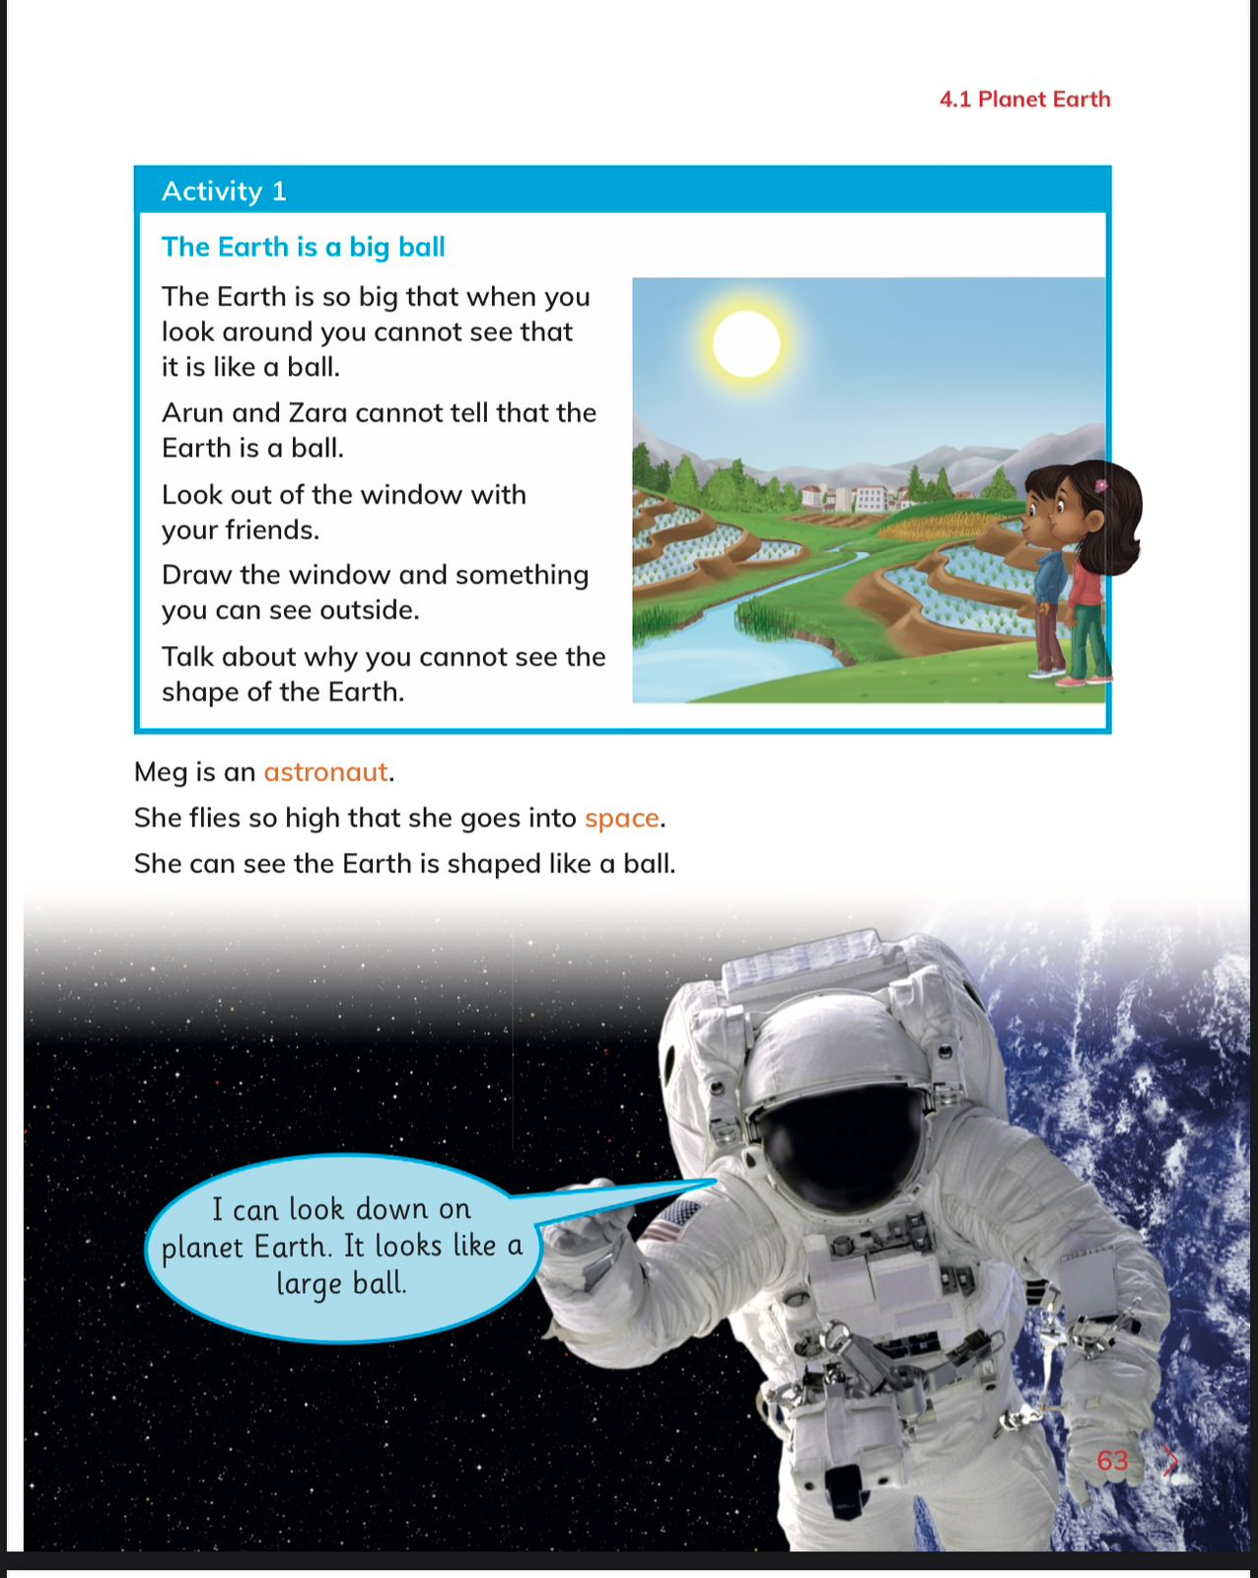

Slide 7
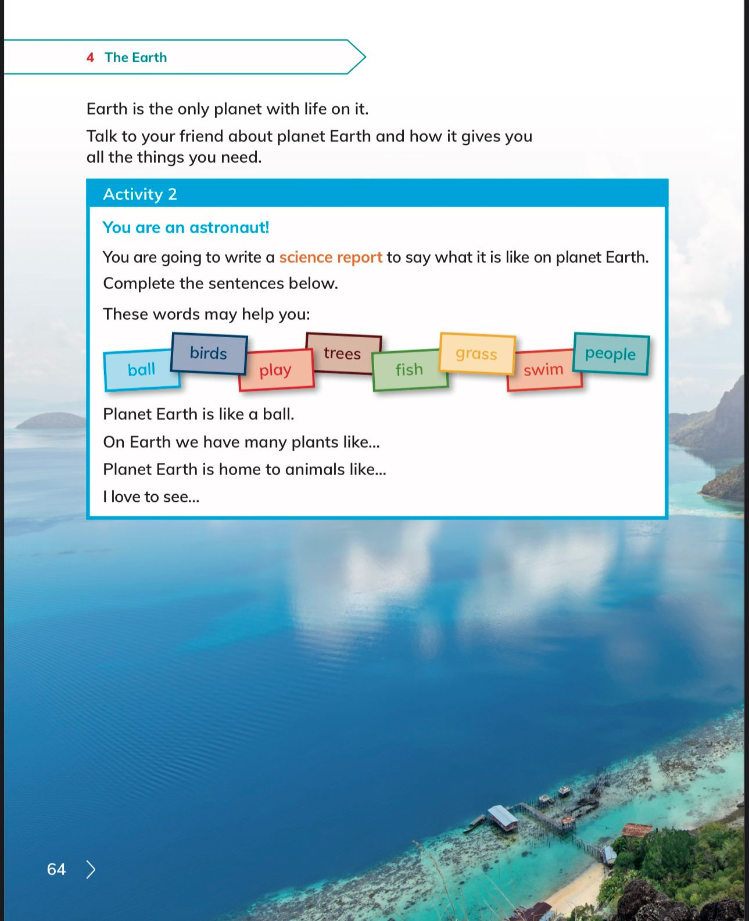

Slide 8
Students to solve pages 37,38,39 in workbook.
Worksheet page 1.

Slide 9
Lesson 2

Slide 12
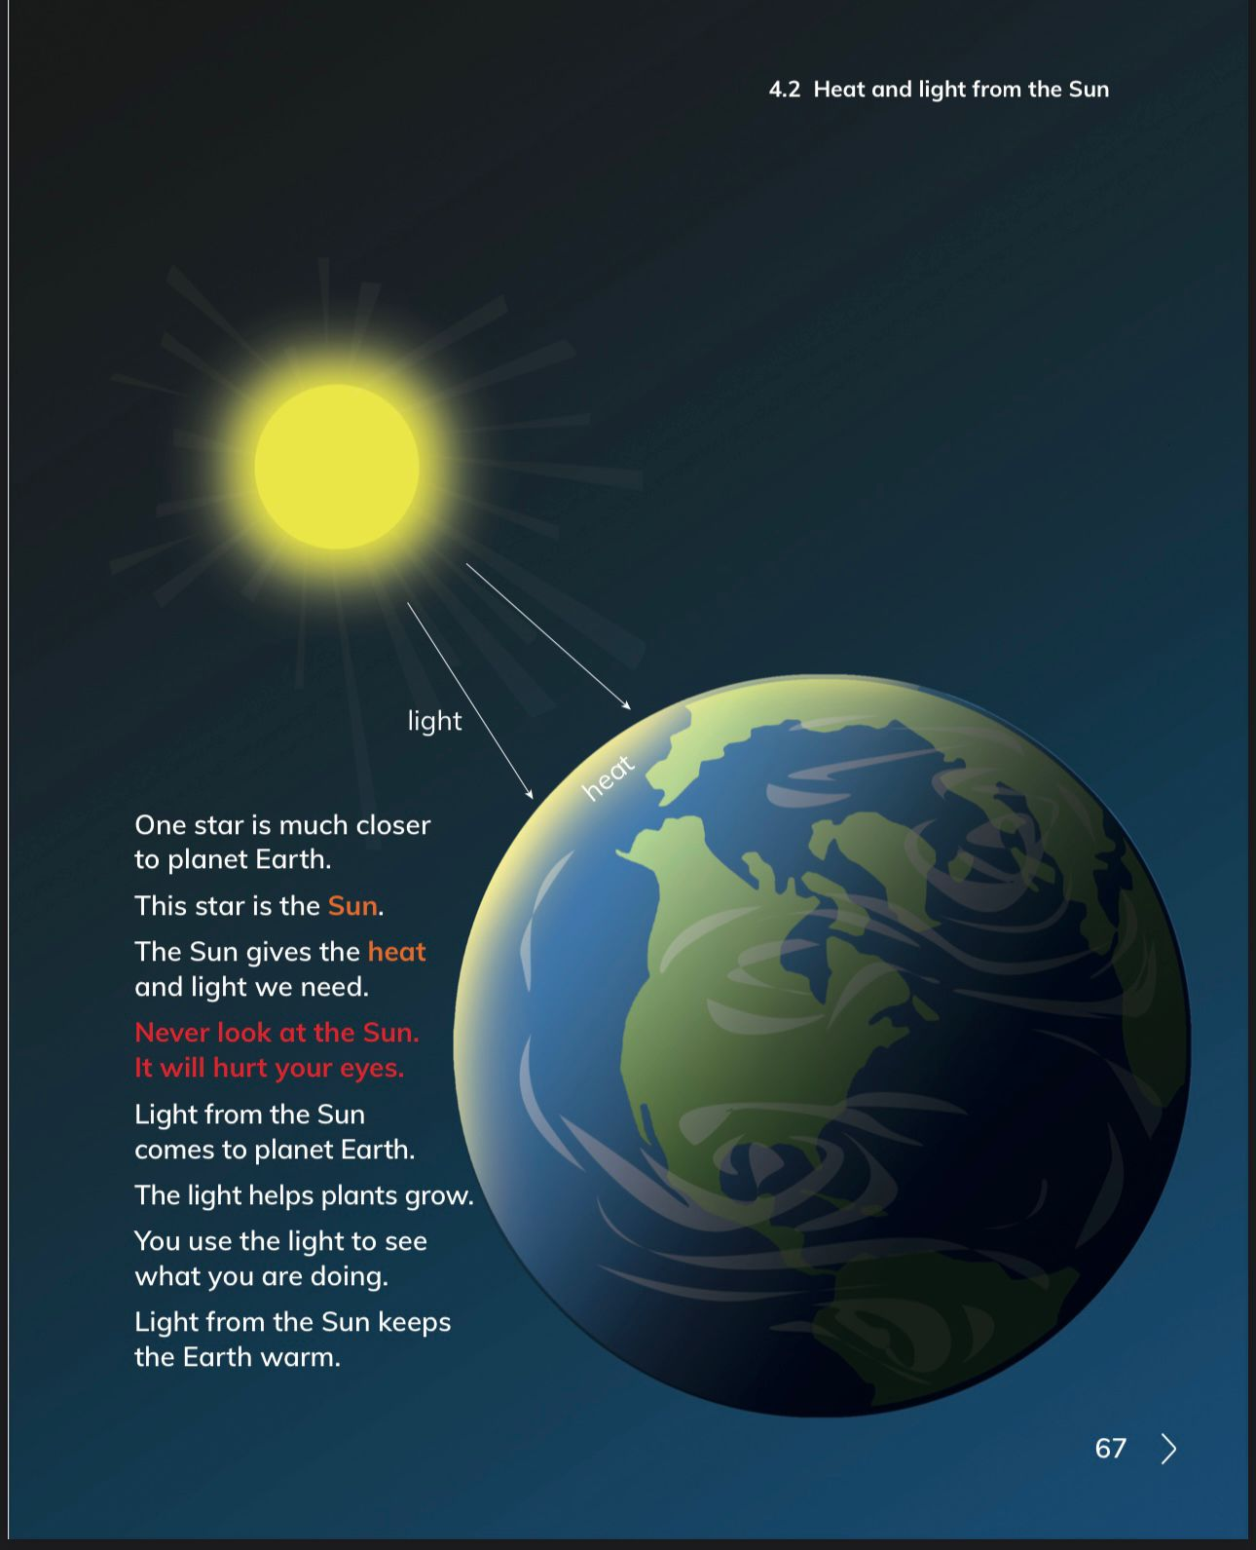

Slide 13
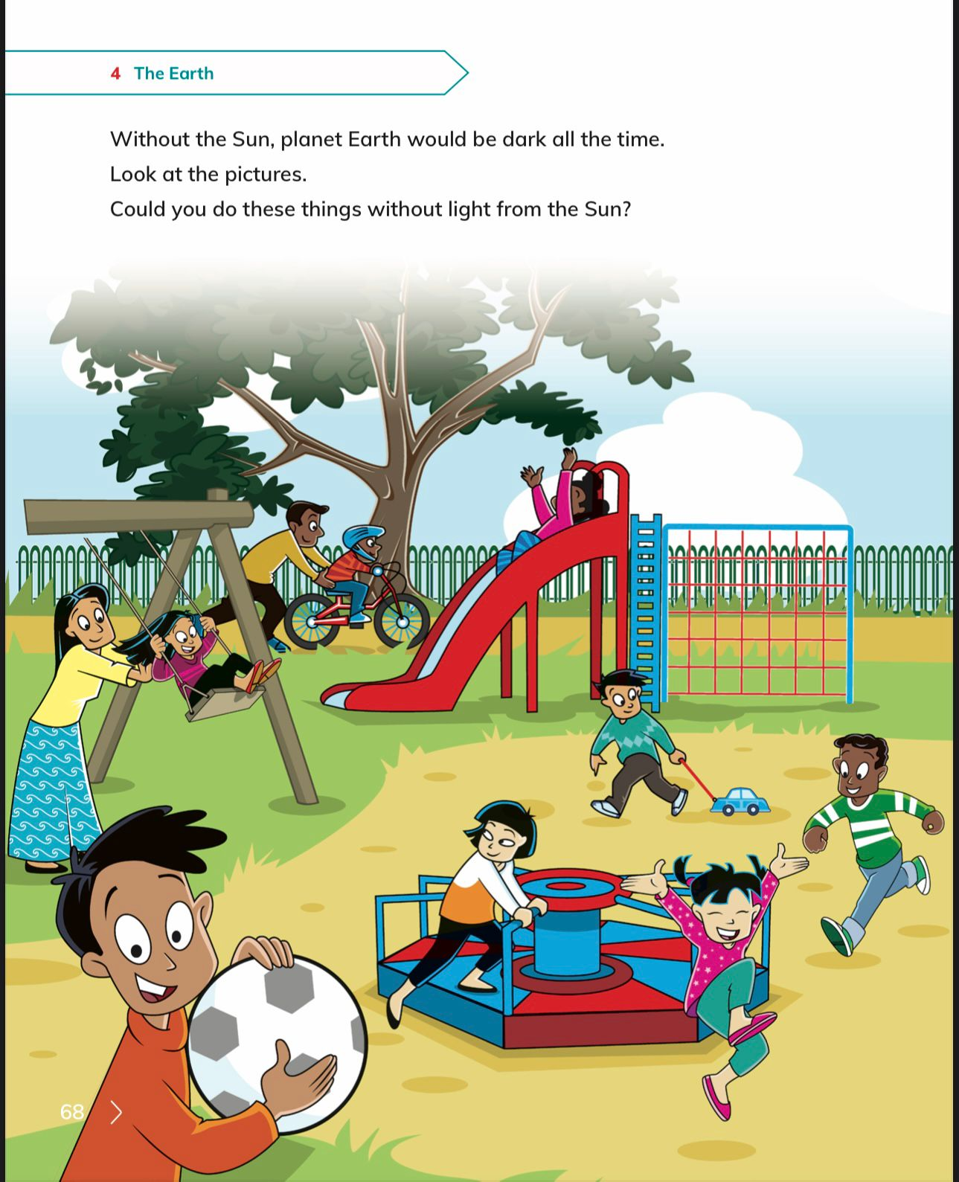

Slide 16
Students to solve pages 40, 41, 42, 43 in workbook.
Worksheet page 2.

Slide 17
Lesson 3

Slide 19
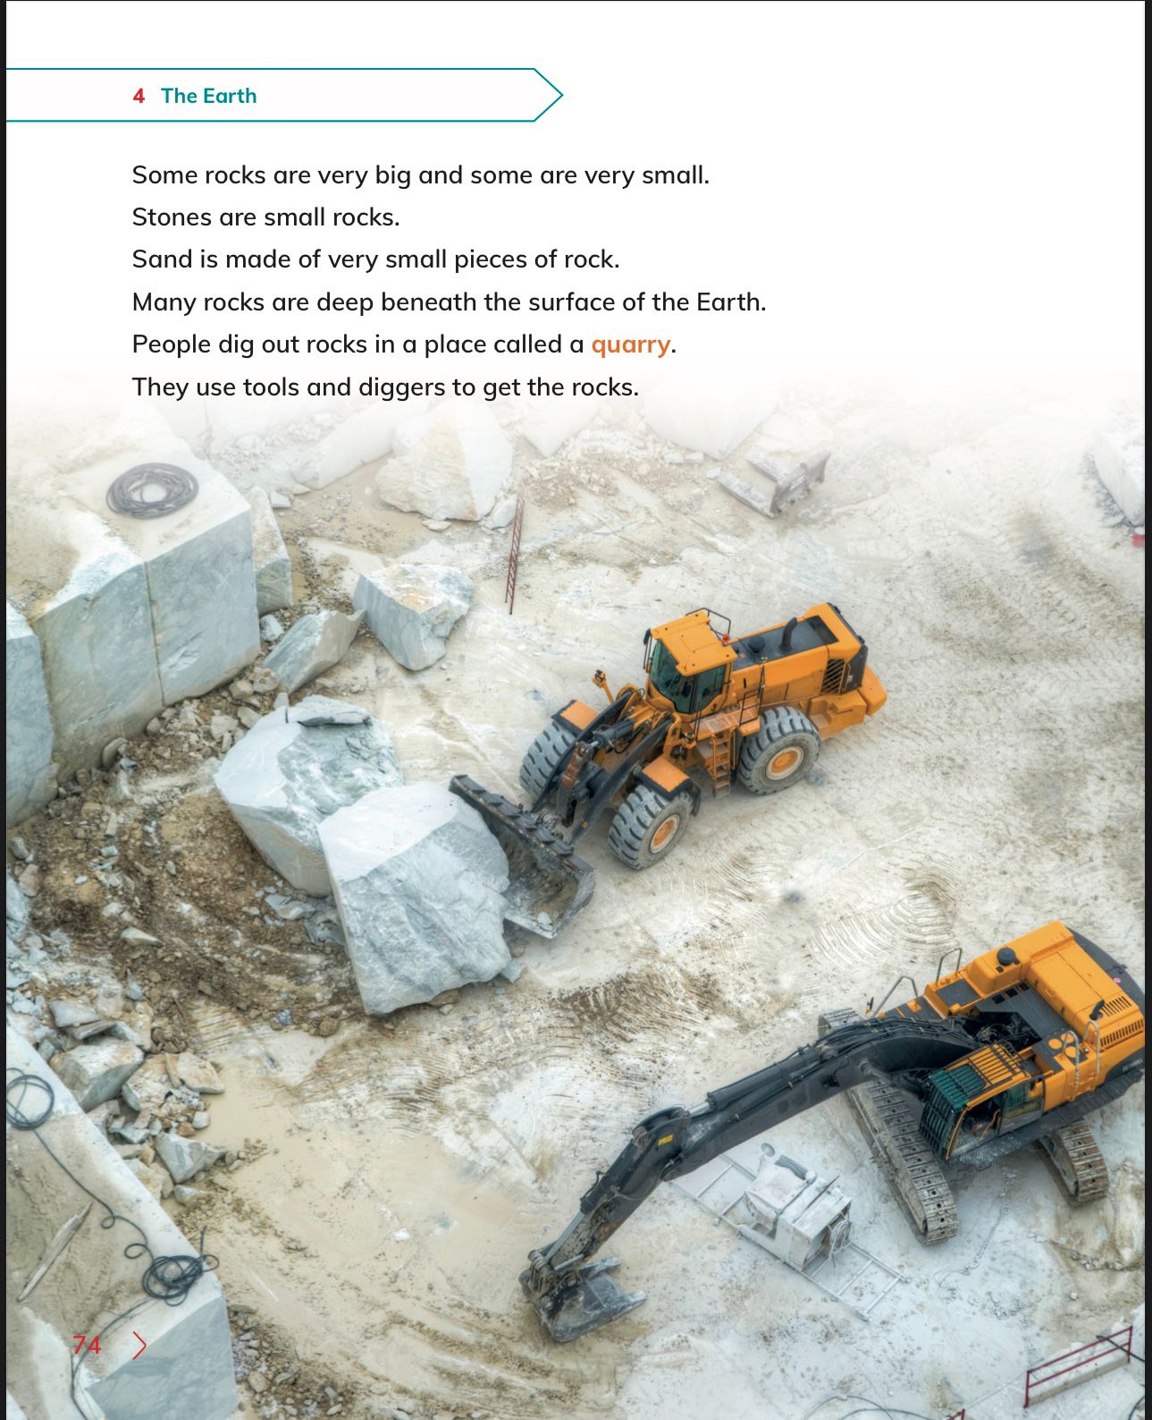

Slide 23
Students to solve page 4 in workbook.
Worksheet page 3.

Slide 24
Lesson 4

Slide 27
Students to solve page 46 in workbook.
Homework page 45 in workbook.

