Slide 2
How can we say this in English?
?
Rainy

Slide 3
How can we say this in English?
?
Sunny

Slide 4
How can we say this in English?
?
Snowy

Slide 5
How can we say this in English?
?
Cloudy

Slide 6
How can we say this in English?
?
Stormy

Slide 7
How can we say this in English?
?
Windy

Slide 8
How can we say this in English?
?
Hot

Slide 9
How can we say this in English?
?
Cold

Slide 10
Let’s Practice
Can you remember how to say these words?
Click below the numbers to check the answer.

Slide 11
How’s the weather?
How’s the weather in this picture? Click on the pictures to check the answer.
Answer
?
?
Answer
?
?
?
?
Sunny

Slide 12
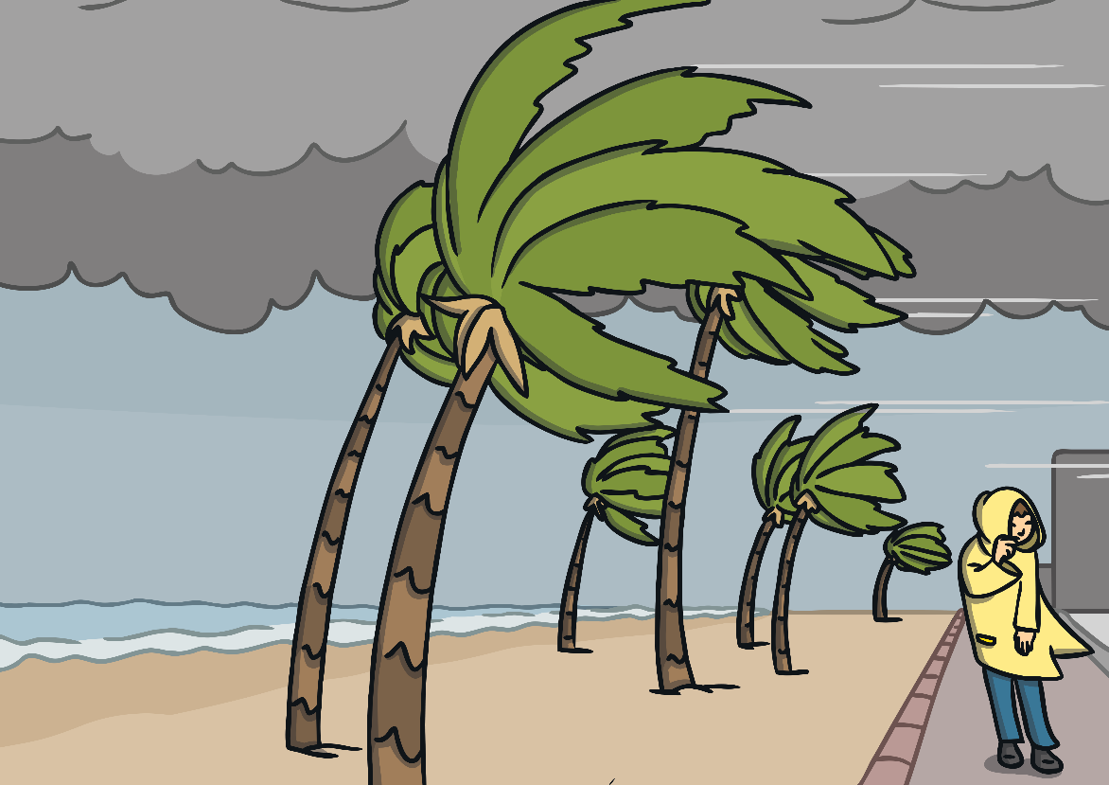
How’s the weather?
How’s the weather in this picture? Click on the pictures to check the answer.
Answer
?
?
Answer
?
?
?
?
Windy

Slide 13
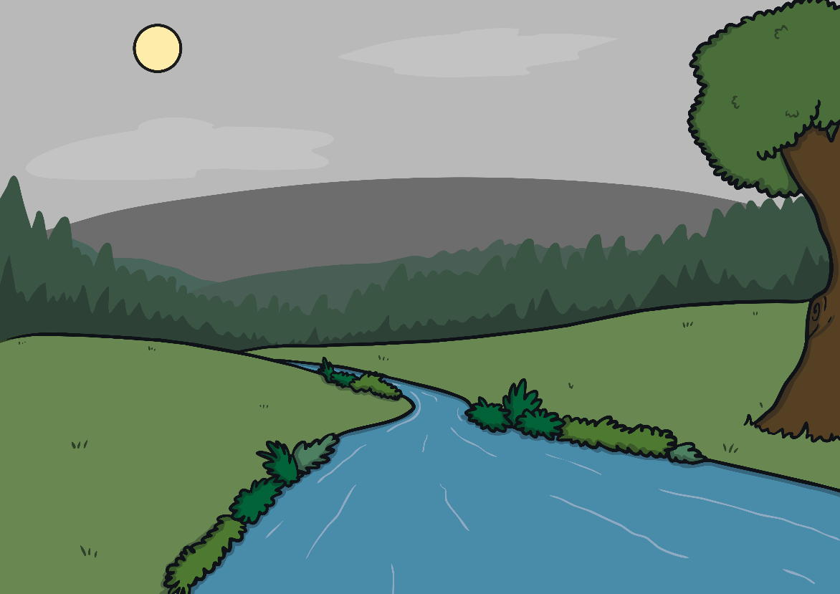
How’s the weather?
How’s the weather in this picture? Click on the pictures to check the answer.
Answer
?
?
Answer
?
?
?
?
Cloudy

Slide 14
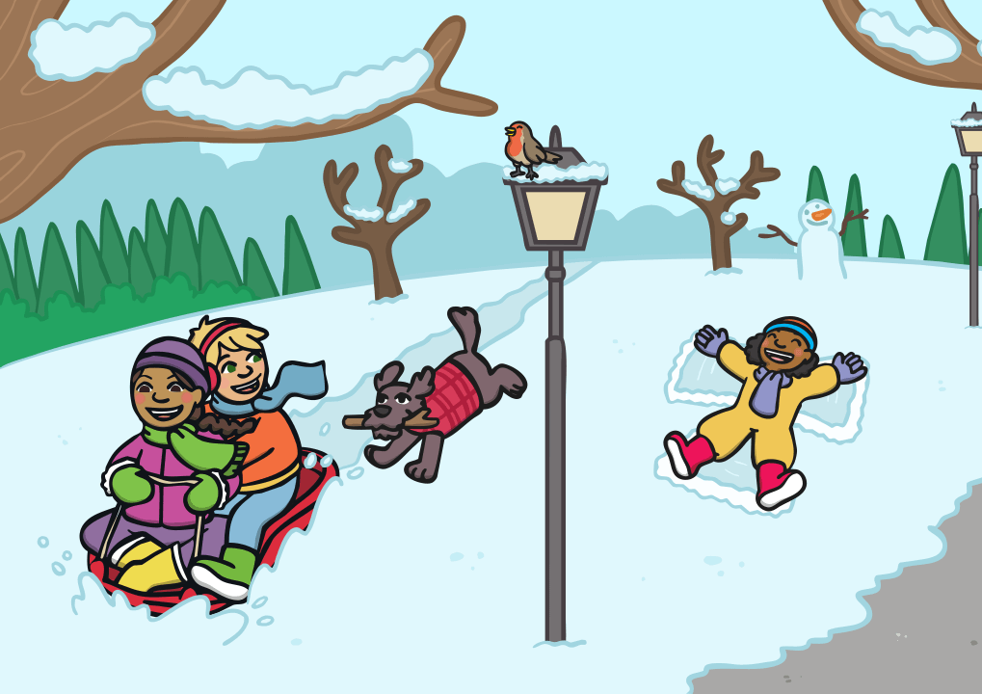
How’s the weather?
How’s the weather in this picture? Click on the pictures to check the answer.
Answer
?
?
Answer
?
?
?
?
Snowy

Slide 15
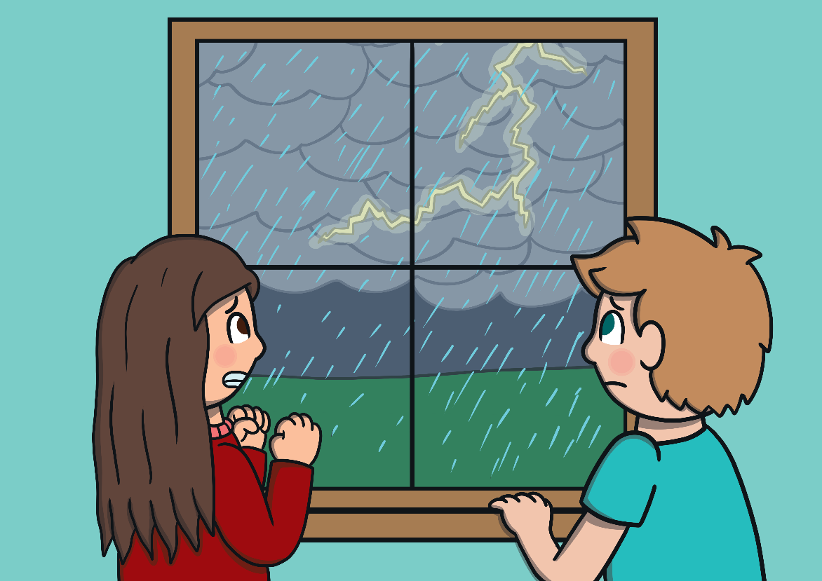
How’s the weather?
How’s the weather in this picture? Click on the pictures to check the answer.
Answer
?
?
Answer
?
?
?
?
Stormy

Slide 16
How’s the weather?
How’s the weather in this picture? Click on the pictures to check the answer.
Answer
?
?
Answer
?
?
?
?
Hot

Slide 17
How’s the weather?
How’s the weather in this picture? Click on the pictures to check the answer.
Answer
?
?
Answer
?
?
?
?
Rainy

