Slide 1
English

Slide 2
Lessons Objectives
By the end of the lesson, learners will be able to :
read the new words.
read the new words.
read the new words.
understand what conjunctions mean
01
identify the meaning for the new words.
identify the meaning for the new words.
identify the meaning for the new words.
02
use the new vocabulary in their writing.
03
use the new vocabulary in their writing.
04

Slide 3
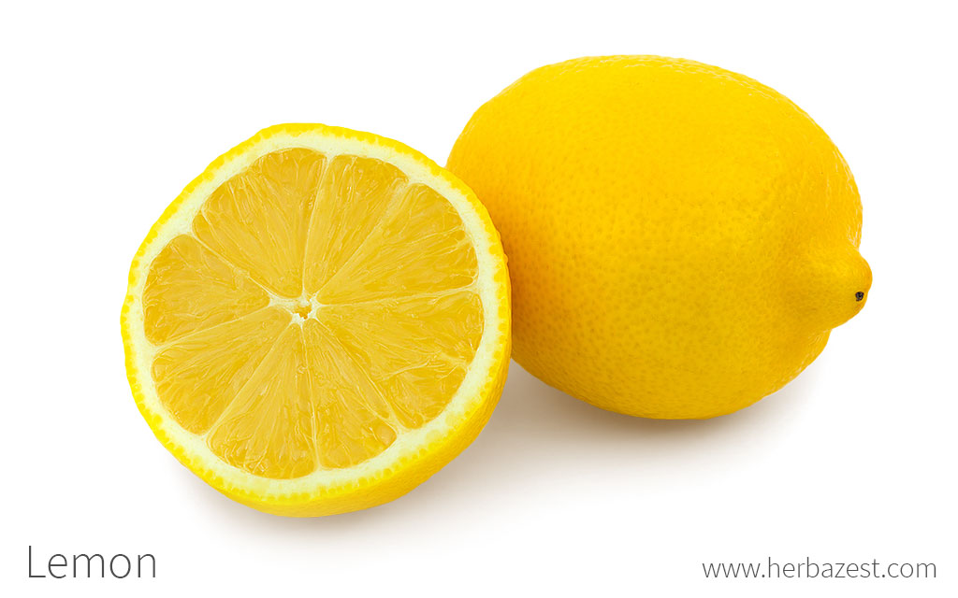
squidgy
soft, moist, and squashy
squidgy is soft and can be squashed easily.
soft and wet and changing shape easily

Slide 4
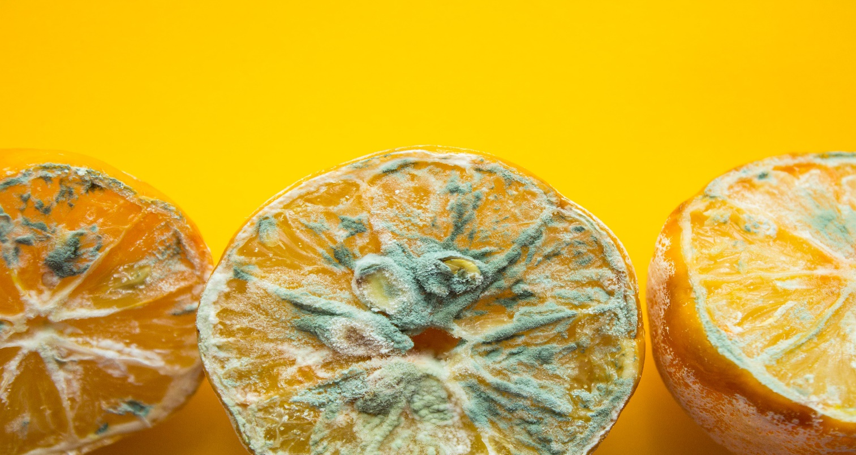
fuzzy
. "Fuzzy leftovers" refers to the mold that grows on food when it rots.

Slide 5
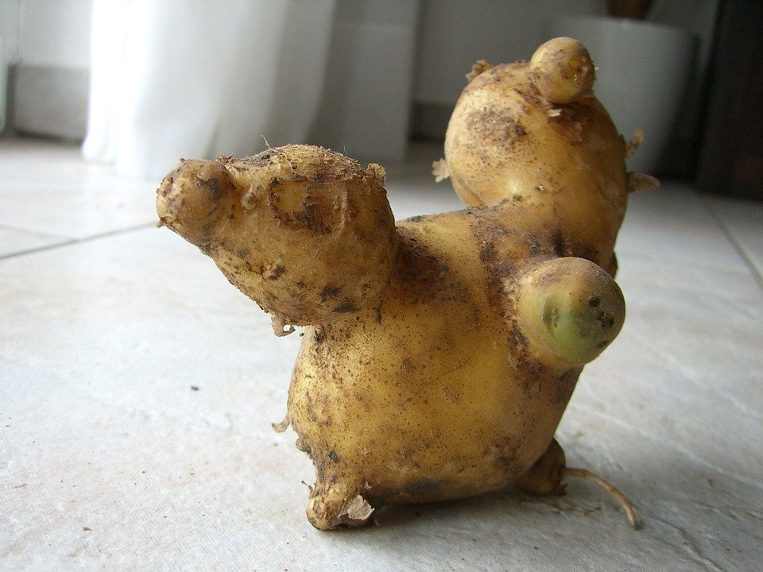
knobbly
If something's lumpy and misshapen, you can describe it as knobbly.

Slide 6
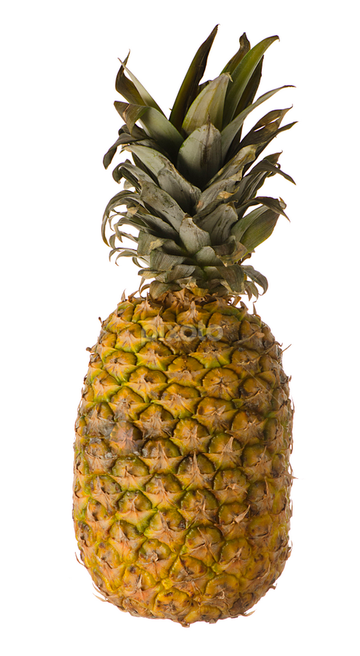
rough
Not smooth

Slide 7
Can you write the words in your dictionary?

Slide 8
Lessons Objectives
Objectives check:
read the new words.
.
01
identify the meaning of the new words.
02
03
use the new vocabulary in their writing.
04

