Slide 2
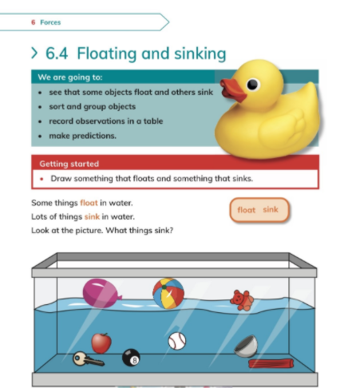

Slide 4
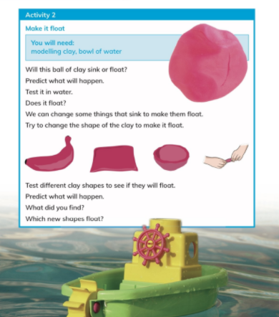

Slide 5
Monday

Slide 6
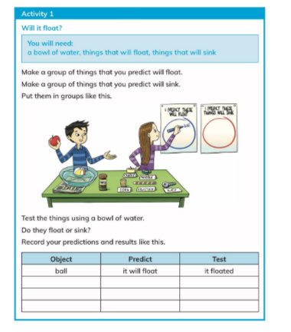
Activity
Students to test out different materials in the classroom and make a prediction of things that will float and sink.
Record prediction on board.

Slide 7
Thursday

Slide 8
Lab
Students to test out different materials and observe if it floats or sinks.

