Slide 2
About your classmate
You have 2 mins to come up with four facts and four opinions about your classmate.
Facts | Opinions

Slide 3
Facts are…
true statements that can be proved.
They: ----- Are true
----- Cannot be argued with
----- Have evidence / proof.
Facebook is a social networking site.
Michael Jackson is dead.
95% of people feel uncomfortable when the TV volume is an odd number.
Donkeys kill more people annually than plane crashes.

Slide 4
OPINION
Opinions are:
people’s personal points of view.
They are:
----- not necessarily true
----- subjective (this means people can disagree with it)
----- will be personal
Examples:
a)Men are better drivers than women
b)The best place in the world is Barbados
c)New technology should make our lives better

Slide 5
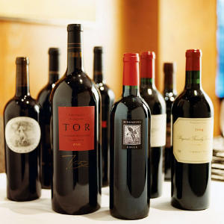
What’s the difference?
‘This wine is too dry.’
This is an opinion based on the drinker’s preference for a sweeter wine. It is not a fact. Written as a fact, the statement should be:
‘This is a dry wine.’

Slide 6
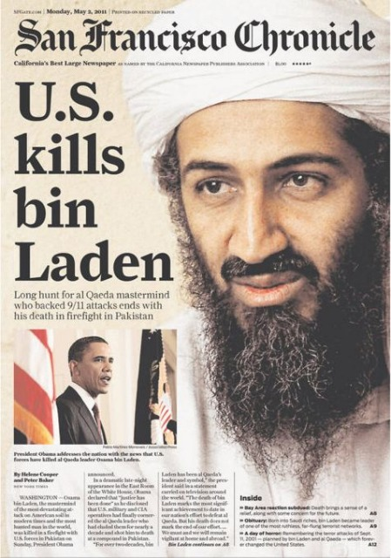
Where do you commonly find fact and opinion?
Newspapers
Magazines
Leaflets
Posters
Internet websites

Slide 7
Odd one out?
“Car pollution will probably destroy our planet”
“My friend is more intelligent than me.”
“More than 70% of the earth’s surface is covered by ocean and seas.”
“Crestwood is the best school in Eastleigh.”

Slide 8
Look at this simple advertisement for a credit card. Pick out the facts and opinions
More than just a bank.
Everyone needs to escape sometimes, and with a Nat West credit card, the world’s your oyster. It’s accepted at over 14 million outlets worldwide, which makes it the ideal getaway card.. For details, call
0800 616 848 or pop into your local branch.

Slide 9
The only facts in it are the (approximate) number of outlets and the phone number. All the rest is opinion (even ‘your local branch’ might be a long way to people who live in the country). This is designed to make the reader think that it is important to own one of these cards.
More than just a bank.
Everyone needs to escape sometimes, and with a Nat West credit card, the world’s your oyster. It’s accepted at over 14 million outlets worldwide, which makes it the ideal getaway card.. For details, call
0800 616 848 or pop into your local branch.

Slide 10
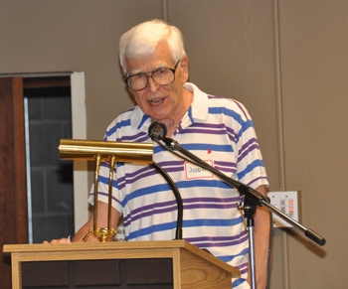
Fact or Opinion:
George’s Speech
6. The group will stop in Denver overnight.
7. Charles Dickens wrote ‘A Christmas Carol’.
8. I will finish before the rest of the class.
9. Gary Barlow is the best judge on X Factor.
10. Bournemouth Pier was created in 1856.
F
F
Mr. Jones has two sons and one daughter.
I think that abortion should be illegal.
3. My daughter's house is really beautiful.
4. My friend has six fingers on one hand.
5. Boris Johnson is the best Mayor of London of all time.
O
F
O
O
F
O
O
F

Slide 11
Fact & Opinion task
Read the newspaper article
Fact & Opinion task
Read the newspaper article
Underline and annotate a ‘F’ (for Fact) on the facts in the article.
Underline and annotate a ‘O’ (for Opinion) on the opinions in the article.
On paper, bullet point the top ten facts of the article in order of importance.

Slide 12
Use
a
mixture
of
facts
and
Opinion
9 points = content
6 points
=
Spelling
Punct
Grammar

Slide 13
You are a newspaper reporter in Japan. A last minute arrangement has been made for you to write a short article about the Tsunami.
Task:
Watch the following video clip.
Note down the facts.
You then have 15 minutes to plan and write your article, so you will need to plan what you are going to report to make sure you put all the information across.
Put your own opinion in, but you must also include facts.
Reminder (from last week!):
Who – When – Where – What – How

Slide 14
http://news.sky.com/skynews/Home/World-News/Video-Japan-Earthquake-Tsunami-Swamps-Land-After-89-Magnitude-Quake-Rocks-Buildings-In-Tokyo/Article/201103215950160?f=rss

