Slide 1
Networks

Slide 2
https://www.google.com/
https://www.wikipedia.org/
https://aspireschool.fireflycloud.net/

Slide 3
Web addresses (URLs).
‘URL’ stands for Uniform Resource Locator but the abbreviation is used in most circumstances. these are human-friendly addresses for the web servers where the webpages are stored.
Each web server may have many URLs because it might store many websites, for lots of different businesses or other organizations, but they all point to the same server.

Slide 4
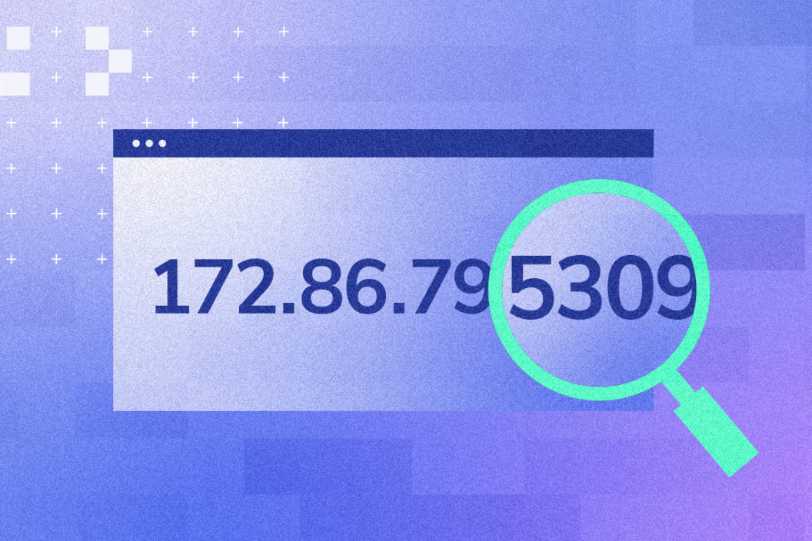
IP addresses
What does IP stand for?
Answer: Internet protocol
What are IP addresses assigned to?
Answer: devices that need to connect to a network
What is the purpose of an IP address?​
Answer: to give devices an address so that data can be transferred to them.​

Slide 5
If you enter a URL into a web browser, how does it know the IP address for the web server?

Slide 6
What is a DNS?

Slide 7
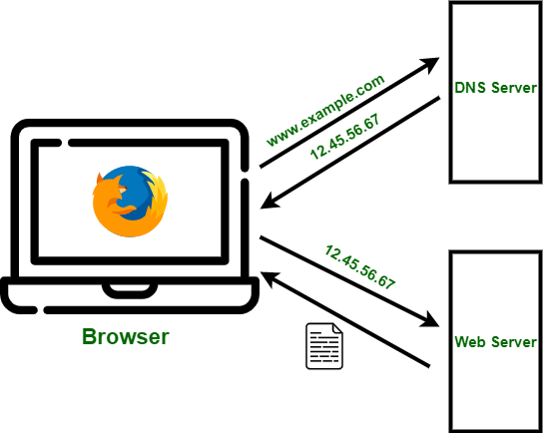
DNS process of converting a URL to an IP:
The user enters a URL into the web browser
The web browser sends the URL to the DNS
The DNS looks for the URL in its database, to find its IP
The DNS sends IP back to the web browser.
The web browser then sends a request to the IP address for the webpage.

