Slide 1
Unit 3: Forces and Energy Lesson 3: Describing Movement
Learning Objectives: Student should be able to:
1-learn how to use graphs to describe movement.
2-understand what a distance/time graph shows.
3-learn to draw a distance/time graph.

Slide 2
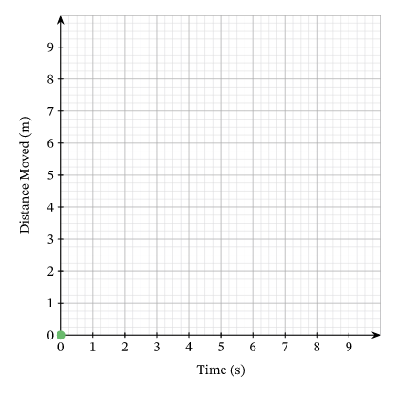
Work in groups to discuss the answer to this question.
This runner will start the competition .
Look to the following pictures then answer this question
What would a line graph look like if you plotted the distance you had run on the vertical axis and time on the horizontal axis?

Slide 3
Describe the speed of a moving object by using this graph
Distance (meters)

Slide 4
Distance/time graph

Slide 5
How to understand distance/time graph
Look to the following graph mention some ways to describe the motion of this car

Slide 6
How to understand distance/time graph
Divide the graph into points (stations)
This is a distance/time graph. It shows the journey of a car from a starting position, A, to a destination, C.
The car then returns to its starting position.
At the starting position, A, the car has travelled zero distance. The car travels at a constant speed away from the starting position to point B. When moving at constant speed, the car travels the same distance in each second. The distance from A increases with time. The distance/time graph show this as a straight, upward sloping line.

Slide 7
How to understand distance/time graph
The car stops at B. It is stationary.
Stationary means not moving, with a speed of zero.
You can also use the term at rest to mean stationary.
The distance of the car from A does not change when the object is stationary, but time still passes. The distance/time graph shows a straight line that is horizontal.

Slide 8
How to understand distance/time graph
The car starts again and moves at a constant speed to its destination, C.
It moves faster than when it travelled between A and B, meaning that it travels a greater distance each second.
So, the distance/time graph shows this as a steeper, straight, upward sloping line.

Slide 9
How to understand distance/time graph
From C, the car travels at a constant speed back to the starting position, A.
The distance of the car from the start decreases with time. The distance/time graph shows this as a straight, downward sloping line.

Slide 10
Solve the following question
You can use the graph to make calculations. Read the distance from the vertical axis, and the time from the horizontal axis.
Then use the equation: Speed = ${Distance (m)}/{Time (s)}$
Measure the speed of a car that covers 10 meters. Using graph.

Slide 11
Types of distance/time graph
Write down the type of each graph and describe the movement of the object

Slide 12
Write down The importance of graphs
Graphs are more useful than words for describing movement because:
it is easier to see trends and patterns you can read any value of distance or time during the journey, from the graph other values, such as speed, can be calculated from the graph information about the whole journey can be seen easily.

