Slide 1
Year 1 – Maths
Months and Days

Slide 4
The months of the year in order – check if you got them right.
January
February
March
April
May
June
July
August
September
October
November
December

Slide 5
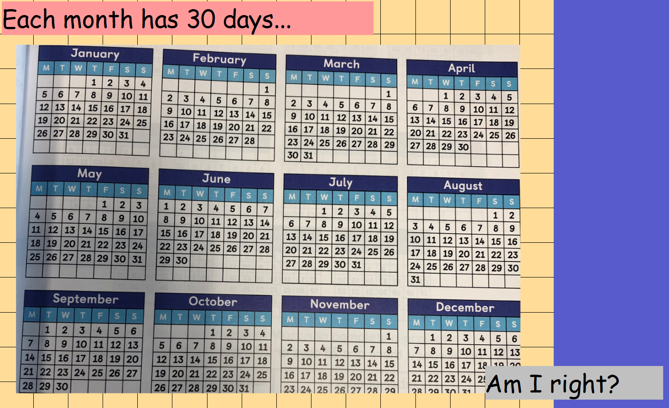

Slide 6
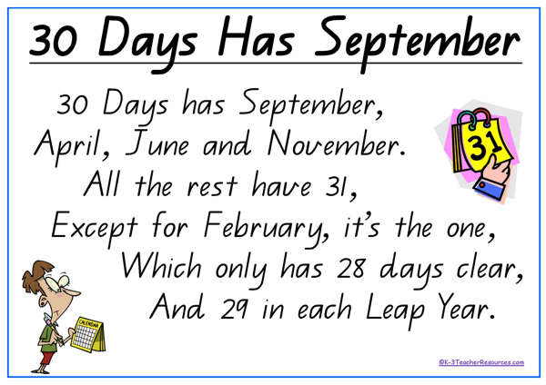
No, each month does not have 30 days.
Some months have 30 and some months have 31 except for February.
We can use this rhyme to help us remember.

Slide 8
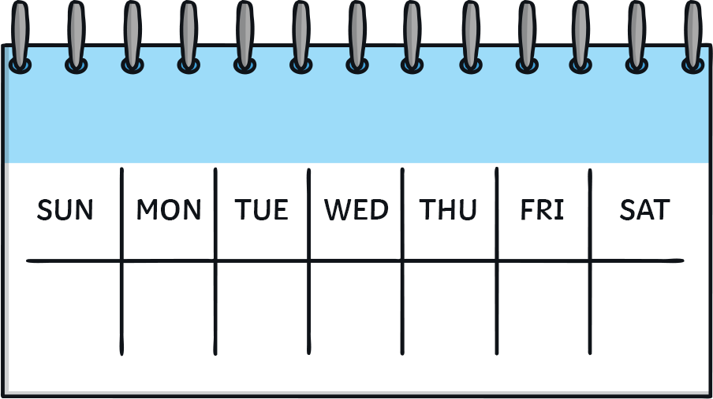
Days of the Week
Each day is part of the week.
Each week has seven days.
Each day is a weekday or a weekend day.

Slide 9
Weekdays
The weekdays are Monday, Tuesday, Wednesday, Thursday, and Friday.
People usually go to school on weekdays.
Doctors’ offices, stores, libraries, and other businesses are open on the weekdays.

Slide 10
Weekends
The weekend days are Saturday and Sunday.
Many people are off from work and school on the weekends.
Schools, doctors’ offices, and some businesses are closed on the weekends, especially on Fridays.
FRI

Slide 11
Quiz
What are the weekend days?
Friday and Saturday

Slide 12
Question
What is your favourite day of the week? Why?
?
?
?

