Slide 1
English

Slide 2
Lessons Objectives
By the end of the lesson, learners will be able to :
read the new words.
read the new words.
read the new words.
understand what conjunctions mean
01
identify the meaning for the new words.
identify the meaning for the new words.
identify the meaning for the new words.
02
use the new vocabulary in their writing.
03
use the new vocabulary in their writing.
04

Slide 3
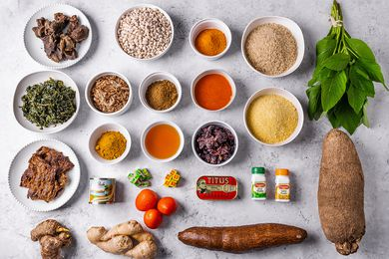
Ingredients

Slide 4
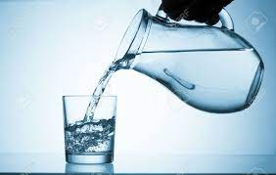
pour

Slide 5
sprinkle

Slide 6
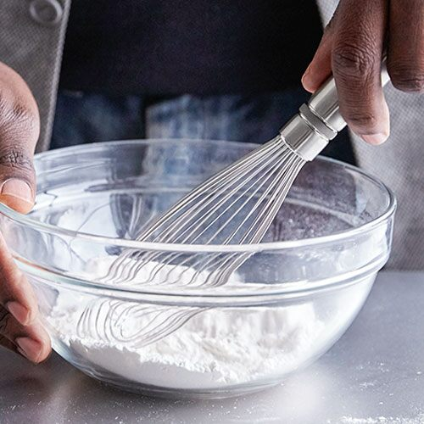
whisk

Slide 7
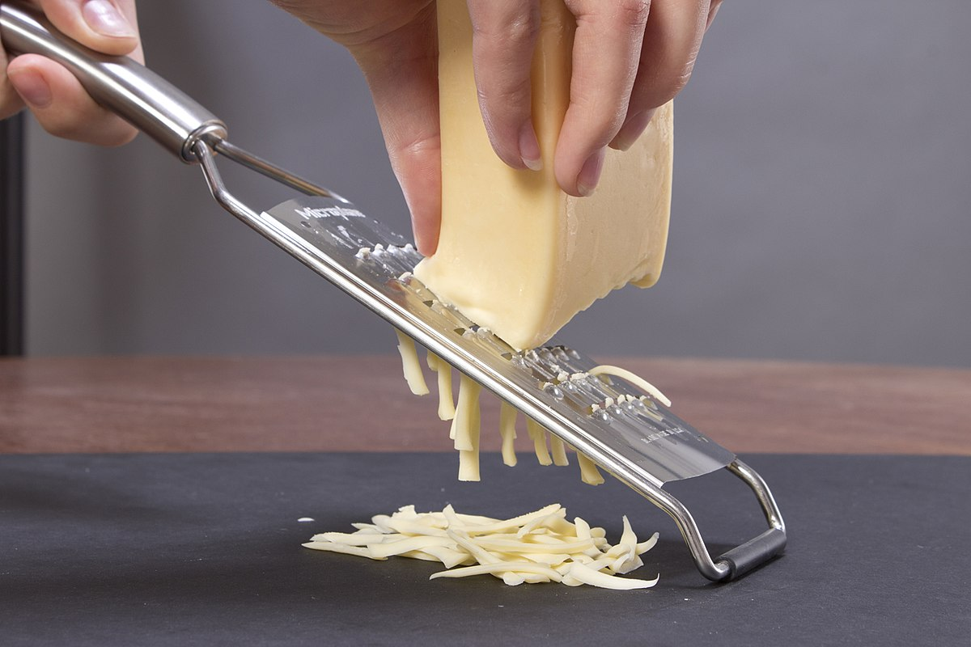
grate

Slide 8
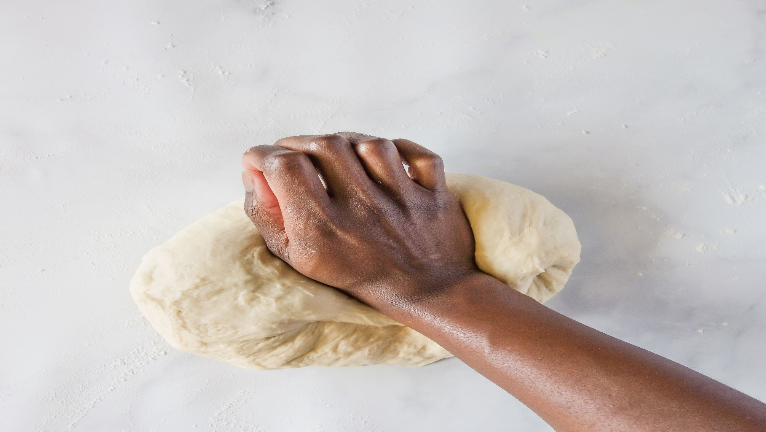
knead

Slide 9
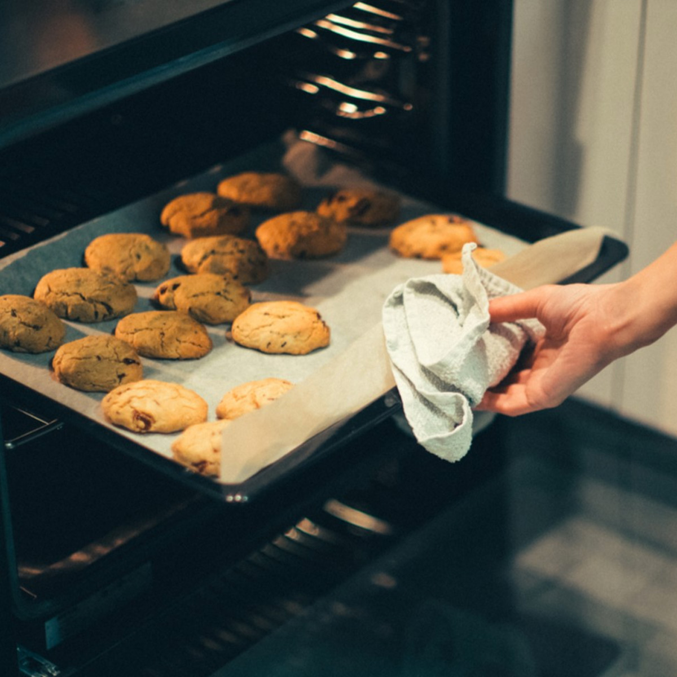
bake

Slide 10
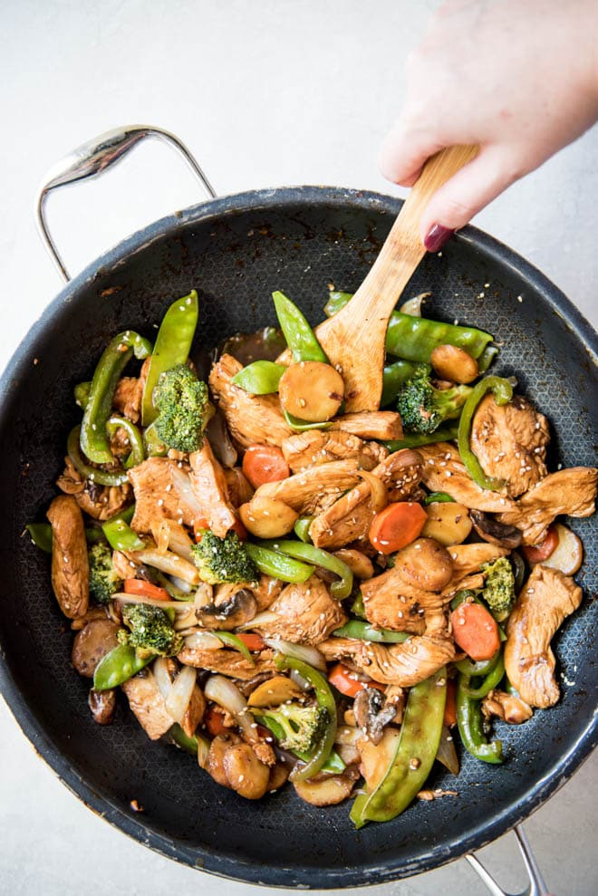
Stir

Slide 11
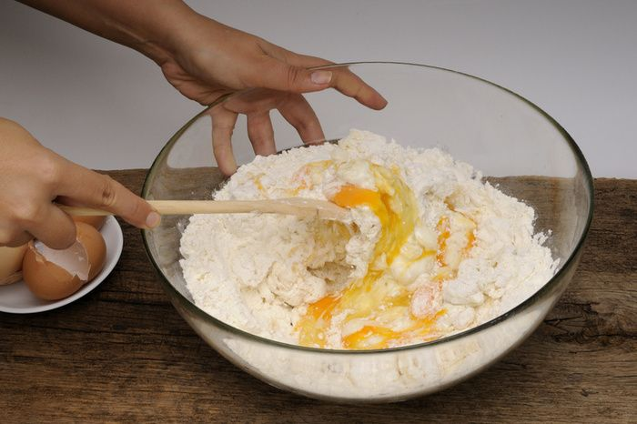
mix

Slide 12
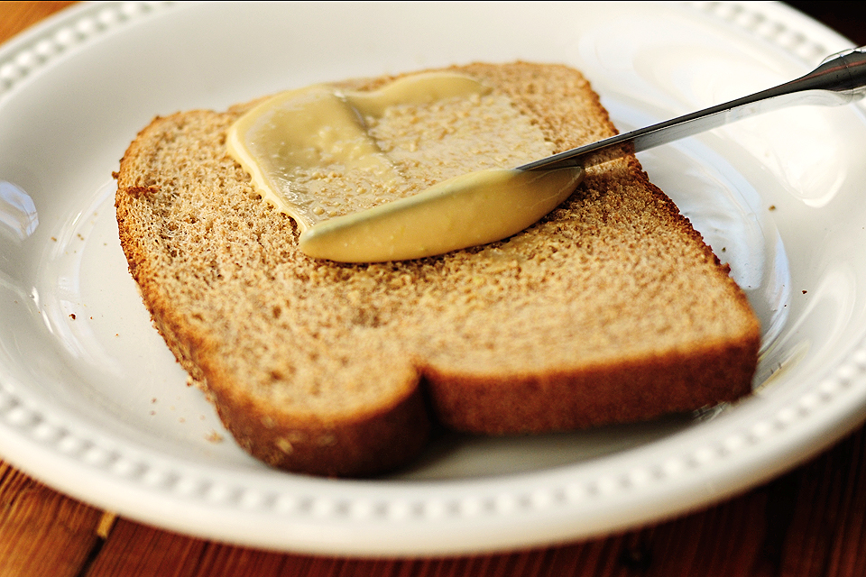
spread

Slide 13
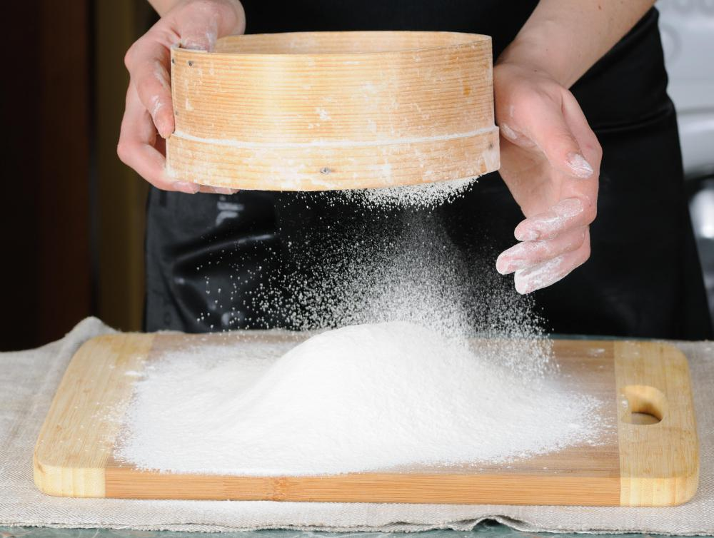
sieve

Slide 14
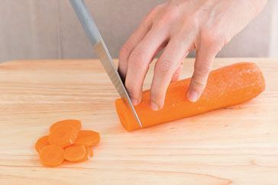
chop

Slide 15
Can you write the words in your dictionary?

Slide 16
Lessons Objectives
Objectives check:
read the new words.
.
01
identify the meaning of the new words.
02
03
use the new vocabulary in their writing.
04

