Slide 1
English

Slide 2
Lessons Objectives
By the end of the lesson, learners will be able to :
recognize and read the sounds.
01
blend and segment the words.
02
Write words related to these sounds.
03
04

Slide 3
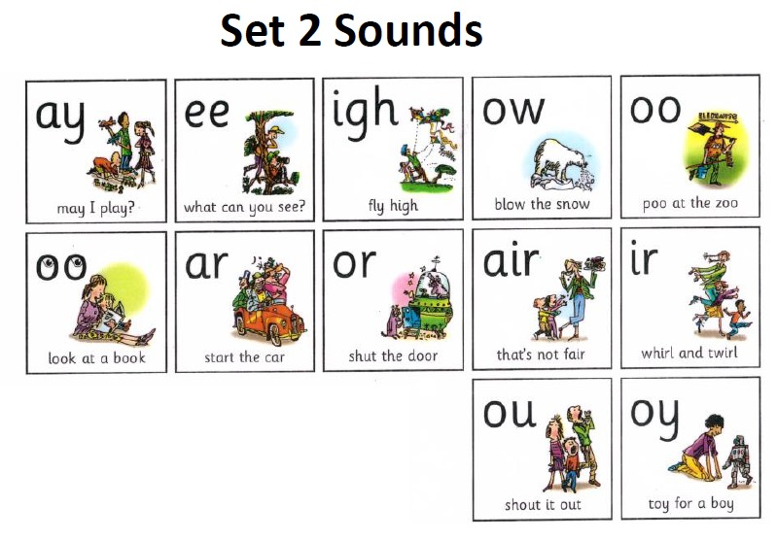

Slide 4
Listen to the video

Slide 5
Warm- up Activity
Level 3
Warm- up Activity

Slide 6
Phonics. (25 mins) Have students sit on the carpet with their whiteboards and markers .

Slide 7
Write a letter sound on the whiteboard. /ay/ Ask each student to sound out the letter on the board to make sure that the students know the sound

Slide 8
Once done start dictating students' words with the sound /ay/ Pay, say, day, way, play, tray. Elicit from students' other words that have the /ay/ sound

Slide 9
Thank You

Slide 10
High Frequency Words Mat

Slide 11
Time to read

Slide 19
Practice time
Say some words with the sound
“ay”

Slide 20
Lessons Objectives
Objectives check:
recognize and read the sounds.
01
blend and segment the words.
02
Write words related to these sounds.
03
04

