Slide 1
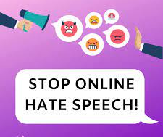
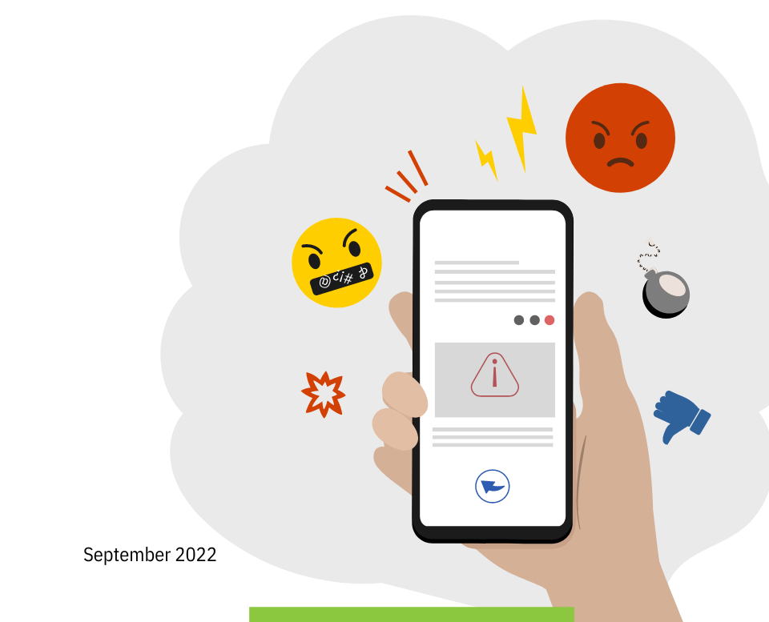
Responding to Online Hate Speech

Slide 2
Essential Question How should you respond to online hate speech?

Slide 4
What do you see?
What do you think about what you see?
What does the artwork make you wonder?

Slide 5
Hate speech
An attack using any form of communication targeting a person or people because of a group they belong to -- race, gender, religion, ability, sexual orientation, etc.

Slide 6
Respectful Discussion Norms
Speak your truth.
Respect others' viewpoints.
Don't interrupt.
Disagree respectfully.

Slide 7
Ways to Respond to Hate Speech

Slide 8
Confront the perpetrator:
Say something.
Reach out to the person being targeted to support them.
Tell a trusted adult about the situation.
Report or flag the post to the website
or app.
Raise awareness about hate speech
at school or in your community.

Slide 9
Cyberbullying
Using digital devices, sites, and apps to intimidate, harm, and upset someone

