Slide 2
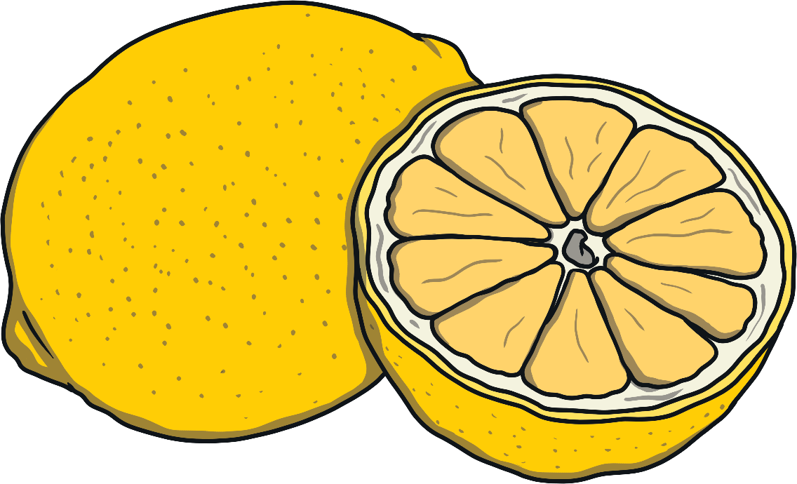
lemon

Slide 3
rubber duck

Slide 4
sunflower

Slide 5
banana

Slide 6
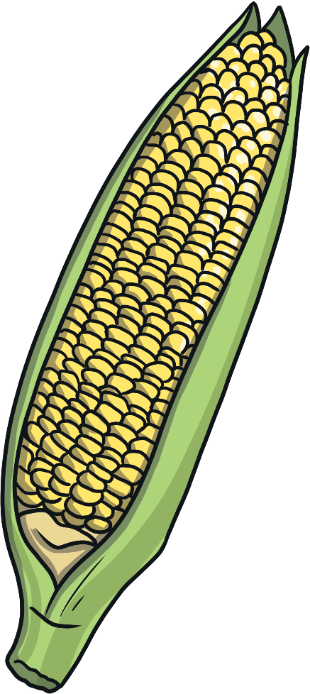
corn

Slide 7
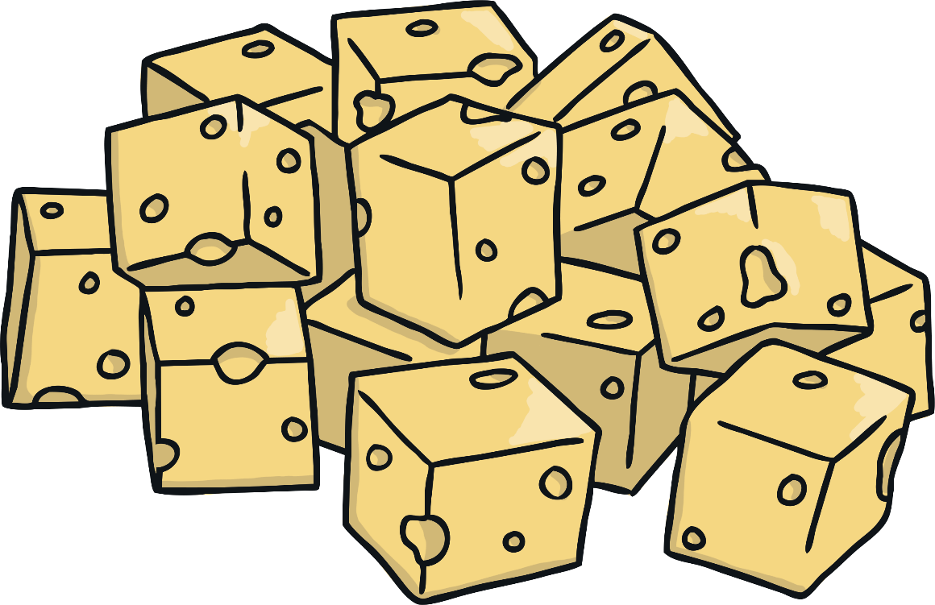
cheese

Slide 8
chick

