Slide 3
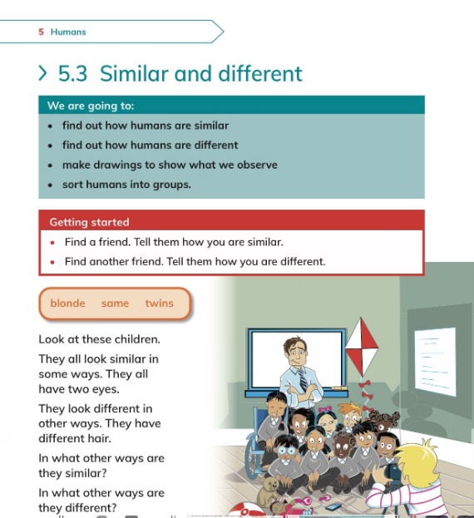
Discuss with students the differences that are easy to change, such as clothes or hair style.

Slide 4
Activity
Students to walk slowly around the classroom and each time teacher says *similar*, students have to find a partner nearby and say one way in which they are similar.

Slide 5
Students to solve workbook page 58.

Slide 6
Monday

Slide 8
Students to list out the different things about humans. Make a list: eye colour height,boy or girl, likes and dislikes.
Students to choose one thing from the list and use it to make groups. .

Slide 9
Students to solve workbook page 60.

Slide 10
Wednesday

Slide 11
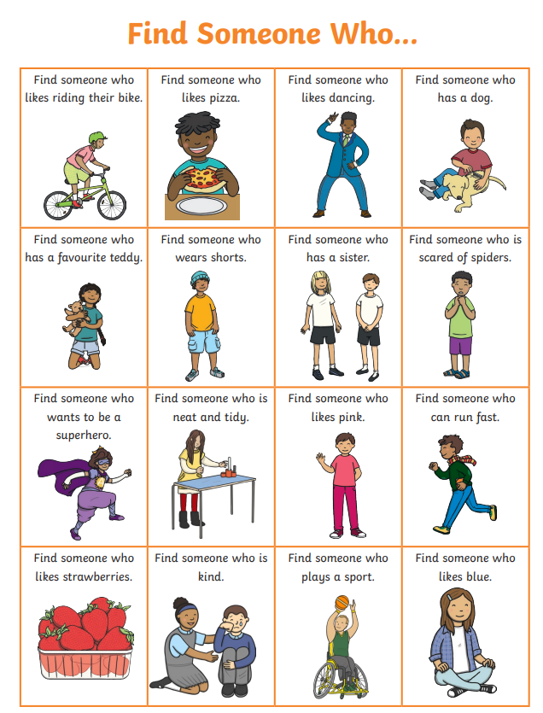
Students to choose a topic and find someoone who....

Slide 12
Students to solve workbook page 59 for homework.

