Slide 1
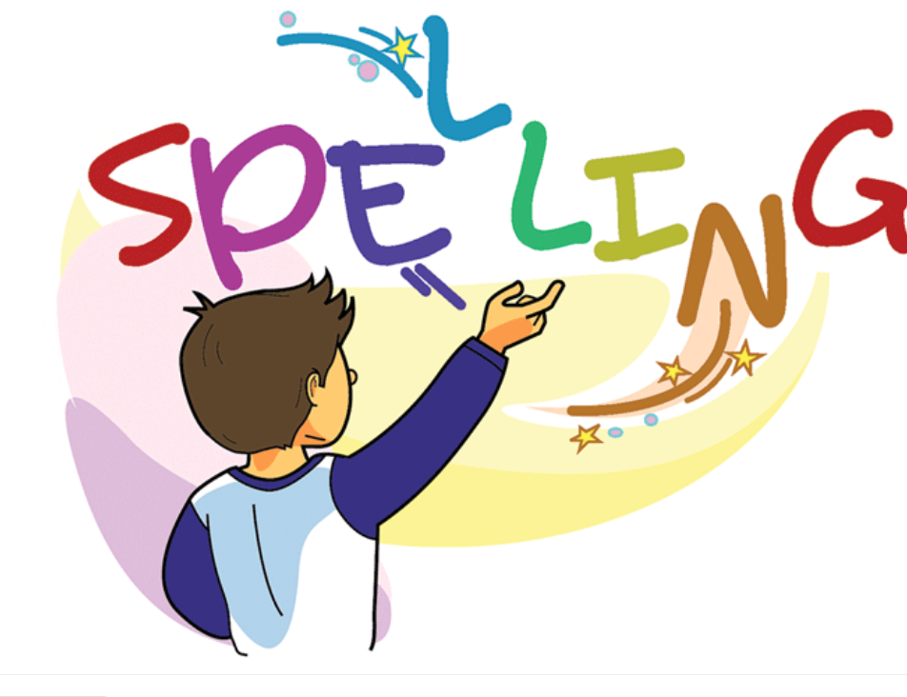

Slide 2
Spelling Test Simple Present Tense Adding “s” 10 minutes
Pop Up Quiz 30 minutes
First Session Completed

Slide 3
Adding “ing” to the Verbs to become Present Continuous
Explain to students that adding “ing” to a verb
changes the word into present continious tense
Ex
Verb Continuous Tense
eat eating
↓ ↓
To eat Still eating

Slide 4
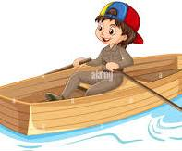
Spelling Words Adding “ing” to the verb
rowing
Rowing is a sport in which people or teams race against each other in boats with oars
Andrew is rowing so fast to win the race.

Slide 5
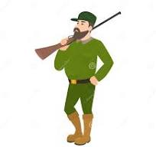
hunting
Hunting is the chasing and killing of wild animals by people or other animals, for food or as a sport.
My uncle Ted is hunting deers.

Slide 6
printing
If copies of a book are printed and published on a number of different occasions, you can refer to each of these occasions as a printing.
We are printing alot of papers.

Slide 7
reading
Reading is the activity of reading books
David is reading all sorts of books.

Slide 8
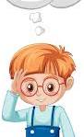
thinking
Thinking is the activity of using your brain by considering a problem or possibility or creating an idea.
Albert Enstein was always thinking about the world around him.

Slide 9
cleaning
Cleaning is the act of removing dirt or something undesirable
Sarah is always cleaning her rooms. They are always shiny after she cleans them.

Slide 10
sweeping
If you are sweeping an area of floor or ground, you push dirt or rubbish off it using a brush with a long handle.
Dan is sweeping our classroom, it is spotless after he finishes.

Slide 11
cooking
When cooking a meal, you are preparing food for eating by heating it.
Mom is cooking pasta for dinner tonight.

Slide 12
singing
When you are singing, you make musical sounds with your voice, usually producing words that fit a tune.
Sarah is singing in our school band.

Slide 13
gardening
Gardening is the activity of planning and cultivating a garden.
Mr. Smith is gradening the flowers and vegetables he grows.

Slide 14
Thank You

