Slide 3
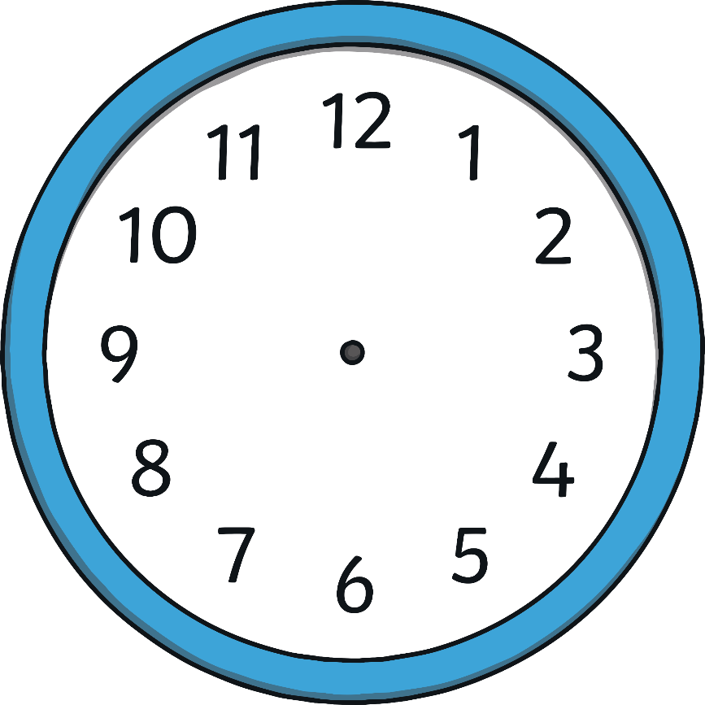
Hours and Minutes
This is the hour hand.
It is the shortest hand on the clock.
This is the minute hand.
It is longer than the hour hand.

Slide 4
Hours and Minutes
When the minute hand is pointing to 12, it is showing a full hour. We call this time ‘o’clock’.
On this clock, the hour hand is pointing at the 8 and the minute hand is pointing to the 12.
This clock is showing that the time is 8 o’clock.

Slide 5
What Time Is It?
12 o’clock
11 o’clock
1 o’clock
10 o’clock
2 o’clock
9 o’clock
3 o’clock
8 o’clock
4 o’clock
7 o’clock
5 o’clock
6 o’clock

Slide 6
What Time Is It?
It is 7 o’clock.

Slide 7
What Time Is It?
It is 3 o’clock.

Slide 8
What Time Is It?
It is 11 o’clock.

Slide 9
What Time Is It?
It is 6 o’clock.

Slide 10
What Time Is It?
It is 9 o’clock.

Slide 11
What Time Is It?
It is 12 o’clock.

Slide 12
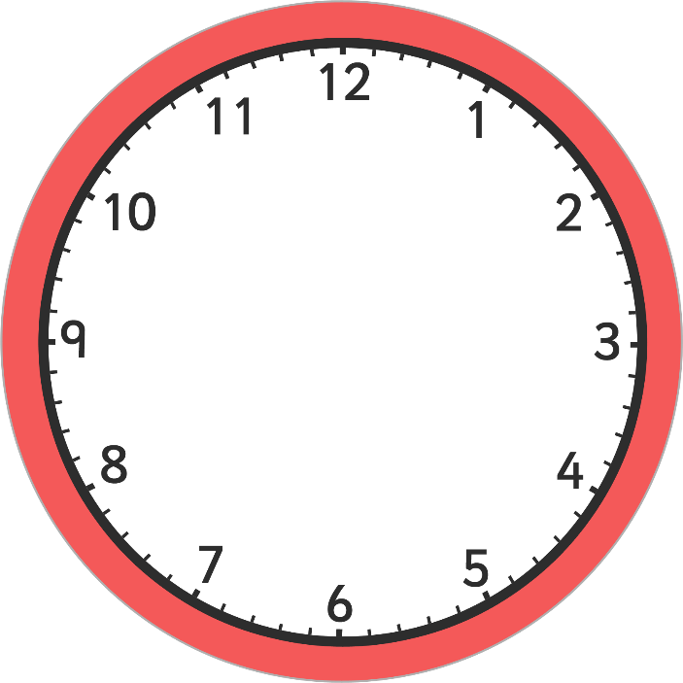
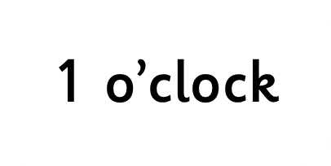
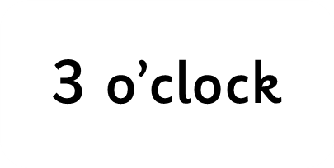

Slide 13
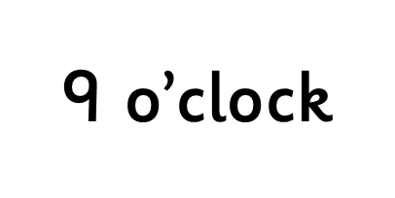
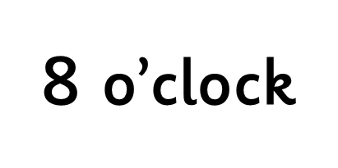

Slide 14
3:00
2:00
6:00

Slide 15
5:00
6:00
7:00

Slide 16
You are Stellar!

