Slide 1
Complex sentences

Slide 3
You can form a complex sentence using Two ways

Slide 4
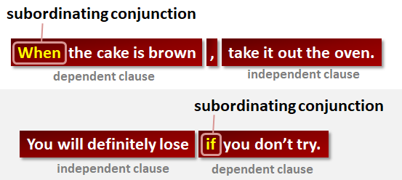
Note: If the dependent clause comes first --> put a comma after it.

Slide 5
Common Subordinating (Dependent) Conjunctions
after | even if | now that | that | where
although | even though | once | though | whereas
as | if | rather than | unless | wherever
as if | whenever | since | until | whether
because | in order that | so that | when | which
before |  | than | in case | while

Slide 6
Milestone (1) check
You’ll need an index card to answer the following question
Write your name

Slide 7
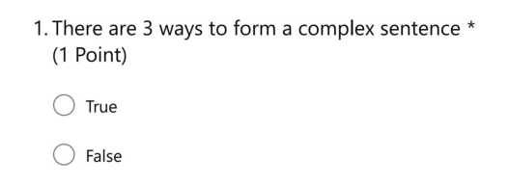

Slide 11
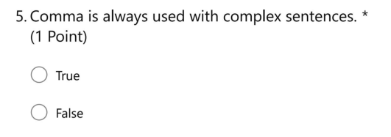

Slide 12
Relative pronouns
Relative pronouns can be used to begin a relative clause, which is also “dependent” and can be used in a complex sentence.
Ex: My uncle, who plays for the Houston Astros, is coming to visit this week.

Slide 13
Essential clauses
Do not use commas with essential (important) clauses.
Clauses beginning with that should be essential.
Ex: The classes that I’m taking this semester are Reading and English.

Slide 14
Non-essential clauses
Use commas to set off non-essential clauses.
Clauses beginning with which should be non-essential.
Ex: My computer, which is a laptop, crashed.

Slide 15
who
It can be used with essential & non-essential clauses. So, using a comma or not depends on the relative clause itself.
Ex.1: the man who found my bag gave it to the security guy.
(essential = no comma)
Ex.2: Ahmed, who sits next to me, helped me with my assignment.
(non-essential = 2 commas before & after)

Slide 16
Milestone (2) check
You’ll need an index card to answer the following question
Write your name

Slide 22
H.W
Booklet p.62 & 63

