Slide 1
Animals with Feathers

Slide 2
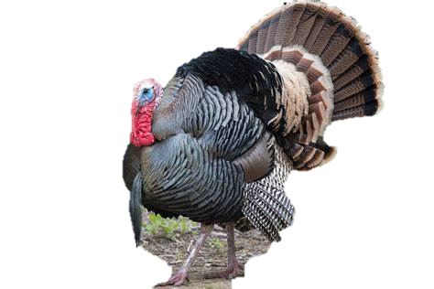
Animals with Feathers
Some animals are covered with feathers like birds to keep them:
-warm
-help most of them to fly .

Slide 3
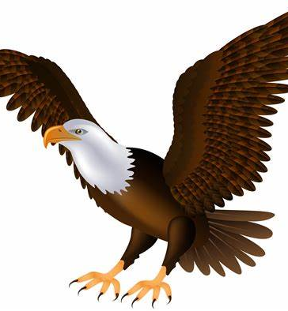
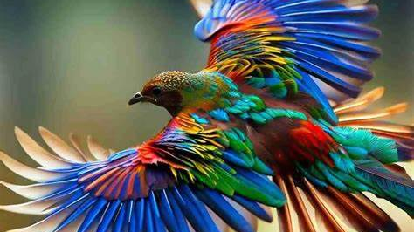
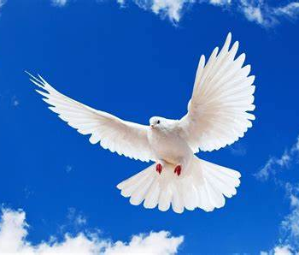
Most of the birds can fly with their wings :
dove
bird
eagle

Slide 4
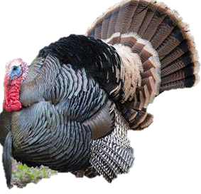
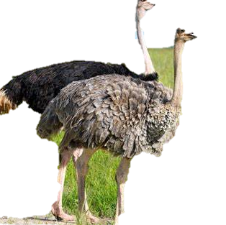
However, some birds can not fly such as:
turkey
Ostrich
penguin

Slide 5
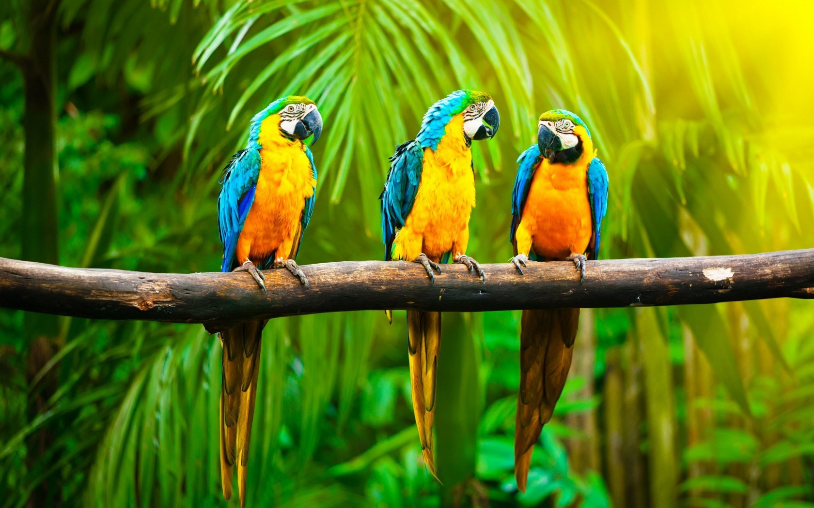
Birds habitats
Birds live in different habitats like:
Parrots live in the jungle :

Slide 6
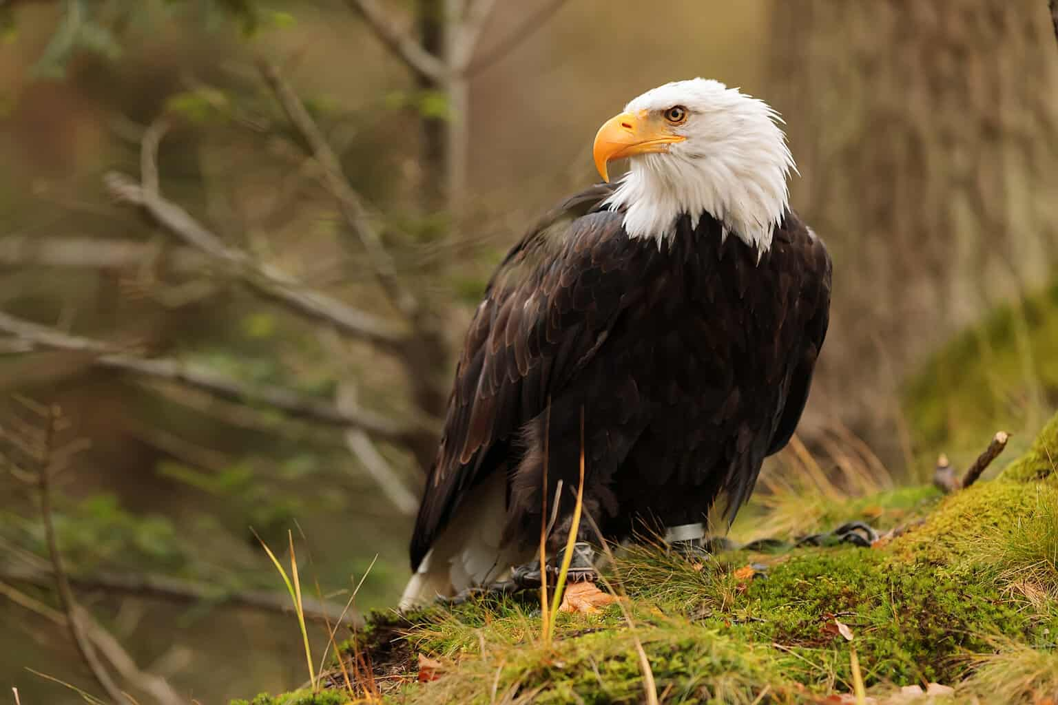
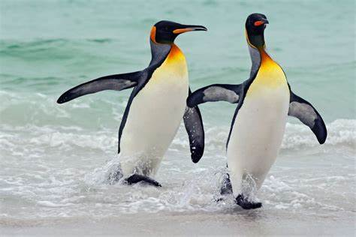
-eagles live in the desert.
-penguins live near water.

Slide 7
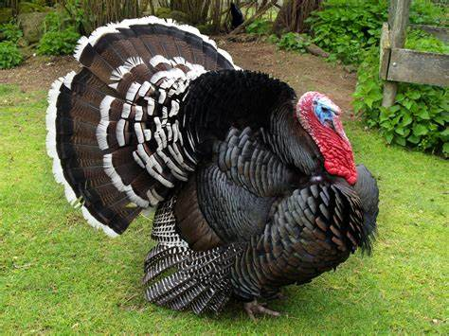
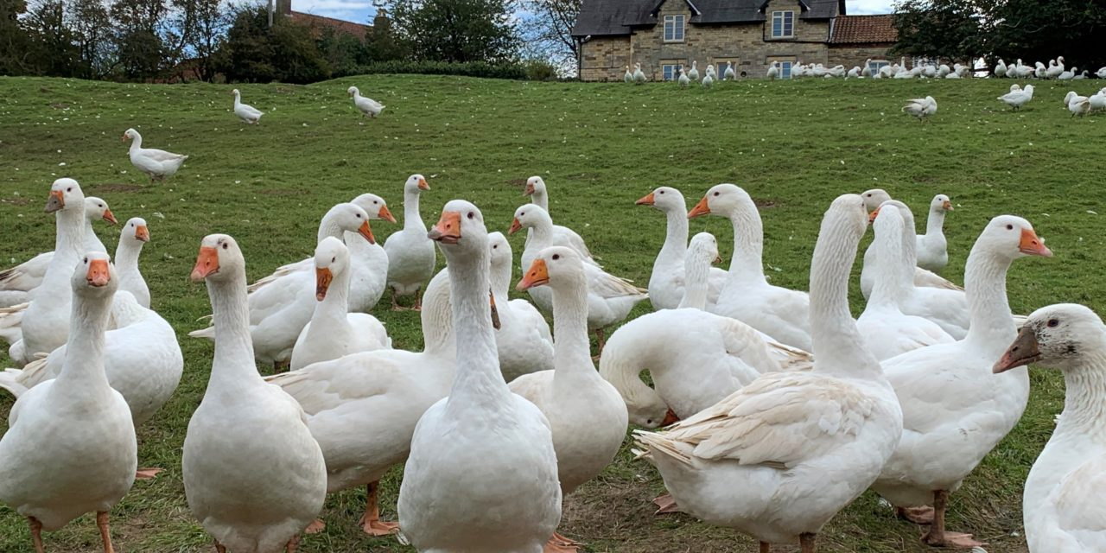
-turkey and goose live on farm.

Slide 8
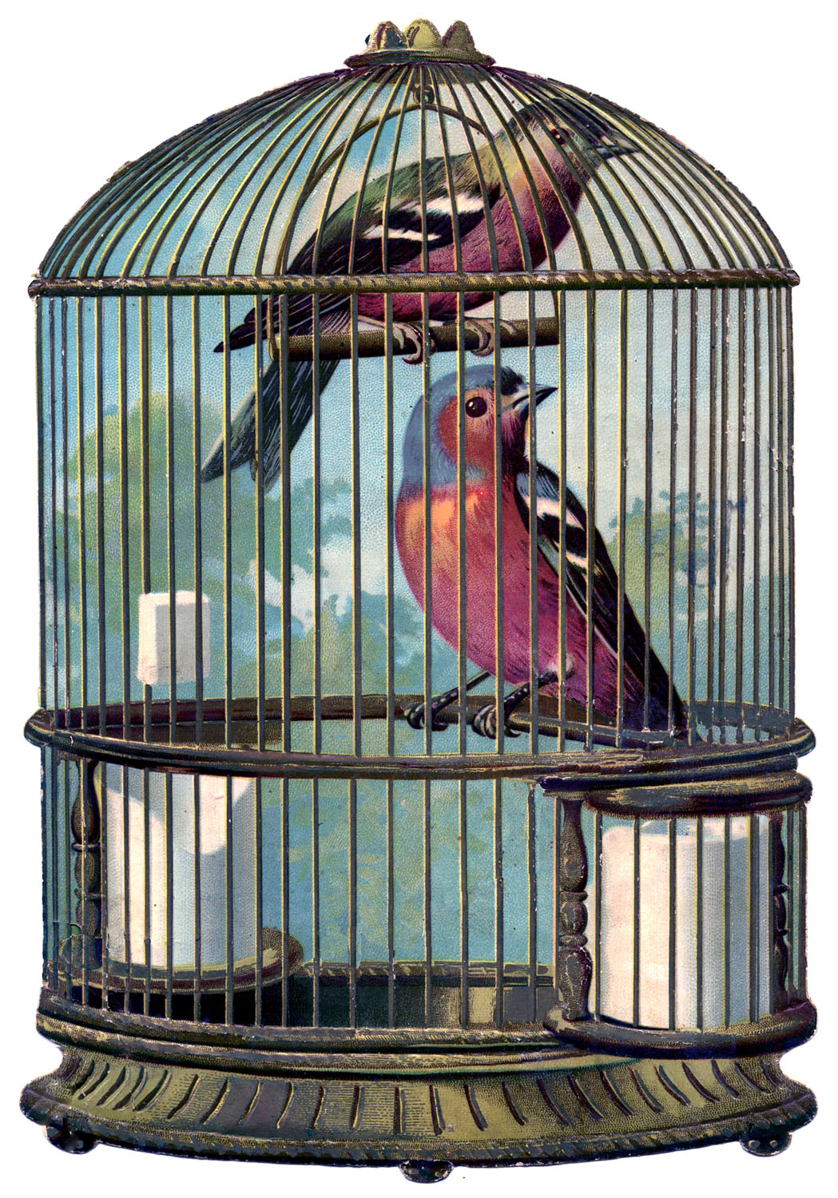
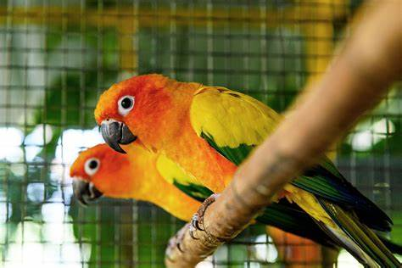
-some birds live in houses.

