Slide 1
Disclaimer/s
We hope you find the information on our website and resources useful.
Animations
This resource has been designed with animations to make it as fun and engaging as possible. To view the content in the correct formatting, please view the PowerPoint in ‘slide show mode’. This takes you from desktop to presentation mode. If you view the slides out of ‘slide show mode’, you may find that some of the text and images overlap each other and/or are difficult to read.
To enter slide show mode, go to the slide show menu tab and select either from beginning or from current slide.
You may wish to delete this slide before beginning the presentation.

Slide 2
Mathematics
Length
Mathematics | Length | Measure to the Nearest Metre and Centimetre | Measuring Us | Lesson 2 of 2

Slide 4
Learning Intention
To measure height or length accurately using metres and centimetres.
Success Criteria
I can measure height and length to the nearest centimetre.
I can record measurements in appropriate ways.
I can decide which unit to use for measuring.

Slide 5
Warm-up
Metres or Centimetres?
Would you measure this using metres or centimetres?
metres (m)

Slide 6
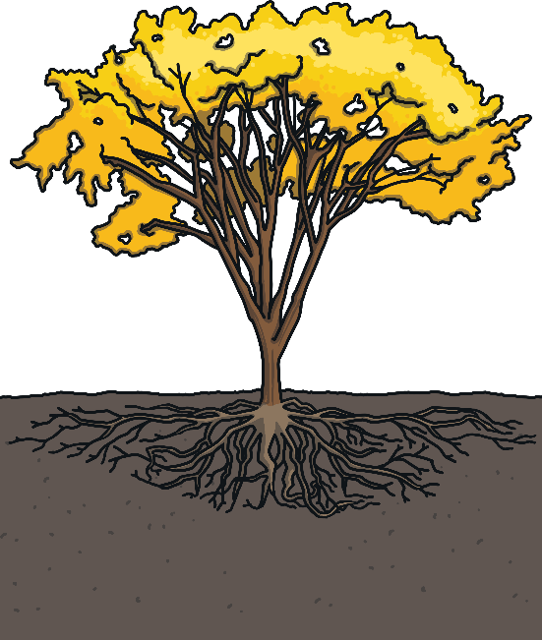
Warm-up
Metres or Centimetres?
Would you measure this using metres or centimetres?
metres (m)

Slide 7
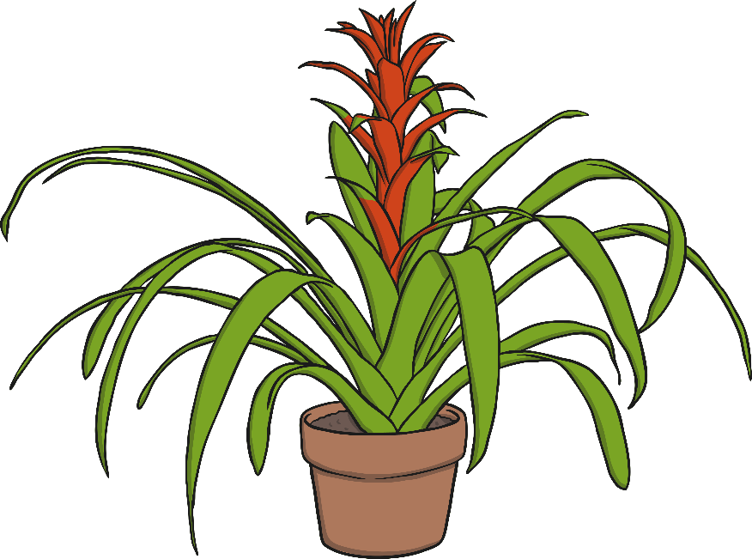
Warm-up
Metres or Centimetres?
Would you measure this using metres or centimetres?
centimetres (cm)

Slide 8
Warm-up
Metres or Centimetres?
Would you measure this using metres or centimetres?
metres (m)

Slide 9
Warm-up
Metres or Centimetres?
Would you measure this using metres or centimetres?
centimetres (cm)

Slide 10
Warm-up
Metres or Centimetres?
What happens when the object we measure isn’t a whole metre?
We have to measure using a combination of metres and centimetres. We can write this as
1 metre 40 cm
or
1.4m
or
140cm

Slide 11
Wrap-up
Metres or Centimetres?
Some objects we measure will not be an exact number of centimetres.
When this happens, we can measure to the nearest centimetre.
Let’s have a close look at the length of this pencil.
To the nearest centimetre,
it is 15cm long (even though it is a little more - 15.2cm).
The pencil is closer to 15cm.

Slide 12
Learning Intention
To measure height or length accurately using metres and centimetres.
Success Criteria
I can measure height and length to the nearest centimetre.
I can record measurements in appropriate ways.
I can decide which unit to use for measuring.

