Slide 1
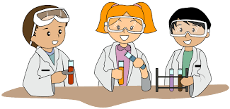
Introduction What is Science?
Science is the study of the world around us.
We learn by observing, describing, and experimenting. Science is curiosity in thoughtful action about the world and how it behaves. Anyone can think like a scientist.

Slide 2
Who is a Scientist?
A scientist is a person who studies and investigates research to further knowledge in a particular area. A scientist is someone who gathers and uses research and evidence, to make hypotheses and test them, to gain and share understanding
and knowledge.

Slide 3
How to be a Scientist

Slide 4
Scientific Method
The Scientific Methods are steps that scientist use in order to understand how things work and why they work the way they do.

Slide 5
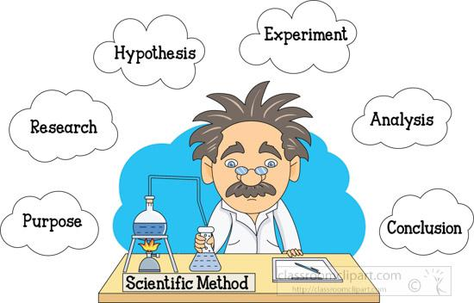
Scientific Method Steps
1. Observation
2 Question
3. Hypothesis
4. Experiment
5. Results
6. Conclusion
These are the main 6 steps of Scientific method.

Slide 6
Observation This step you gather information on a topic, using your 5 senses. What do you see, hear, taste, smell or touch?

Slide 7
Question What is my question? -What am I trying to find out? -Which object will turn blue? --What happens to butter when it is in a hot place? -Does salt dissolve in water?

Slide 8
Hypothesis A hypothesis is an education guess. You basically guess the question and say what you think will happen. Your guess can turn out to be right or wrong which you will find out in the last step. A hypothesis should begin with “I think….Because….”

Slide 9
Experiment In this step you design and do tests that will help determine if the hypothesis is correct. You gather up the materials that you need and go through steps to do your experiment. You can repeat experiments if needed. “I am going to….I will first….next I will…..”

Slide 10
Results In this step you record your results after you finish your experiment. “ I have found out that….”

Slide 11
Conclusion In this step you discuss what you found out and answer your question and state if your hypothesis turned out to be right or wrong. “My conclusion is…..”

Slide 12
Practical Work:
Use the scientific method to experiment sugar, salt and sand in water.
Experiment: Does sugar and sand dissolve in water?
Materials Need: 2 visible cups, 1 spoon, small bottle of water, sugar, salt and sand.

