Slide 2
We are learning to...
Write limericks using the correct rhyming pattern and metre so that we can create fun and engaging limericks of our own.
I will know I am successful when...
I have written the limericks from the PowerPoint and my limericks follow the structure that has been shown in the PowerPoint.

Slide 3
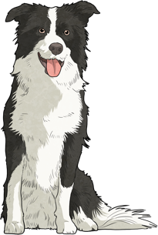
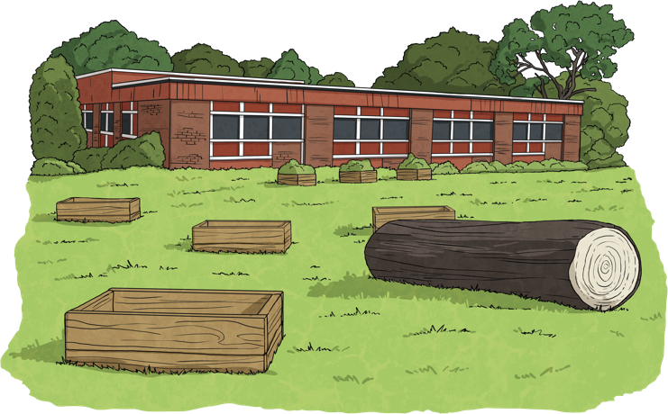
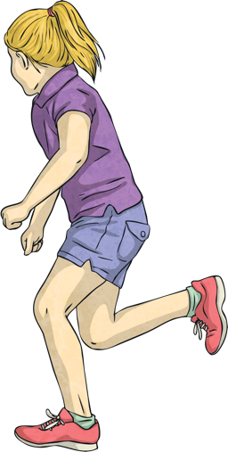
Look at these limericks below. Can you identify the rhyming pattern?
Bob was an old, shaggy dog
Who sat on a very small log
The log started to break
Bob began to shake
And he jumped from the log like a frog
Sarah was as fast as a hare
She would run almost everywhere
But one day she tripped
And over she flipped
Then landed in a big old armchair

Slide 4
Limericks follow a specific rhyming pattern.
Limericks need to rhyme in the AABBA pattern.
This means that the 1st, 2nd and 5th lines rhyme with each other and the 3rd and 4th lines rhyme with each other.
Bob was an old, shaggy dog
Who sat on a very small log
The log started to break
Bob began to shake
And he jumped from the log like a frog

Slide 5
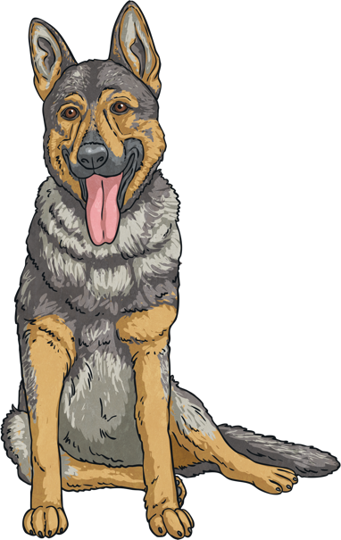
Do you know what the metre of a limerick is?
No, we are not talking about how long the limerick is! When we talk about ‘metre’ in poetry we are referring to the ‘rhythm’ of each line. The metre is the number of syllables in each line and the emphasis that is placed on each of those syllables.
A limerick uses anapestic meter – which means there are two unstressed syllables followed by one stressed syllable. This gives limericks a light, sing-song rhythm and often makes them easy to remember.
Bob was an old, shaggy dog

Slide 6
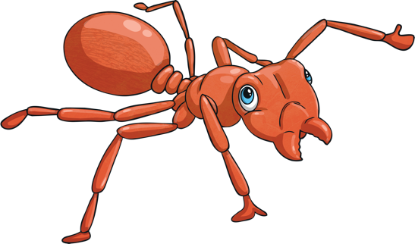
Shared Writing
Let’s write a poem together about a silly ant.
Close your eyes and imagine everything you know about ants. Think about where they live, what colour they are and what they eat.
Now think about what this ant might do that is a bit silly and a bit funny.

Slide 7
Shared Writing
As a class, have a go at writing a limerick about that ant. Remember to follow the rhyming pattern and develop a light, sing-song rhythm.

Slide 8
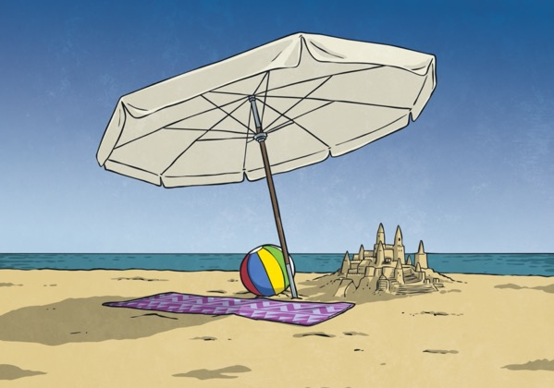
Independent Writing
Now, you’re going to write your own limerick about the beach.
First, brainstorm all the things you know about the beach. What does it look like? What do you wear there? What do you do there? Where is it? Do any animals live there?

Slide 9
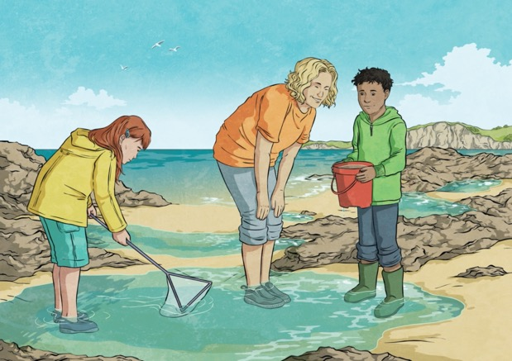
Independent Writing
Now, use the ideas in your brainstorm to write a limerick about the beach. Remember to follow the rhyming pattern and develop a light, sing-song rhythm.

