Slide 1
VOCABULARY WORDS
Week 2

Slide 2
splendid
Extremely good

Slide 3
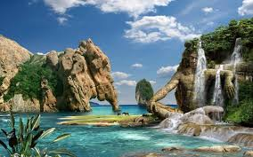
stunning
Very beautiful

Slide 4
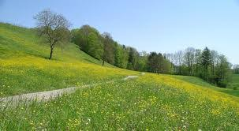
spacious
Wide and large

Slide 5
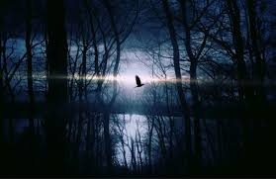
dusky
dim

Slide 6
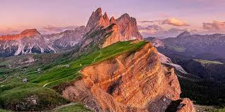
vast
Extremely large

Slide 7
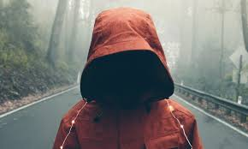
mysterious
Unknown

