Slide 1
Disclaimer
We hope you find the information on our website and resources useful.
Animations
This resource has been designed with animations to make it as fun and engaging as possible. To view the content in the correct formatting, please view the PowerPoint in ‘slide show mode’. This takes you from desktop to presentation mode. If you view the slides out of ‘slide show mode’, you may find that some of the text and images overlap each other and/or are difficult to read.
To enter slide show mode, go to the slide show menu tab and select either from beginning or from current slide.
You may wish to delete this slide before beginning the presentation.

Slide 2
Disclaimer
We hope you find the information on our website and resources useful.
ESL Acronym
This resource has been made for the purpose of teaching English language learners. We
know that students can be learning English in many different places, in many different ways and at age, so we try to keep these resources as general as possible.
There are many acronyms associated with English language teaching. These include (but are not limited to) ELT, TEFL, EFL, ELL, EAL and ESOL. While the term ESL may not fully represent the linguistic backgrounds of all students, it is the most widely recognised term for English language teaching globally. Therefore, we use the term ‘ESL’ in the names of our resources to make them easy to find but they are suitable for any student learning to speak English.
You may wish to delete this slide before beginning the presentation.

Slide 4
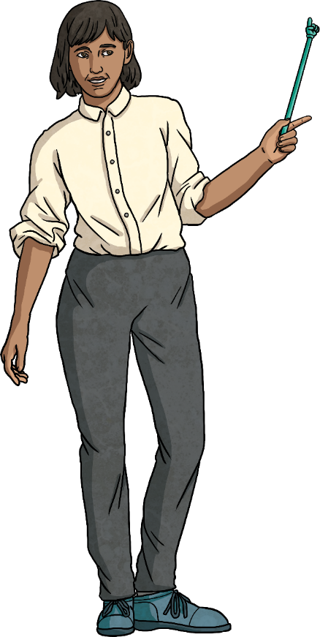
In this lesson, we will…
Discover what ‘comparatives’ and ‘superlatives’ are.
Learn about the different spelling rules with comparatives and superlatives.
Practise using them in sentences.
Use comparatives and superlative adjectives to create an advert.

Slide 5
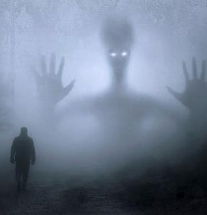
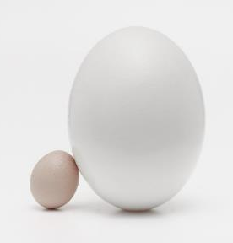
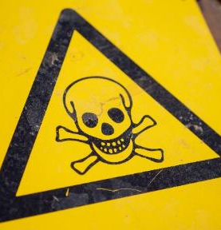
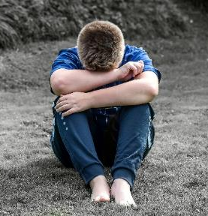
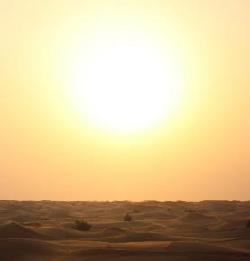
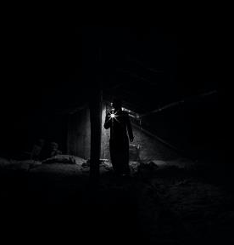
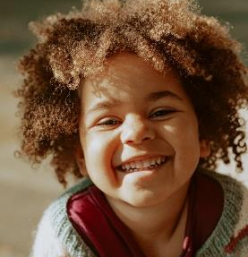
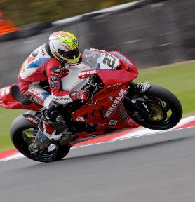
Vocabulary
Click to reveal the image.
?
?
?
?
Scary
Large/Big
Dangerous
Sad
?
?
?
?
Hot
Dark
Happy
Fast

Slide 6
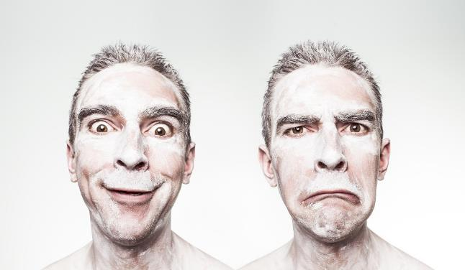
What are Comparative Adjectives?
When we compare two people, actions, or things, we use comparative adjectives.
Look at the picture above. The man on the left is happier than the man on the right.
So, the man on the right is sadder than the man on the left.
Look at the picture above. The man on the left is happier than the man on the right.
So, the man on the right is than the man on the left.
When comparing like this, we use ‘than’ after the comparative adjective.

Slide 7
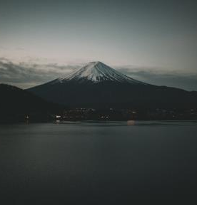
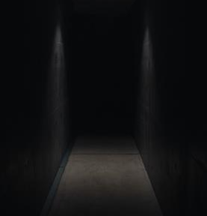
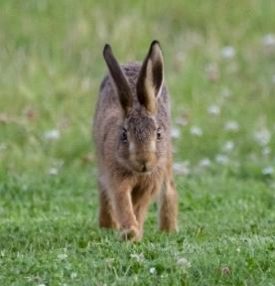
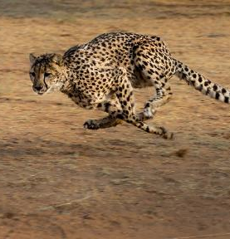
What are Comparative Adjectives?
Usually, we can make a comparative adjective by adding ‘er’ to the adjective, like in these examples:
Dark
Darker
Fast
Faster

Slide 8
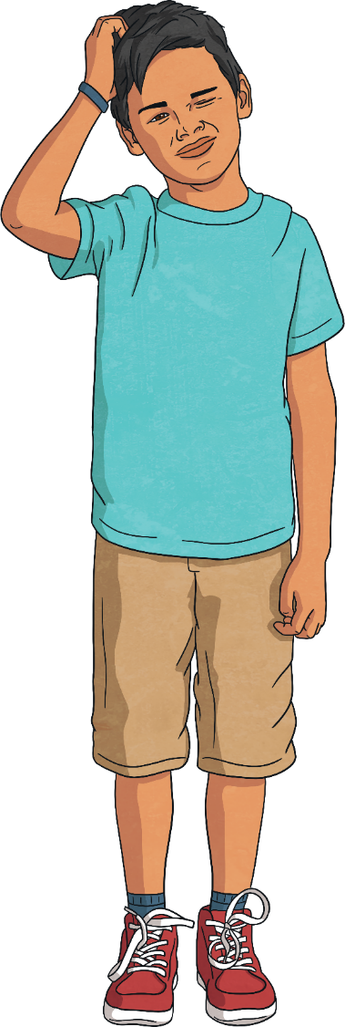
Exceptions
However, there are some important rules when it comes to spelling.
Spelling Exception 1
Two or more syllable words that end in ‘y’
If a word has two or more syllables and ends in ‘y’, we remove the ‘y’ and add ‘ier’ to make a comparative adjective. So…
Happy becomes
Happy becomes happier
Happy
Rainy becomes
Rainy becomes rainier
Rainy
Sunny becomes…
Sunny
Remember: one syllable words that end in ‘y’ add an ‘er’ as normal.
Dry becomes
Dry
Dry becomes dryer
Shy becomes…
Shy

Slide 9
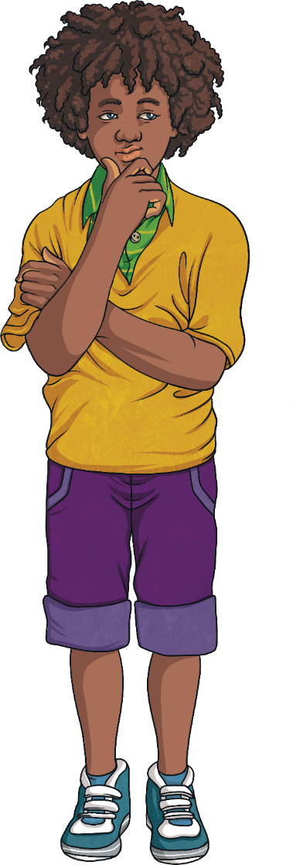
Exceptions
Spelling Exception 2
The word ends in ‘e’
If an adjective ends in ‘e’, you only need to add the ‘r’ to make a comparative adjective.
Large becomes larger
Large becomes
Large
Fake becomes
Fake becomes faker
Fake
Tame becomes…
Tame

Slide 10
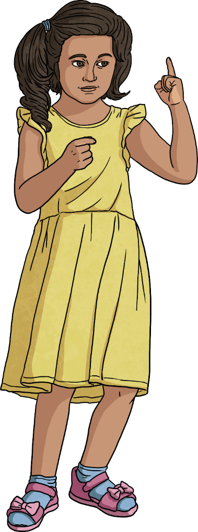
Exceptions
Spelling Exception 3
The word ends in one vowel and one consonant
If an adjective ends in one vowel and one consonant, you add the consonant again before adding ‘er’.
Hot becomes
Hot becomes hotter
Hot
Sad becomes
Sad becomes sadder
Sad
Flat becomes…
Flat

Slide 11
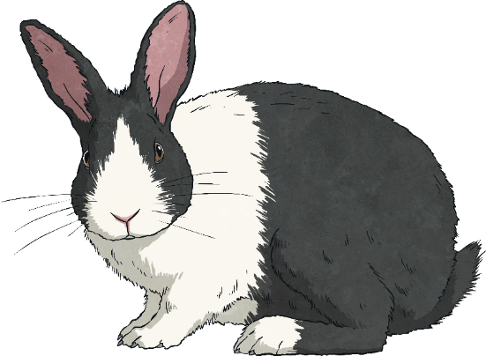
Longer Comparative Adjectives
Most comparative adjectives require an ‘er’ at the end. But longer adjectives do not. Any adjective with three or more syllables, and some with two syllables, becomes a comparative adjective by adding ‘more’ in front.
Interesting becomes
Interesting becomes more interesting
Interesting
Dangerous becomes
Dangerous becomes more dangerous
Dangerous
Terrified becomes…
Terrified
With these comparative adjectives, we can use ‘less’ too, like in this example:
Rabbits are less dangerous than lions.

Slide 12
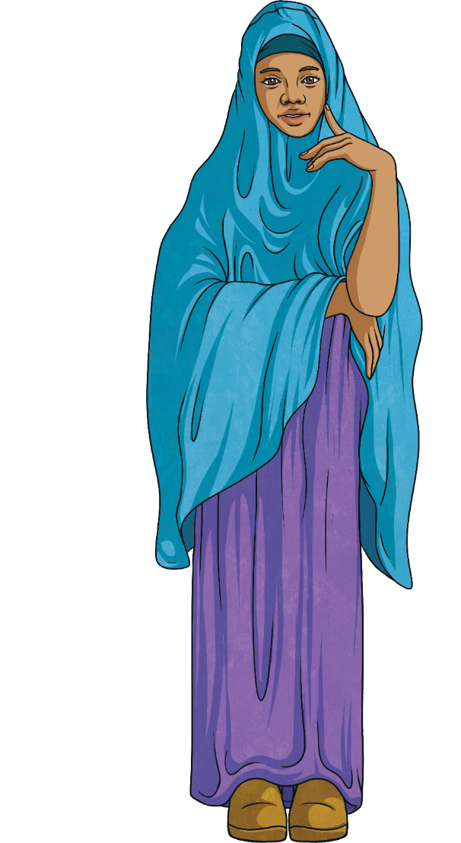
Irregular Comparative Adjectives
English has some irregular adjectives too:
Good
Good becomes
Good becomes better
Bad
Bad becomes
Bad becomes worse

Slide 13
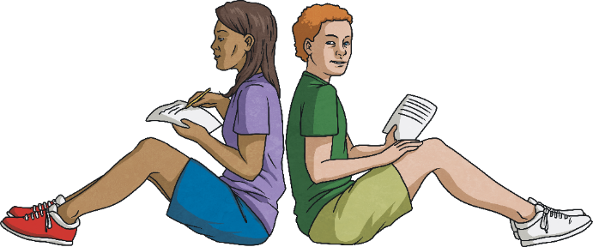
Look at the adjectives below. With a partner or by yourself, see if you can remember how to make them comparative adjectives.
Dry
Click to reveal
Dryer
Happy
Click to reveal
Happier
Large
Click to reveal
Bad
Larger
Click to reveal
Worse
Hot
Click to reveal
Fast
Hotter
Click to reveal
Faster
Sad
Click to reveal
Bright
Sadder
Click to reveal
Brighter
Good
Click to reveal
Better
Tame
Click to reveal
Tamer
Interesting
Click to reveal
More interesting
Dangerous
Click to reveal
More dangerous

Slide 14
Look at the sentences below. Use comparative adjectives to finish them.
Brazil is than Argentina.
Big
Brazil is bigger than Argentina.
New Zealand is than Australia.
Small
New Zealand is smaller than Australia.
Lions are than rabbits.
Dangerous
Lions are more dangerous than rabbits.
Life is now than it was 50 years ago.
Own answer
The countryside is than the city.
Own answer

Slide 15
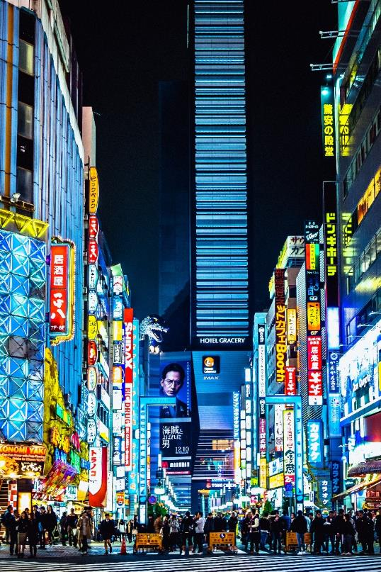
What are Superlative Adjectives?
When we compare more than two people, actions, or things, we use superlative adjectives.
Tokyo is the largest city in the world.
In the sentence above, we are comparing Tokyo with every city in the world.
We use ‘the’ before the superlative, too.

Slide 16
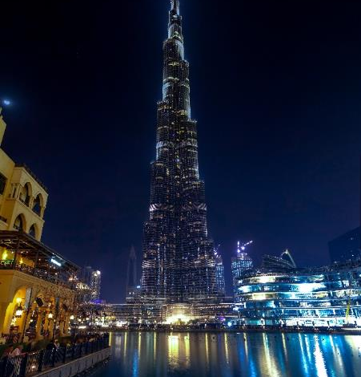
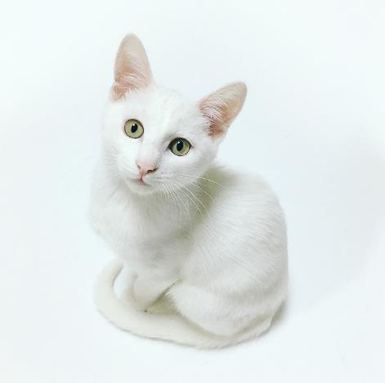
What are Superlative Adjectives?
Usually, we can make superlative adjectives by adding -est to the adjective.
Tallest building
Smallest cat

Slide 17
Exceptions
As with comparatives though, there are some important rules when it comes to spelling. These rules are very similar.
Spelling Exception 1
Two or more syllable words that end in ‘y’
If a word has two or more syllables and ends in ‘y’, we remove the ‘y’ and add ‘iest’ to make a superlative adjective. So…
Happy becomes
Happy becomes happiest
Happy
Rainy becomes
Rainy becomes rainiest
Rainy
Sunny becomes…
Sunny
Remember: one syllable words that end in ‘y’ add an ‘est’ as normal.
Dry becomes
Dry
Dry becomes driest
Shy becomes…
Shy

Slide 18
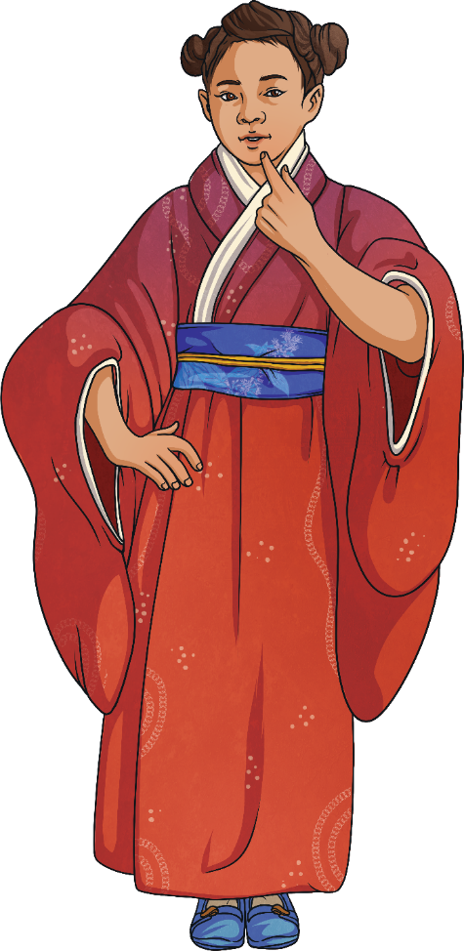
Exceptions
Spelling Exception 2
The word ends in ‘e’
If an adjective ends in ‘e’, you only need to add the ‘st’ to make a comparative adjective.
Large becomes largest
Large becomes
Large
Fake becomes
Fake becomes fakest
Fake
Tame becomes…
Tame

Slide 19
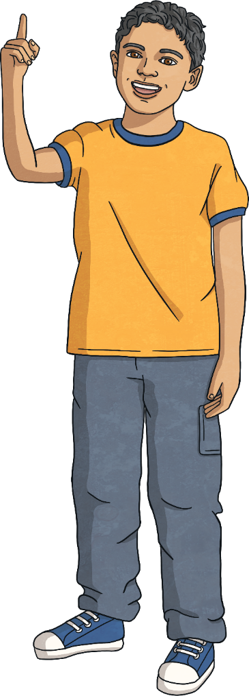
Exceptions
Spelling Exception 3
The word ends in one vowel and one consonant
If an adjective ends in one vowel and one consonant, you add the consonant again before adding ‘est’.
Hot becomes
Hot becomes hottest
Hot
Sad becomes
Sad becomes saddest
Sad
Flat becomes…
Flat

Slide 20
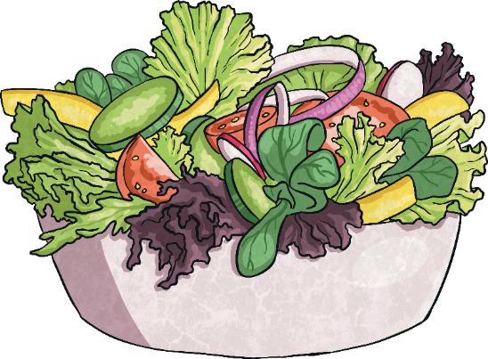
Longer Superlative Adjectives
Most superlative adjectives require an ‘est’ at the end. But longer adjectives do not. Any adjective with three or more syllables, and some with two syllables, becomes a comparative adjective by adding ‘most’ in front.
Interesting becomes the most interesting
Interesting becomes
Interesting
Dangerous becomes
Dangerous becomes the most dangerous
Dangerous
Terrified becomes…
Terrified
With these comparative adjectives, we can use ‘the least’ too, like in this example:
Salad is the least delicious meal.

Slide 21
Look at the adjectives below. With a partner or by yourself, see if you can remember how to make them superlative adjectives.
Dry
Click to reveal
The driest
Happy
Click to reveal
The happiest
Large
Click to reveal
Bad
Click to reveal
The largest
The worst
Hot
Click to reveal
Fast
Click to reveal
The hottest
The fastest
Sad
Click to reveal
Bright
Click to reveal
The saddest
The brightest
Good
Click to reveal
The best
Tame
Click to reveal
The tamest
Interesting
Click to reveal
The most interesting
Dangerous
Click to reveal
The most dangerous

Slide 22
Look at the sentences below. Use comparative adjectives to finish them.
New York is city in the USA.
Big
NewYork is the biggest city in the USA.
Books are art form.
Interesting
Books are the most interesting art form.
The sun is place in the solar system.
Hot
The sun is the hottest place in the solar system.
Lions are animal.
Own answer
I am .
Own answer

Slide 23
Advert Writing
Adverts often use comparative and superlative adjectives.
They help to show someone why they should buy a product.
It’s the cheapest soap around!
Dogs think our dog food is the tastiest.
Our new burger is tastier than the others!
This X13 TV is two times bigger than the X12 TV!
With a partner or on your own, create a poster or radio advert for a product. Don’t forget to use plenty of comparatives and adjectives.

Slide 24
Final Activity
Look at the sentences below. Can you spot the mistakes?
The weather is more hot here.
The weather is hotter here.
That book is interestingest.
That book is the most interesting.
He is gooder at sports.
He is better at sports.
She is the shiest in class.
She is the shyest in class.
That cake is largeer.
That cake is larger.

