Slide 1
Educate to Elevate
Igniting the Flame of Learning
Active and passive voice

Slide 2
Objectives
Explore how using the passive or active voice affects communication.
To be able to identify subject, verb, object.
To be able to recognise active and passive voice.
To be able to explain how active and passive sentences affects communication.

Slide 3
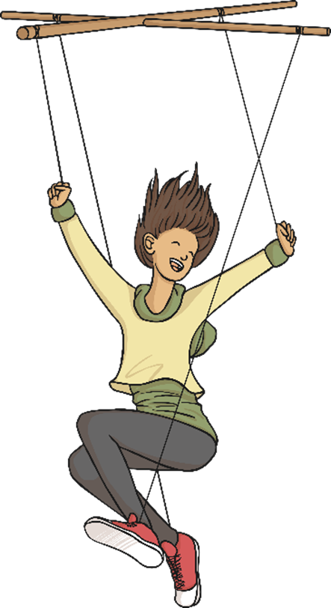
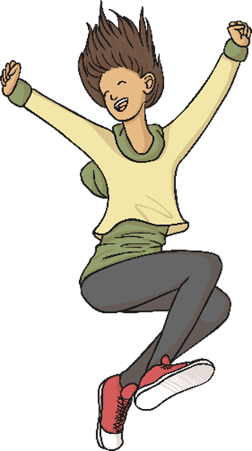
Passive and Active

Slide 4
Subject, Verb, Object
Subject: Who we are talking about in the sentence. For example, Milo is who we are talking about.
Verb: The ‘doing word’ of the sentence, which tells you what the subject is up to. For example ‘grabbed’.
Object: This is the thing the verb is working on. In this case, the postman’s leg.

Slide 5
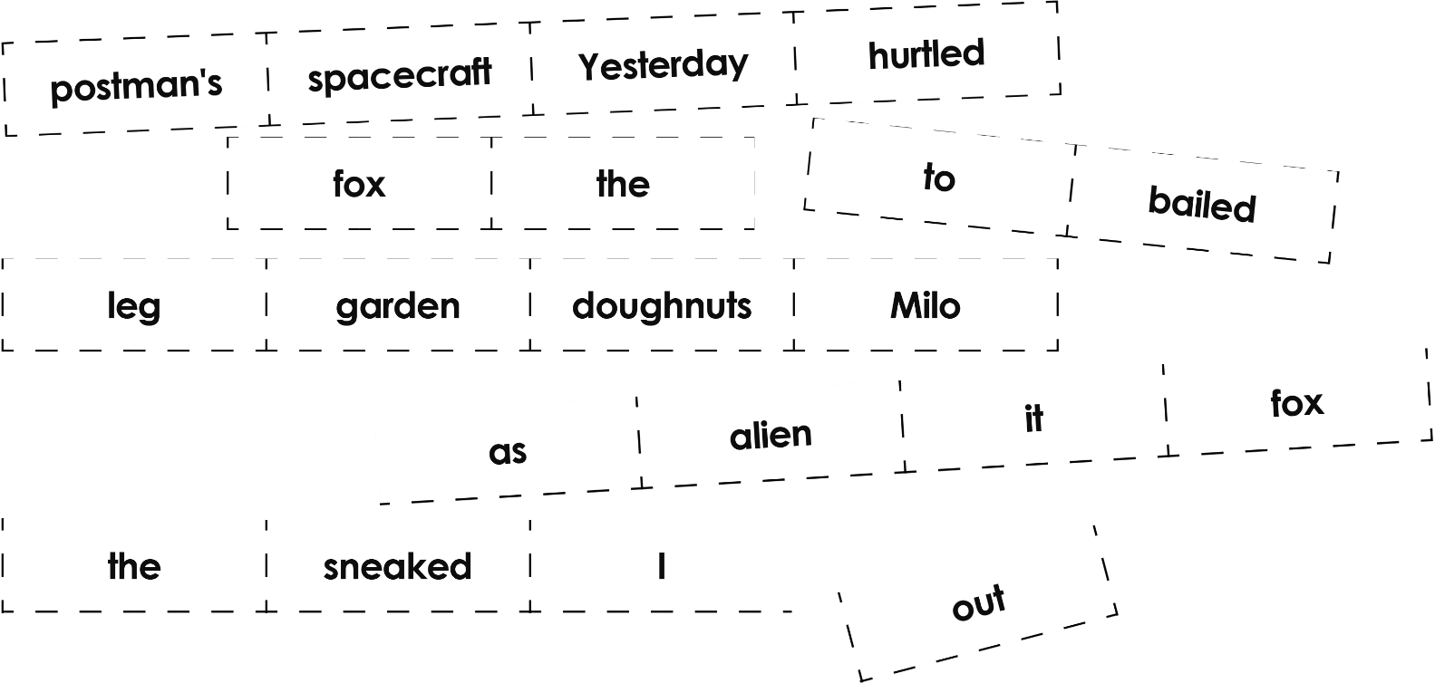
Do now:
5min
Sort the sentence builders on your desk into four different sentences. Don’t forget the punctuation!

Slide 6
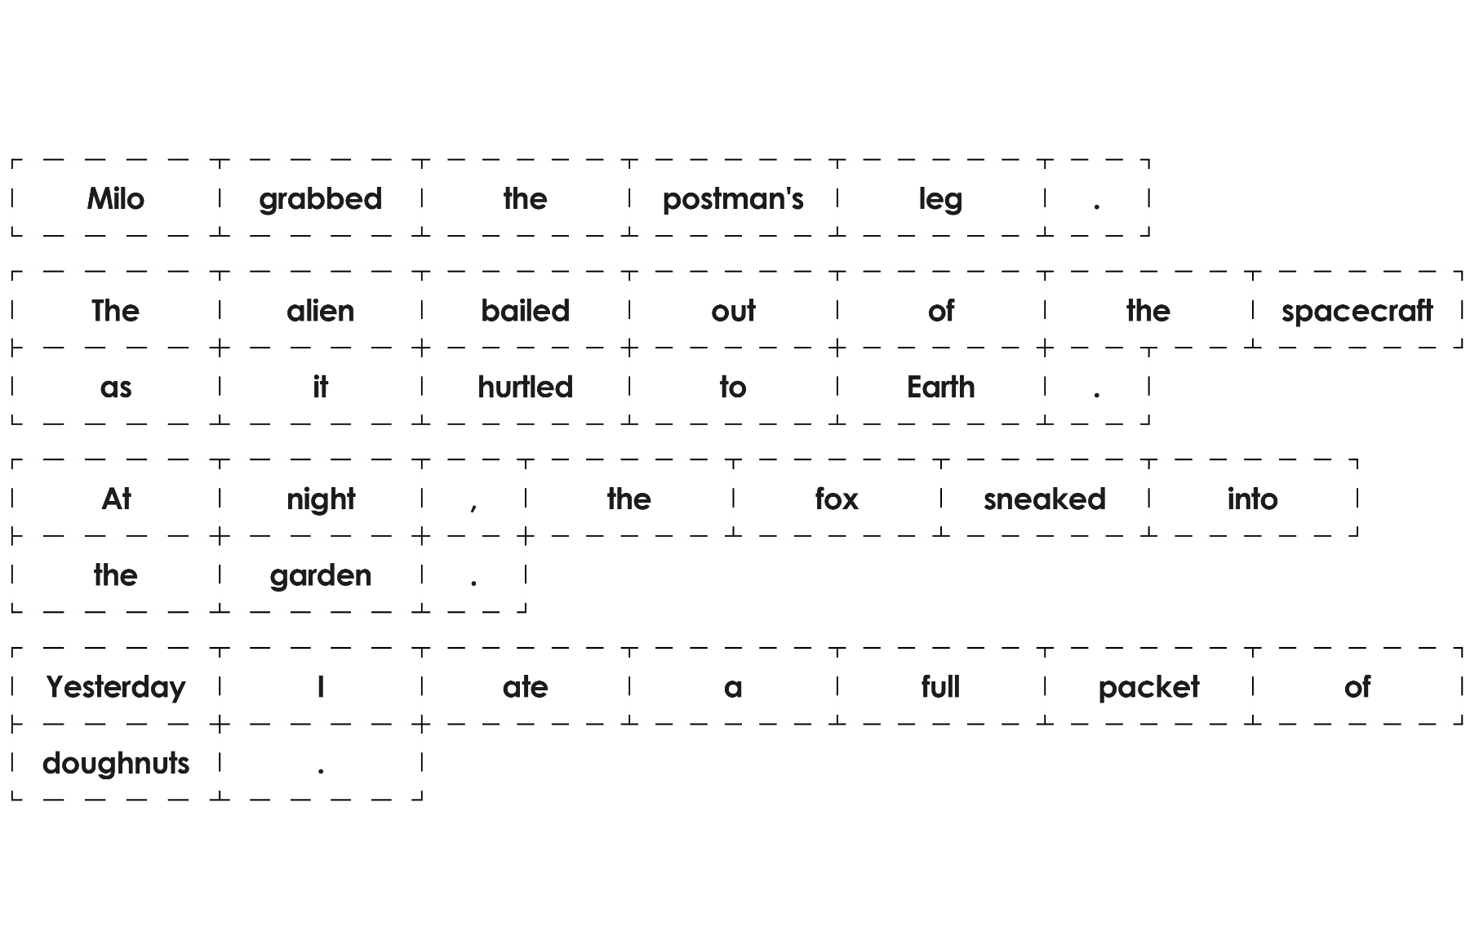
Mark the subject, verb and object for each sentence you've created

Slide 7
Rally Robin!
(15m.)
Study the following sentences and discuss with your partner
Who was performing the action?
Think of formation changes
What is the significance of this change?
What is the main difference between the two sentence?

Slide 8
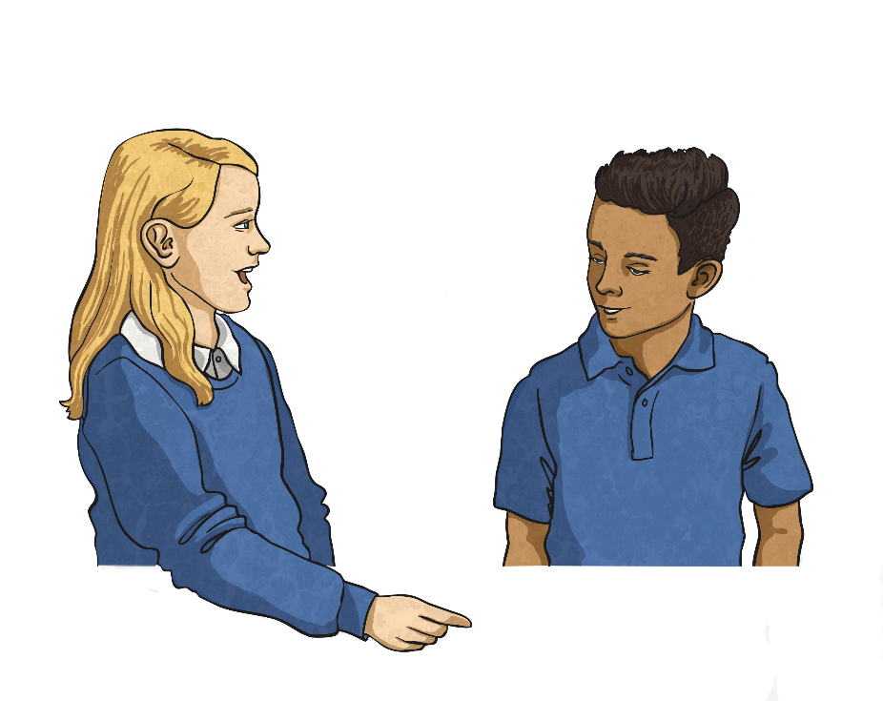
(5m.)
Can you write definitions for ‘active’ and ‘passive’ voice?
Active Voice
In an active sentence, the subject performs the action (the verb) to the object.
Passive Voice
In a passive sentence, the thing that would normally be the object gets turned into the subject through the use of the passive form of the verb. They often include a prepositional phrase starting with ‘by’.

Slide 9
Identifying Parts of the Sentence
(15m.)
To be able to recognise and use active and passive voice, you must be able to identify the parts of the sentence. In the following sentences, identify the subject, action (the verb) and object:
The plane is boarded by the family.
The plane is boarded by the family
The damage was caused by the storm.
The damage was caused by the storm.
Issac threw a ball at the window.
Issac threw a ball at the window.
The magician pulled a rabbit from the hat.
The magician pulled a rabbit from the hat.
The flowers were grown by my nan.
The flowers were grown by my nan.
Did you notice the preposition ‘by’ in some of these sentences?

Slide 10
Active or Passive Voice?
Now, sort these sentences into the correct places in the table below:
The plane is boarded by the family.
The magician pulled a rabbit from the hat.
Issac threw a ball at the window.
Helen practised her recorder every day.
The flowers were grown by my nan.
The damage was caused by the storm.
Active
Passive
The magician pulled a rabbit from the hat.
Issac threw a ball at the window.
Helen practised her recorder every day.
The plane is boarded by the family.
The damage was caused by the storm.
The flowers were grown by my nan.

Slide 11
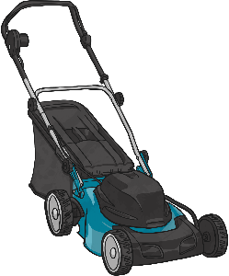
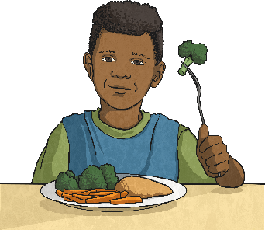
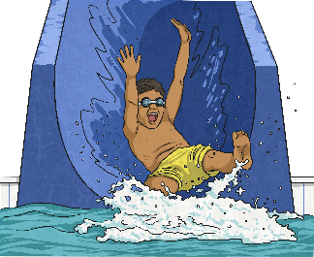
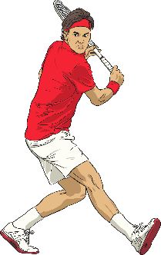
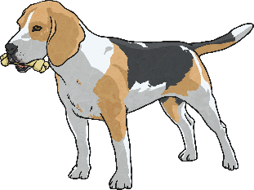
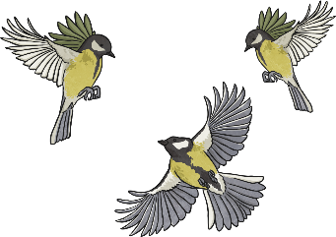
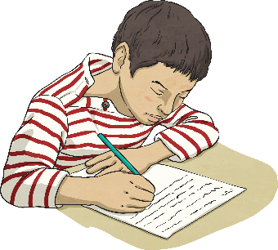
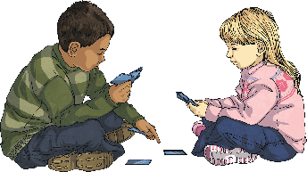
Your Turn – Active Sentences
(15m.)
Choose a square to reveal a picture. Write an active sentence about the picture:
?
?
?
?
?
?
?
?
?
?

Slide 12
Changing Sentences
(5m.)
It is possible to change a sentence from active to passive voice, or from passive to active voice. It is important that you do not change the tense of the sentence. Have a go at altering these sentences:
On the plain, an antelope was chased by the lioness.
On the plain, the lioness chased an antelope.
Sandwiches were eaten by Harry for lunch.
Harry ate sandwiches for lunch.
The carrots are always eaten by my brother.
My brother always eats the carrots.
Are your new sentences active or passive?

Slide 13
Tricky Passive Sentences
(5m.)
Read these passive sentences. What do you notice about them?
The jewellery was stolen.
The jewellery was stolen.
The bicycle was ridden.
The bicycle was ridden.
The present was opened.
The present was opened.
They all have an action and a subject but none of them have a object. Sometimes the prepositional (by…) phrase can be removed and the sentence will still make sense – you just won’t know who/what performed the verb.

Slide 14
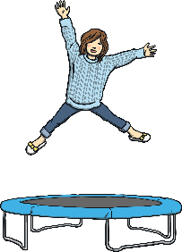
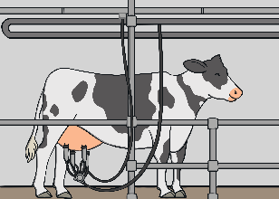
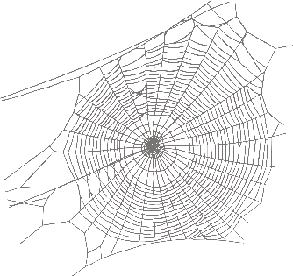
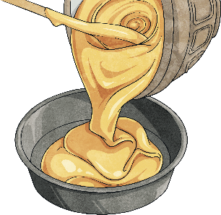
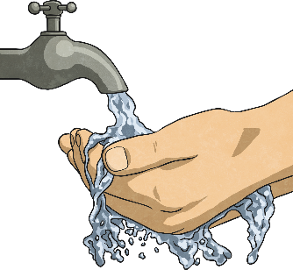
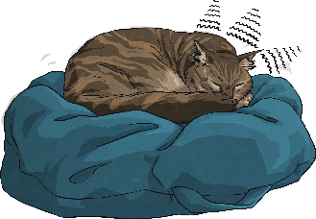
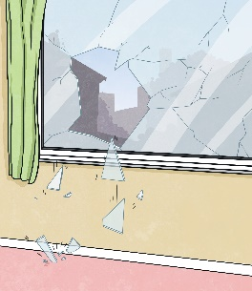
Your Turn – Passive Sentences
Choose a square to reveal a picture. Write a passive sentence about the picture:
?
?
?
?
?
?
?
?
?
?

Slide 15
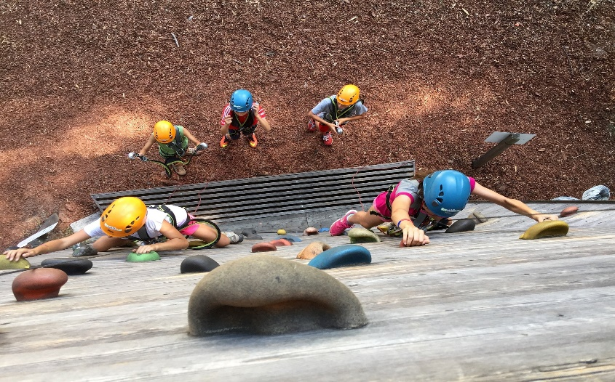
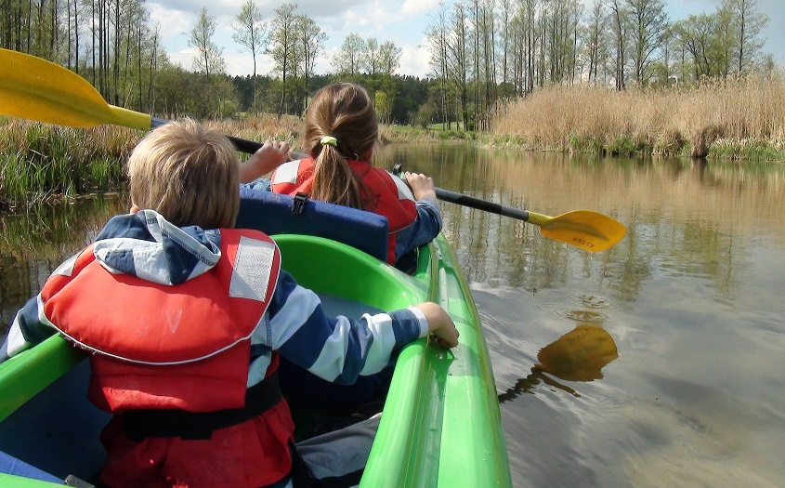
Amazing Active Voice
(10m.)
Can you write descriptions of these photos in the active voice?
The children enjoyed climbing during their school camp.
They spent the day kayaking down the river.

Slide 16
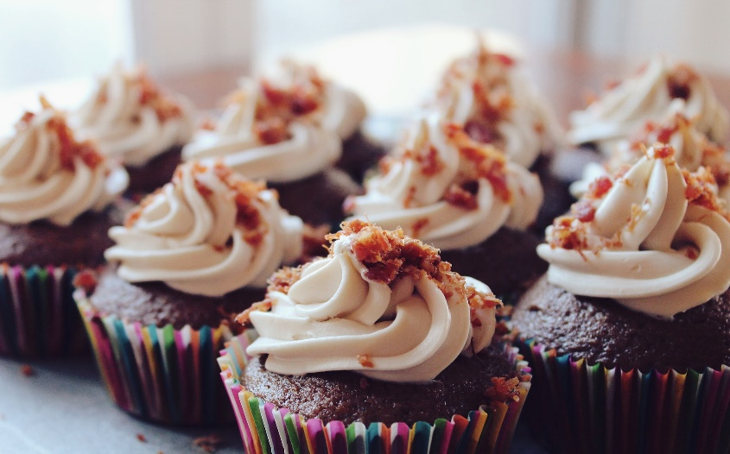
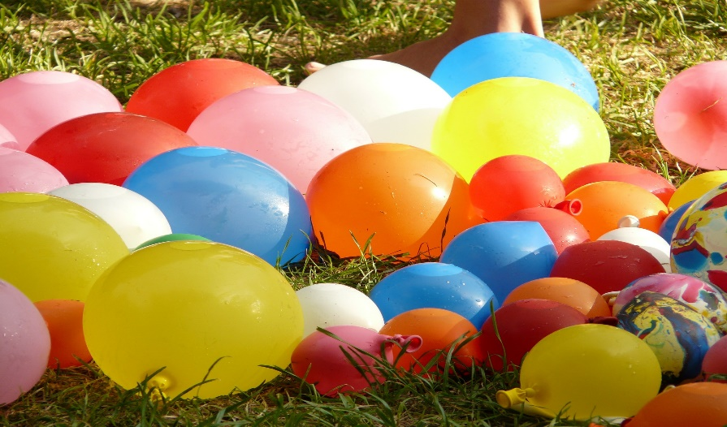
Perfect Passive Voice
(10m.)
Can you write descriptions of these photos in the passive voice?
(1m.)
Tasty cupcakes were baked by my aunt for my birthday party.
The water balloons were blown up by my brother for the water fight.

