Slide 1
Y2 Science T3 W5

Slide 2
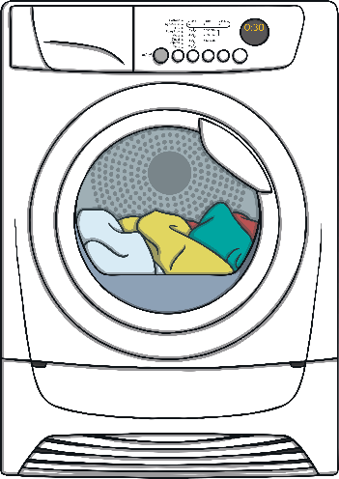
Energy
Energy gives
animals
and appliances
people
the power to work everyday

Slide 3
Solar Energy
The sun is the biggest source of energy we have.
Plants use the energy from the sun to grow.

Slide 4
Food Energy
Humans and animals get most of their energy from eating food.

Slide 5
Electricity
Electricity is a source of energy.

Slide 6
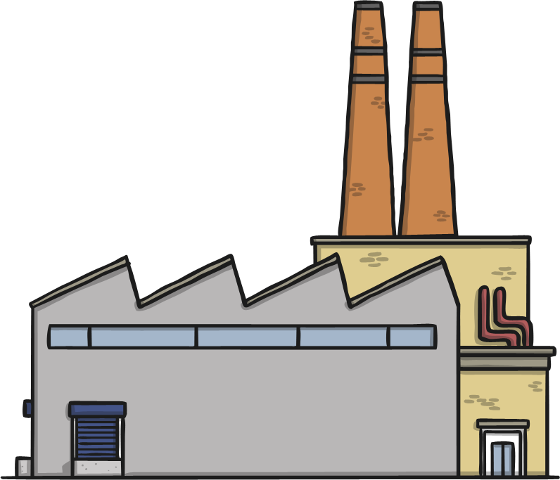
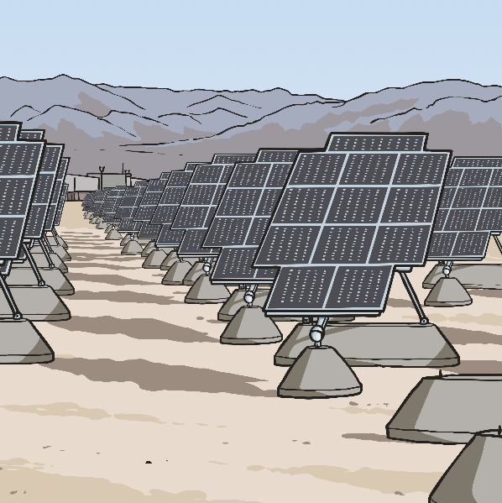
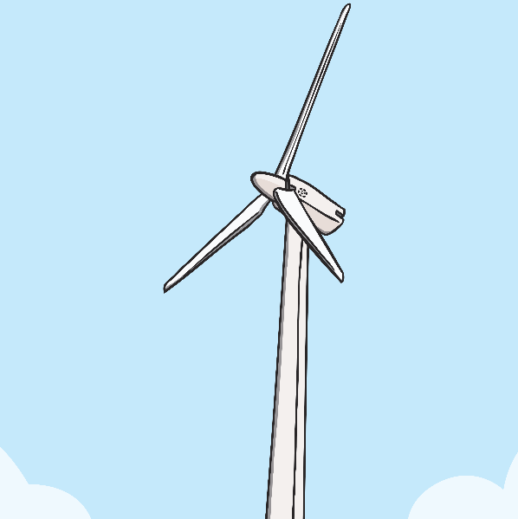
Electrical Energy
Electricity is made
in big power stations,
by collecting the sun's energy into solar panels,
and by converting wind energy with the use of wind turbines.

Slide 7
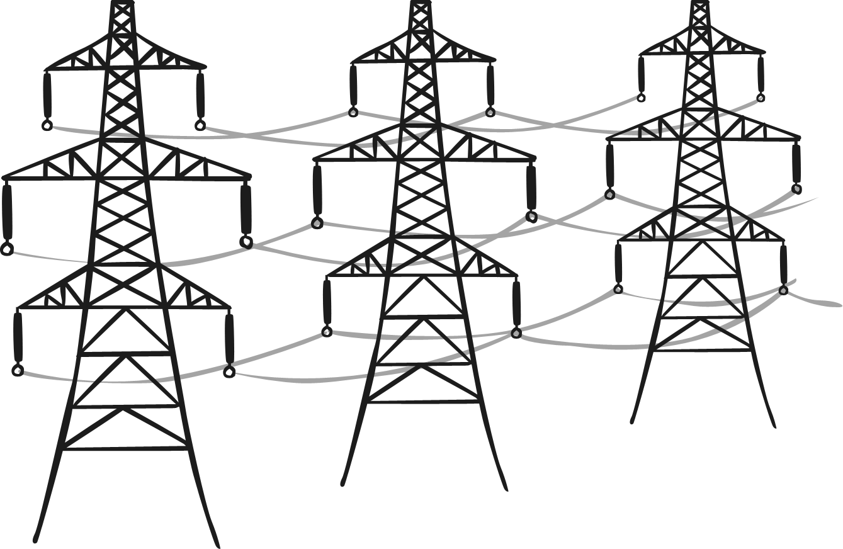
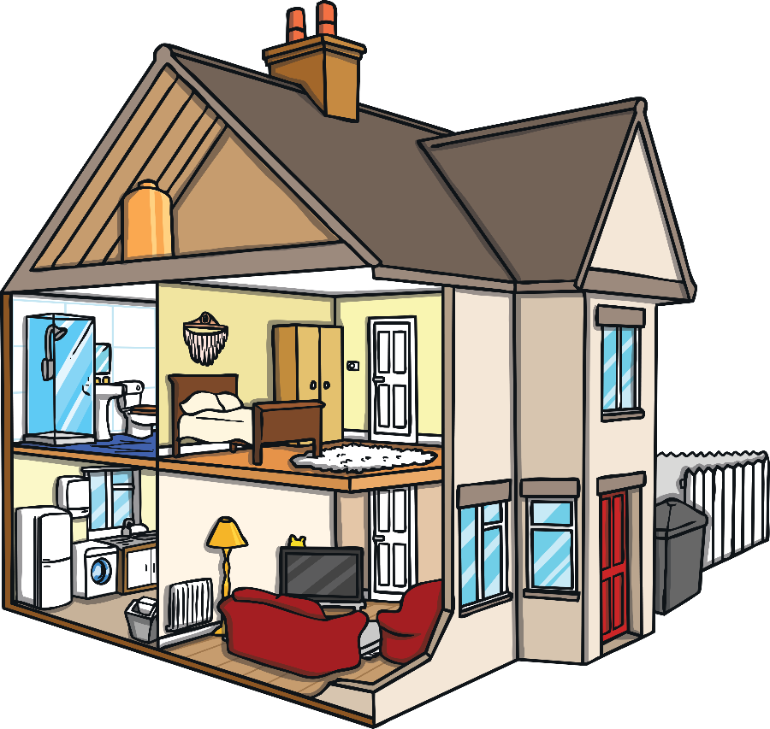
Electrical Energy
This electricity then travels along wires into our homes.

Slide 8
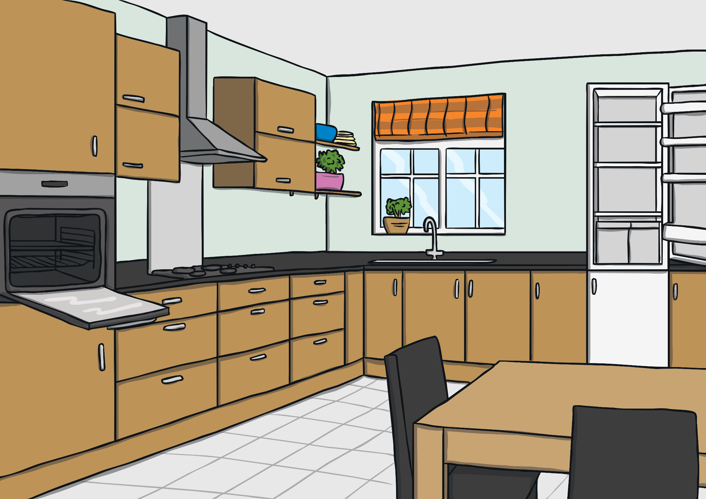
Appliances
Most appliances use electricity as a source of energy.

Slide 9
We use many different appliances in our homes.
Can you think of any?

Slide 10
We use many different appliances in our school.
Can you think of any?

