Slide 2
I can smell…
next

Slide 3
I can smell a rose.
back

Slide 4
I can smell freshly baked bread.
back

Slide 5
I can smell stinky socks!
back

Slide 6
What can you smell?

Slide 7
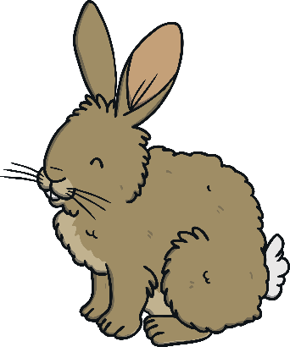
I can see…
next

Slide 8
I can see the moon shining in the night sky.
back

Slide 9
I can see a rabbit hopping around the fields.
back

Slide 10
I can see a boat floating on the water.
back

Slide 11
What can you see?

Slide 12
I can hear…
next

Slide 13
I can hear a bell ringing.
back

Slide 14
I can hear music playing loudly.
back

Slide 15
I can hear fireworks crashing and banging in the sky.
back

Slide 16
What can you hear?

Slide 17
I can touch…
next

Slide 18
I can touch a fluffy, soft cat.
back

Slide 19
I can touch crunchy, cold snow.
back

Slide 20
I can touch crumbling, brown soil.
back

Slide 21
What can you touch?

Slide 22
I can taste…
next

Slide 23
I can taste a delicious ice cream.
back

Slide 24
I can taste a sweet strawberry.
back

Slide 25
I can taste a sour lemon.
back

Slide 26
What can you taste?

Slide 27
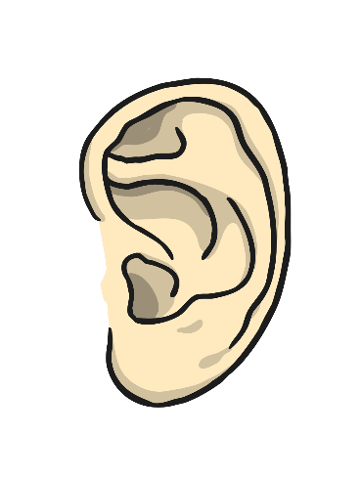
sight
taste
smell
hearing
touch

